Slide 1
Socio-economic Baseline Assessment using Ecosystem Goods and Services (EGS)
2nd RSTC Consultation, Nadi
February 15 – 17 2021

Slide 2
Content
Introduction
Incorporation of EGS into current projects
Moving forward with EGS
Recommendations

Slide 3
Introduction - Decisions on EGS
Recommendation 5 of the mid-term review (MTR) that “the project should adopt goods and services framework as the foundation of its scientific and technical approach by:
  Integrating ecosystem goods and services;
  Integrating an EGS approach/context as the basis for all relevant project activities including for R2R planning, mainstreaming and policy;
  Testing an EGS and valuation approach as the entry point in a limited number of appropriate demonstration projects that have yet to commence or have recently commenced (subject to country needs and buy-in);
  Commencing basic training on ecosystem goods and services (including valuation) for national capacity building, including considering a dedicated module on this topic as part of the ongoing post-graduate training delivered through an appropriate institution (subject to resource availability).

Slide 4
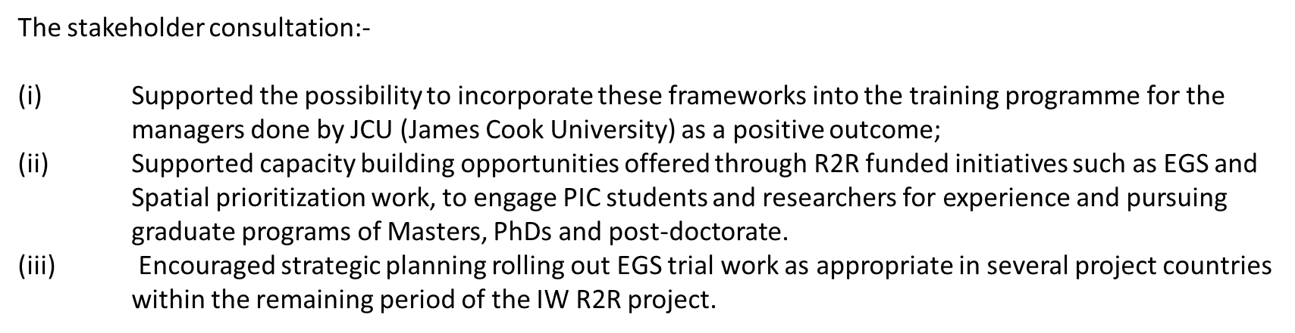
1. Introduction cont.
1st RSTC Consultation:

Slide 5
2. Incorporating EGS framework
Challenges
  Many of the projects in-country were already underway
  Data collection limitation – limited resources (time, money)
  Limited capacity
  Covid-19

Slide 6

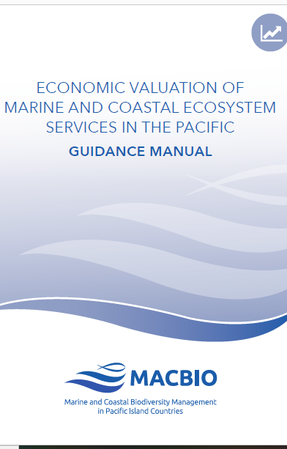
3. Moving forward with EGS
Project duration – 6 months left
Available tools

Slide 7

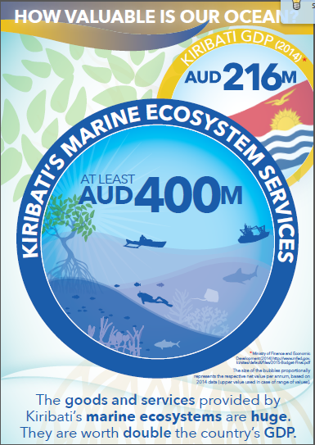

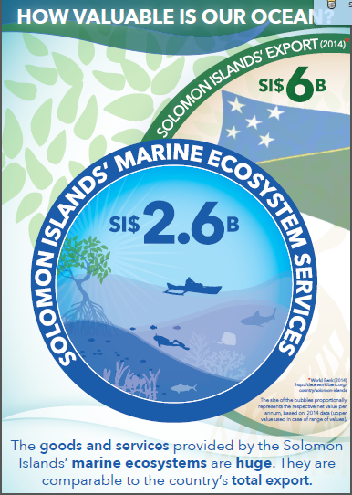
EGS valuation in Pacific

Slide 8
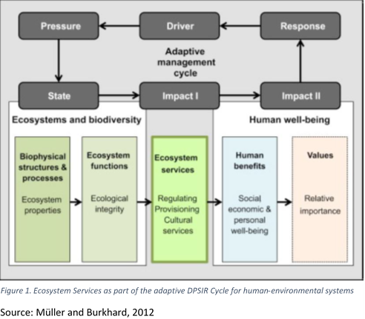
EGS framework vs. DPSIR
Notes:
The DPSIR framework and the EGS approach can be coupled as shown in Figure 1. This is in line
with the decision by the RSTC to support the implementation of a hybrid approach where it will strengthen
the scientific approach while avoiding any duplication of effort.

Slide 9
The TEEB Approach
The TEEB approach comprises six steps: -
Specify and agree on key policy issues with stakeholders
Identify the most relevant ecosystem services
Define information needs and select appropriate methods
Assess and value ecosystem
Identify and outline the pros
Review, refine and report.

Slide 10
4. Recommendation
The R2R Technical Consultation is invited to:
Discuss current delays and difficulties progressing EGS valuation works or trials as recommended by the RSTC and MTR; and
Evaluate and provide clear advice on the suggested options and information provided for consideration in the remaining of current projects, or upscaling or replicating future R2R projects.

Slide 11
Key questions for discussion
Identify means for linking with existing databases, the R2R baseline assessments (environment, governance, socio-economic, cultural) using EGS and DPSIR approaches in future R2R investments?
Identify and prepare concepts to advance work from current data systems to commercial projects as part of or in isolation of future R2R investments?
Reflect on implementation and challenges for the R2R PMIS and recommend appropriate measures to enhance achievement of project outcomes?

