Slide 1
Pacific Islands Ridge to Reef National Priorities – Integrated water, land, forest and coastal management to preserve biodiversity, ecosystem services, store carbon, improve climate resilience and sustain livelihoods
Facilitators Notes
Sam
Nadi, Fiji

Slide 2
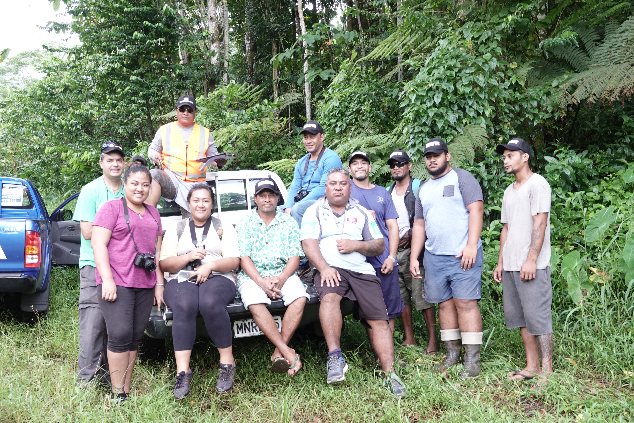
Purpose
Consistent with the RSTC ToR, this is an opportunity to re-engage members and observers in scientific and technical discussions
Approach - encourage broad inclusive participation, frank and informal discussion relevant to deliver on project outcomes
active and action-oriented efforts, and
clear advice on what needs to be done & not bogged down in the process.
Notes:
Issue – RSTC sidelined, not active,

Slide 3
Participants will use the opportunity at the 2.5 days of the workshop to
review the R2R workplan considering new timelines, and
engage further in technical discussion on range of topics relevant to deliver on the project outcomes.

Slide 4
Expected outcomes
Improved awareness and understanding
Suggested approach supporting active and action-oriented efforts of the RSTC
Clear advice to RSTC, RSC on what needs to be done
Partners, researchers, and students

Slide 5
Revised science-policy workplan that can be considered in the broader preparation of the regional project MYCWP.
Training plan for R2R funded workshops – e.g., GIS/Data Officials on the application of R2R coast spatial systems
Draft plan for EGS trials for national demonstrations
Revised drafts of lessons learned as contributions to the R2R framework document
Peer-reviewed research findings, draft manuscripts and related work from consultants and researchers who are undertaking funded project activities.
Draft ToR of WG responsible to progress work on the next phase or project of R2R
Indicative list of knowledge products from RSTC members and observers

Slide 6
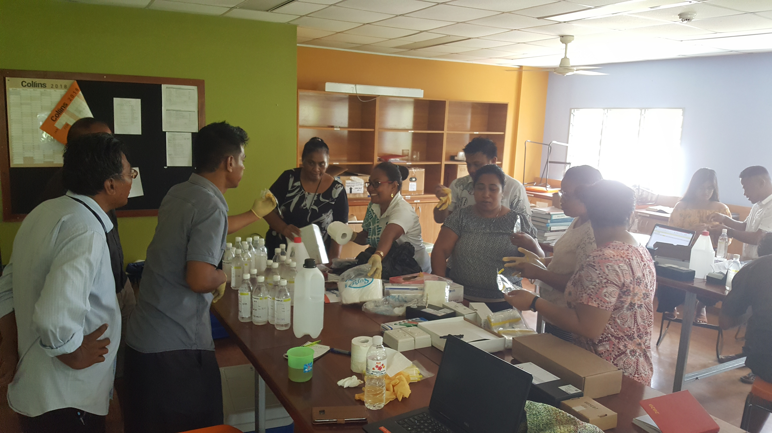
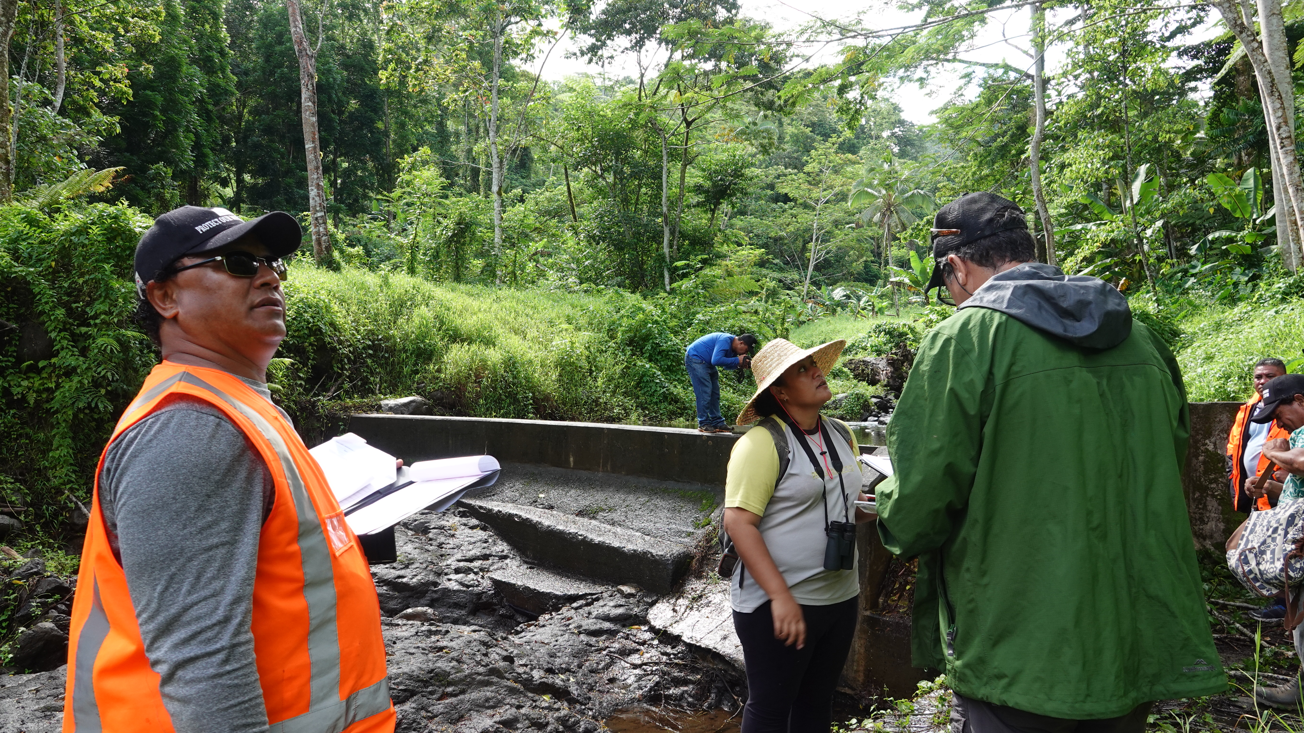
Making Progress?
Acknowledge we all are responsible for where we are now?
Most importantly, deciding where we want to be in the future?
as GEF Pacific R2R Programme (or 15 child projects)
Then, determine what we need to do in the short, medium and long-term?

Slide 7
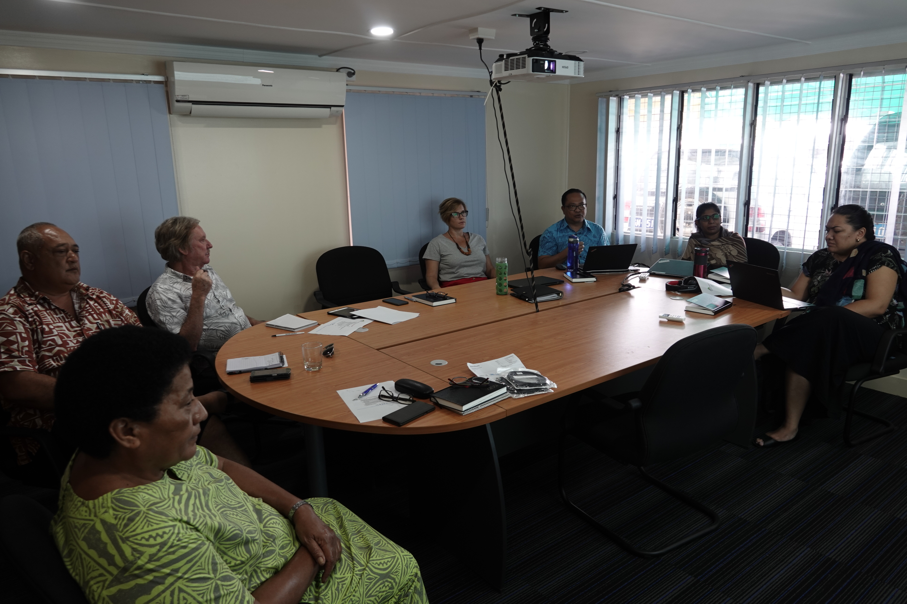
Where we are now?
Where exactly we are in the R2R program?
• Communication of lessons learned
• National R2R demonstrations and achieving stress reduction targets
• Science-policy strategic policy framework
• Mainstreaming R2R
Notes:
which is intrinsically linked to and measured by how far we have progressed achieving its primary goal and objective
- and in turn, linked to the following key areas and the updates briefly provided in the paper

Slide 8
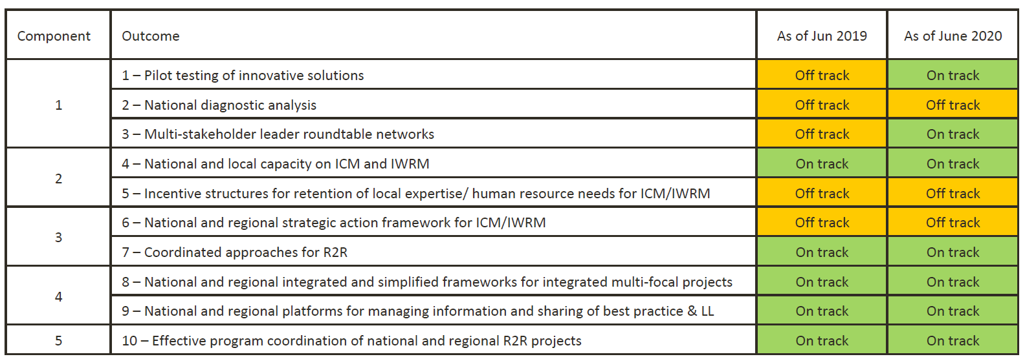

Slide 9
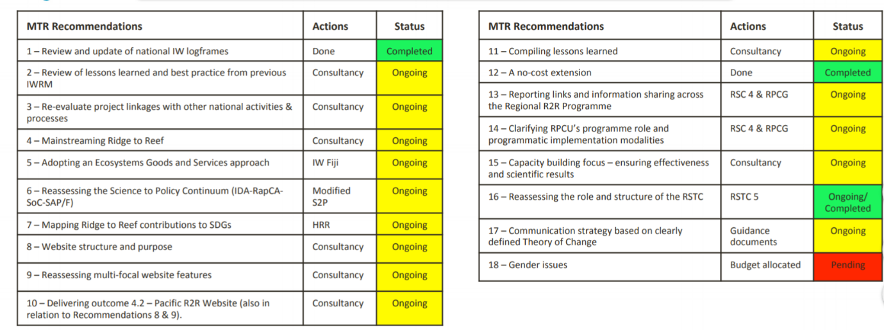
MTR Recommendations

Slide 10
Further Updates
SPC-RPCU
R2R Implementing Agencies
Role of RSTC and its TOR
RSC-5 approved workplan & budget
Improved communication of lessons learned within the Pacific R2R network
National R2R demonstrations
Science-policy strategic policy framework
COVID Strategy - Future Opportunities & Directions

Slide 11
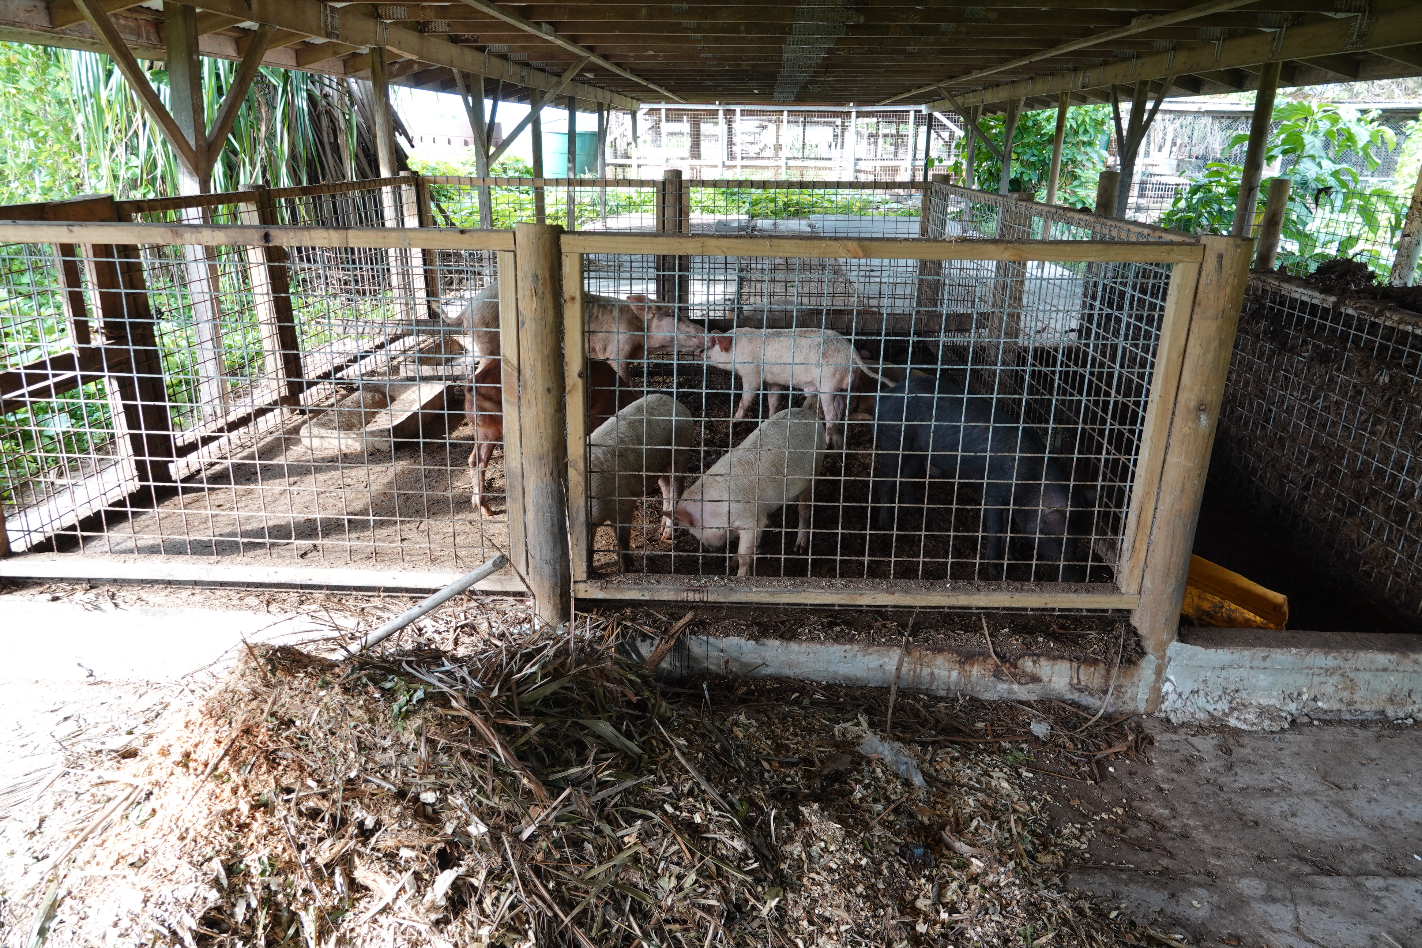
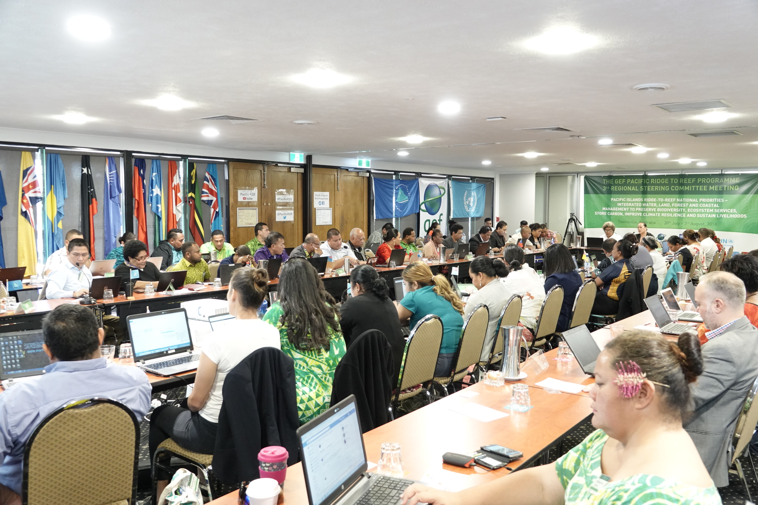
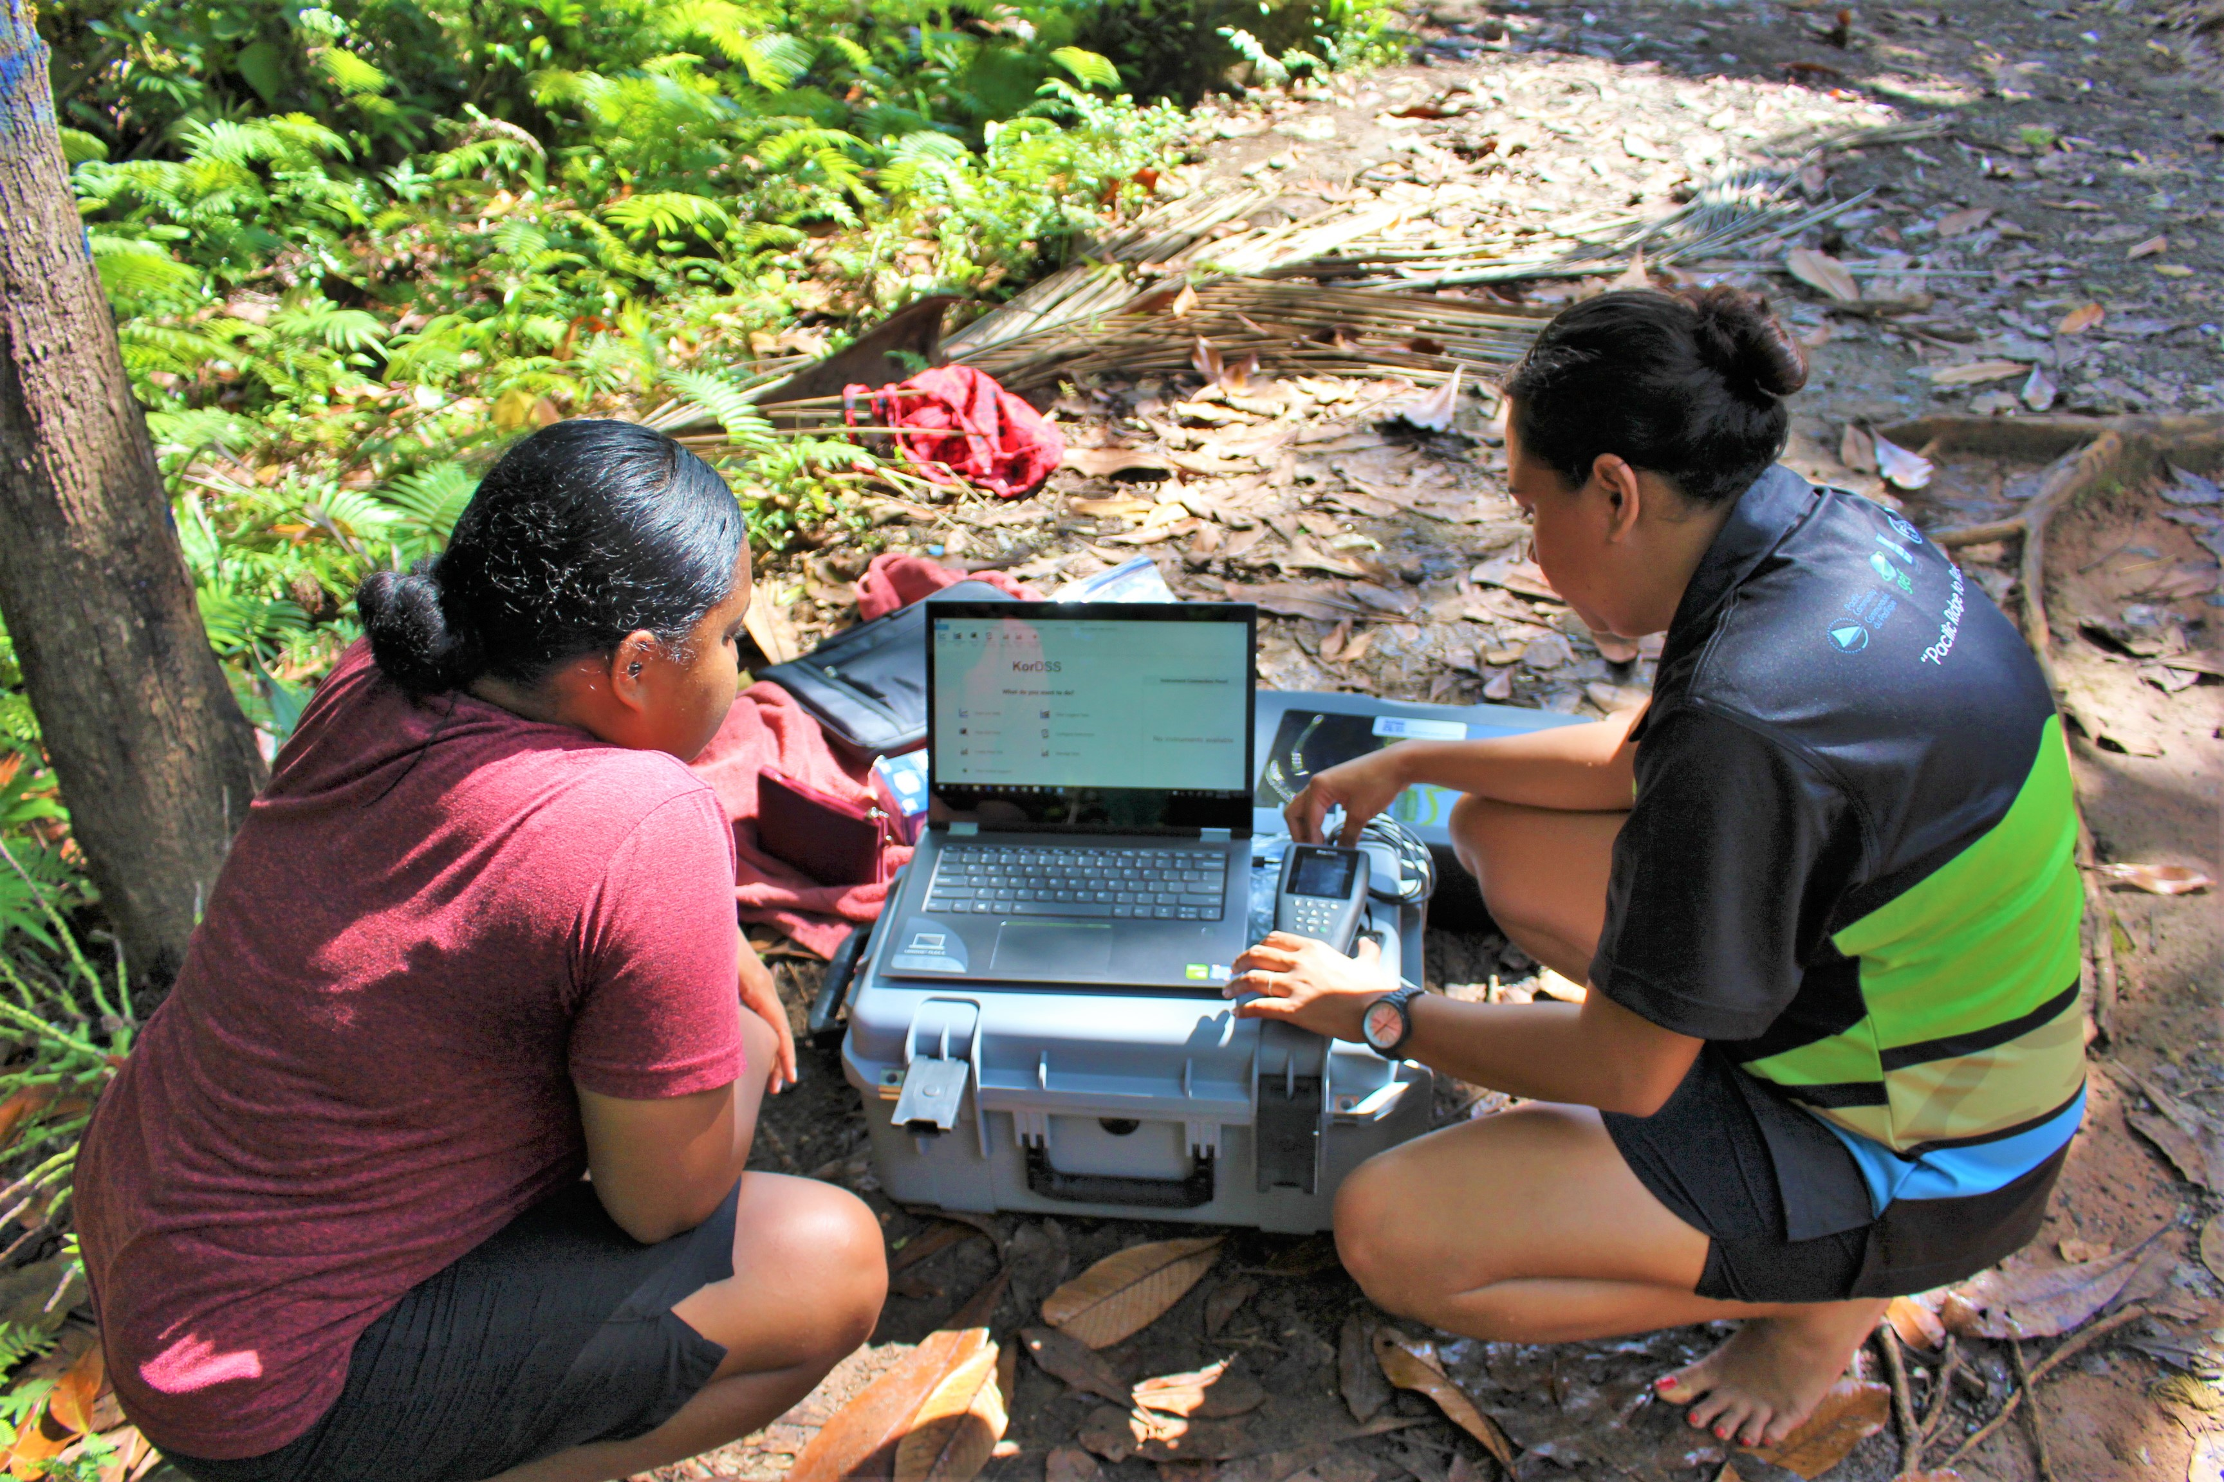
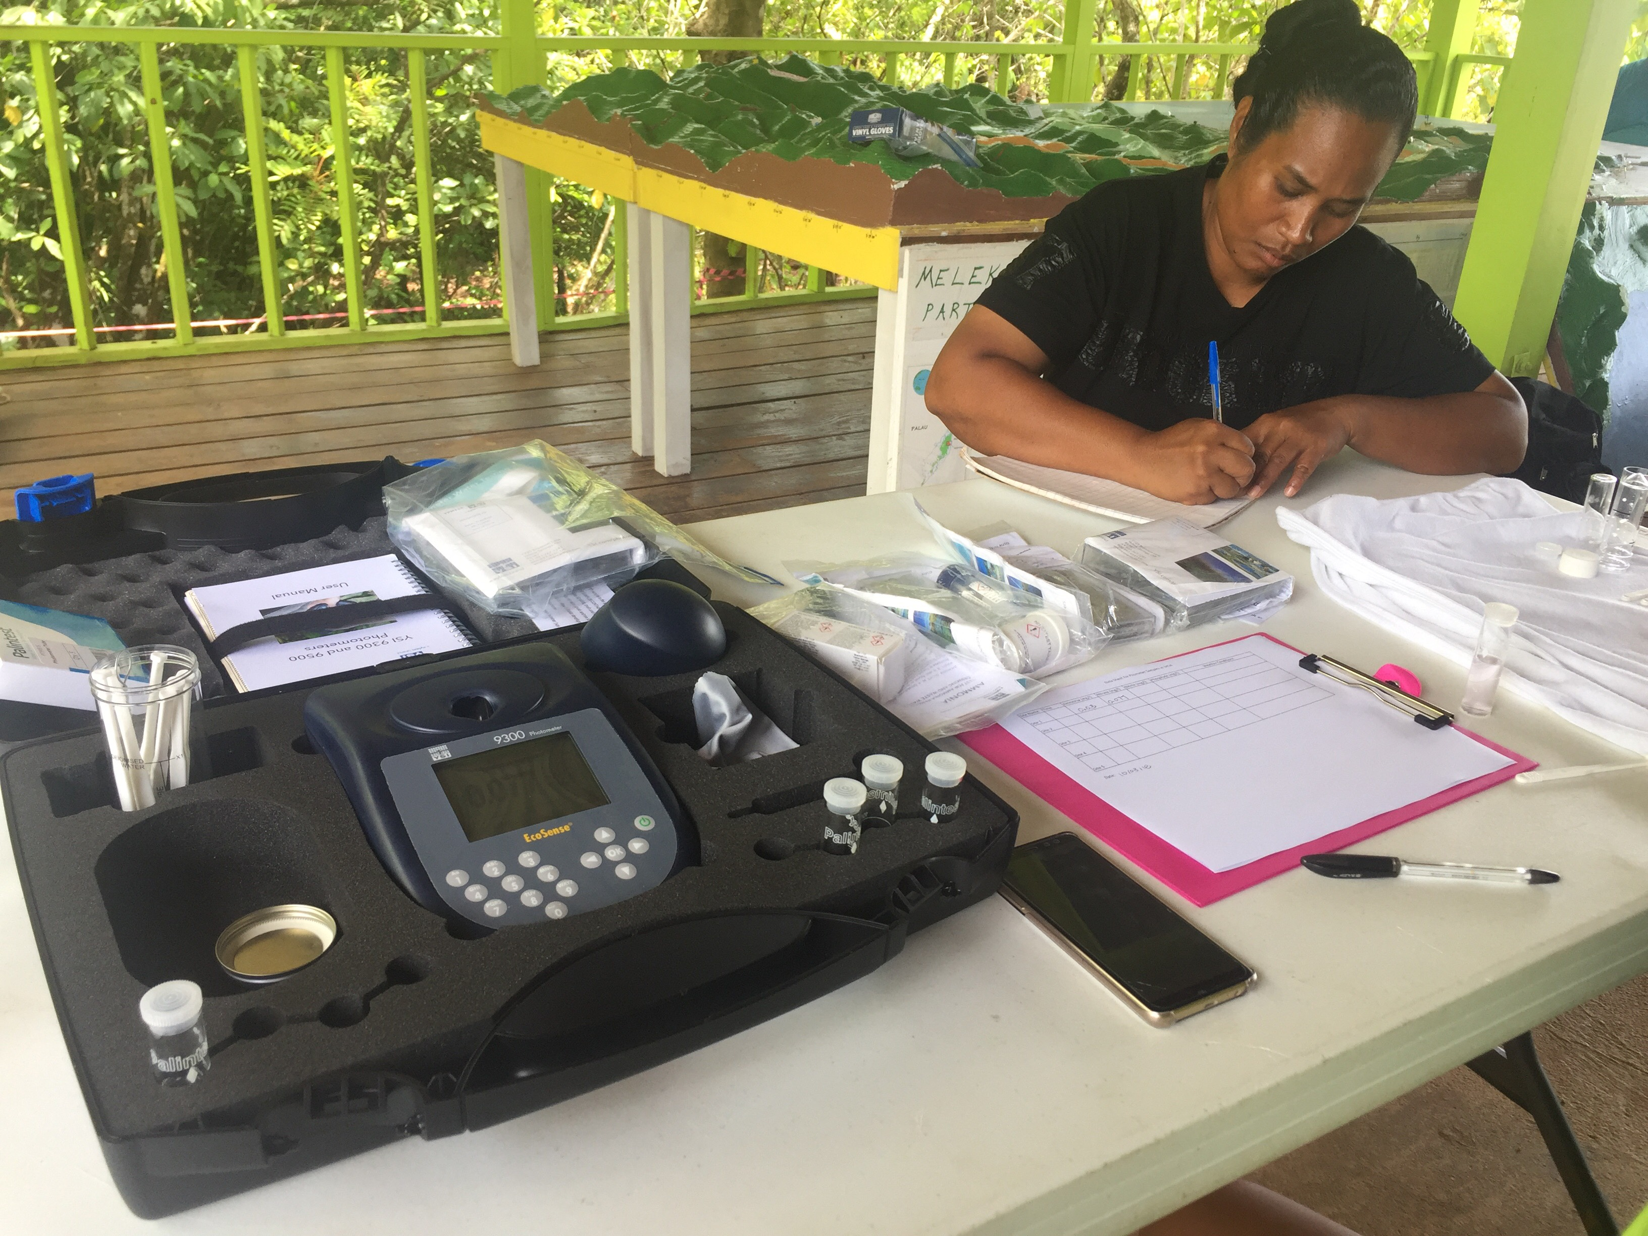
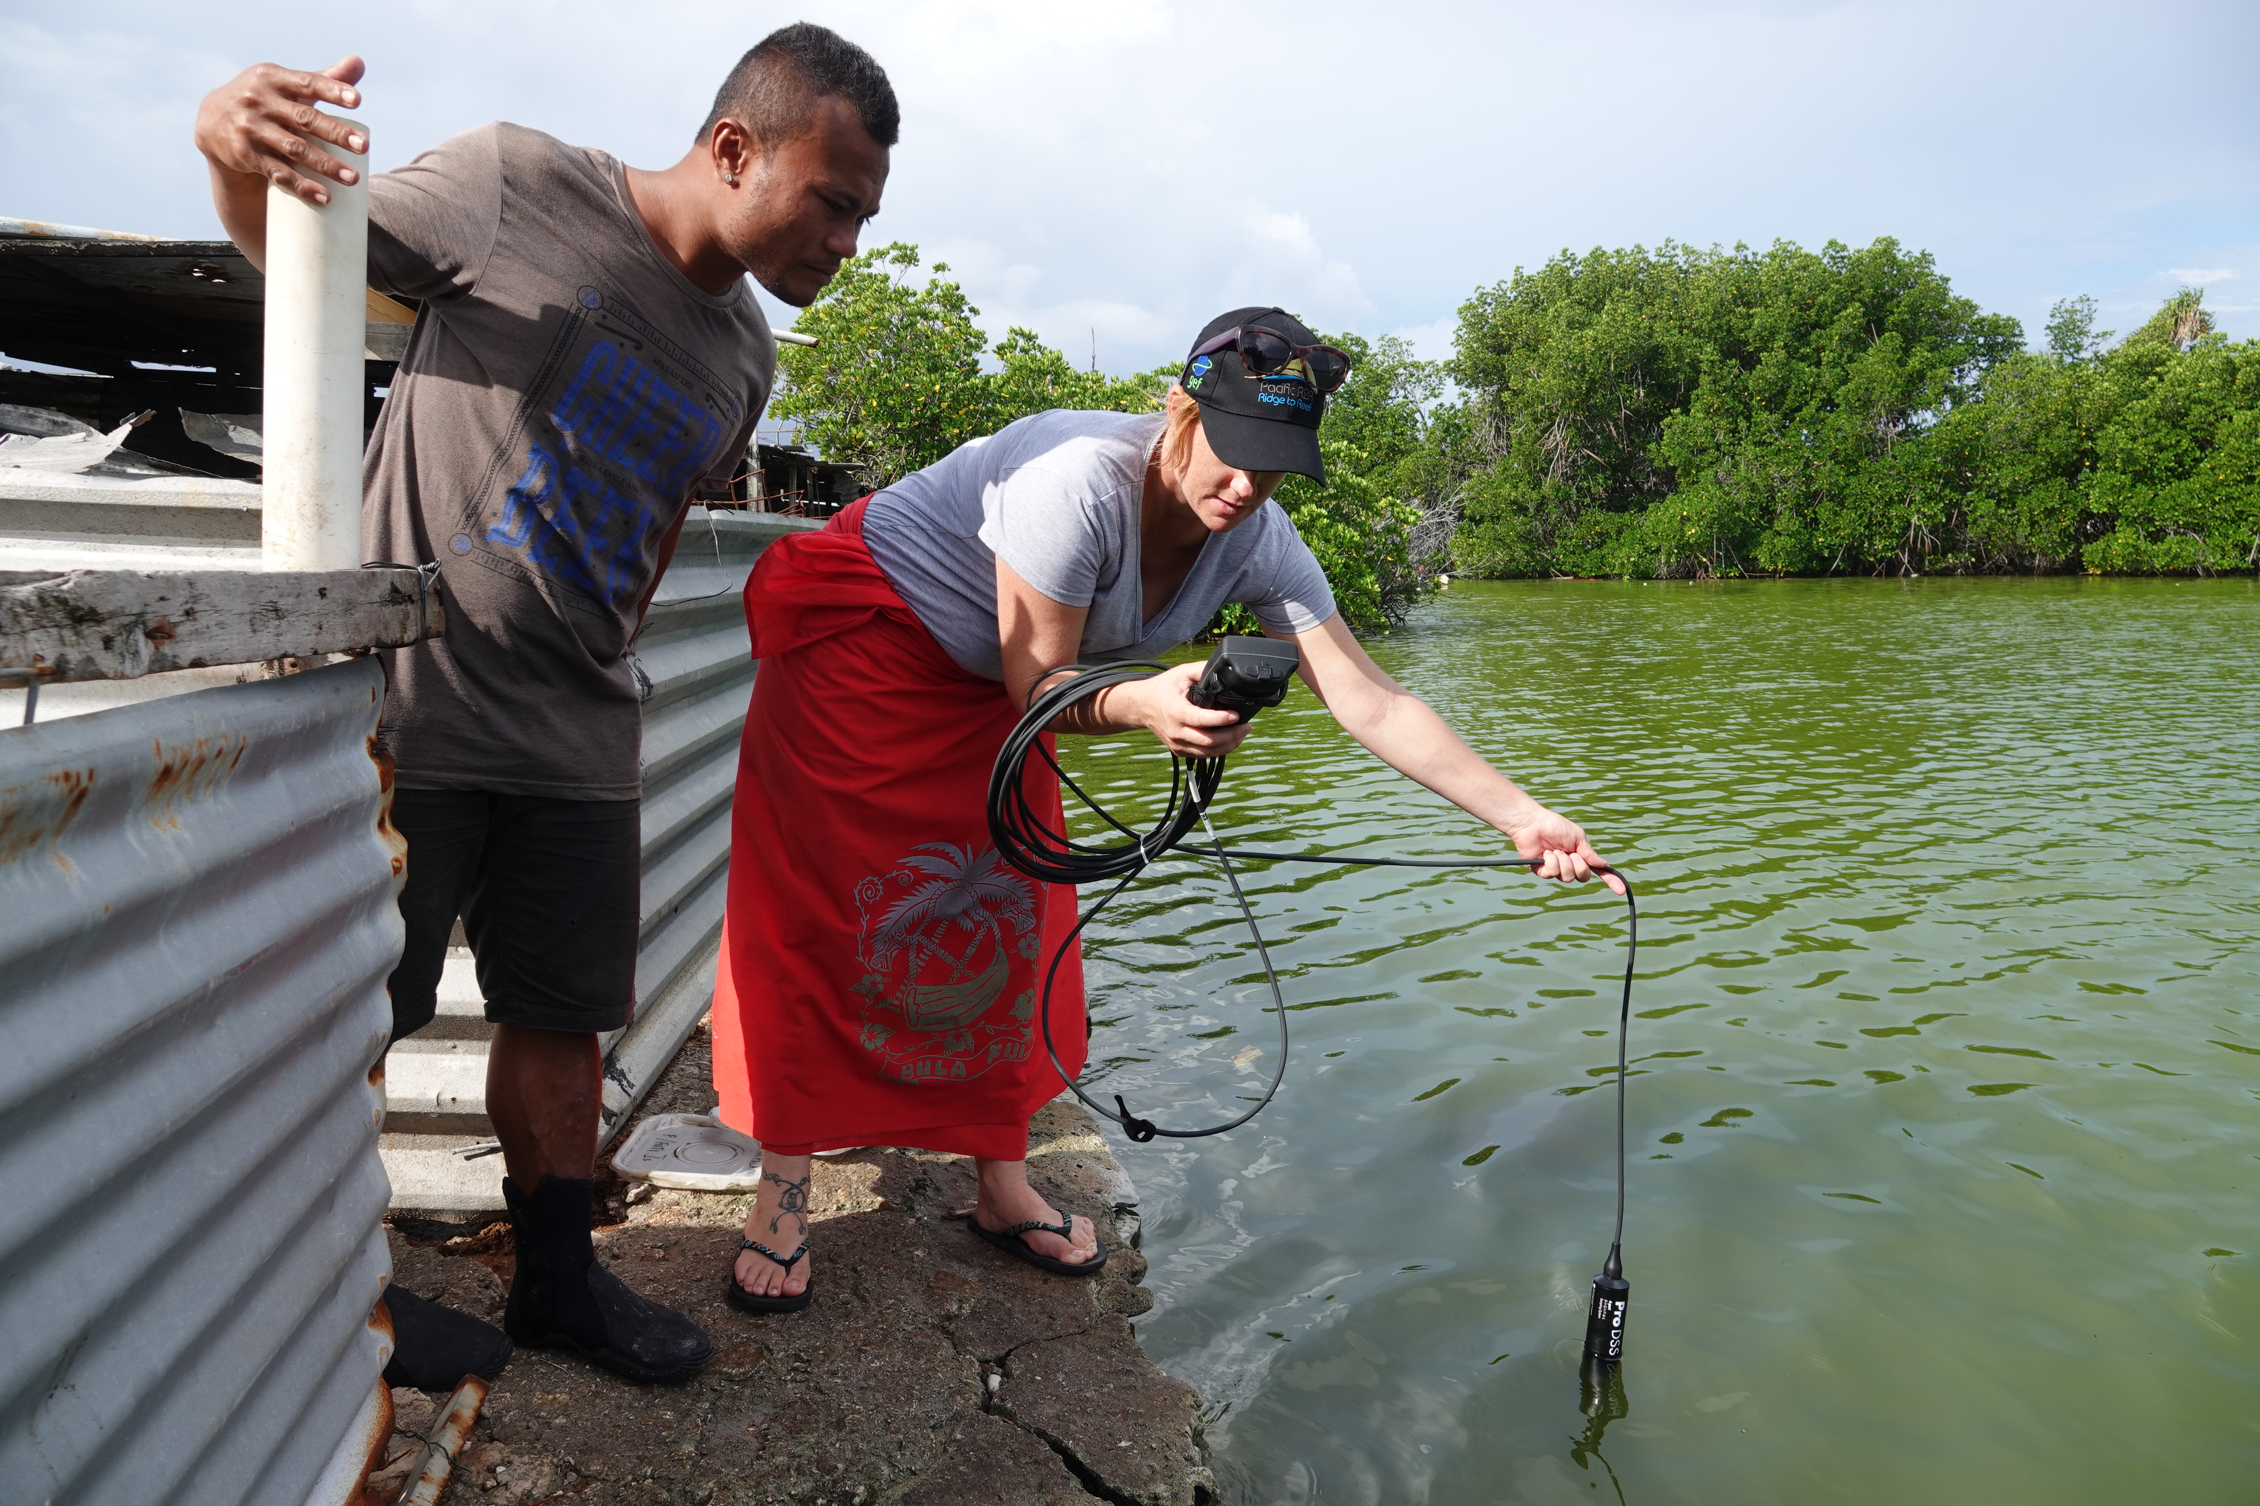
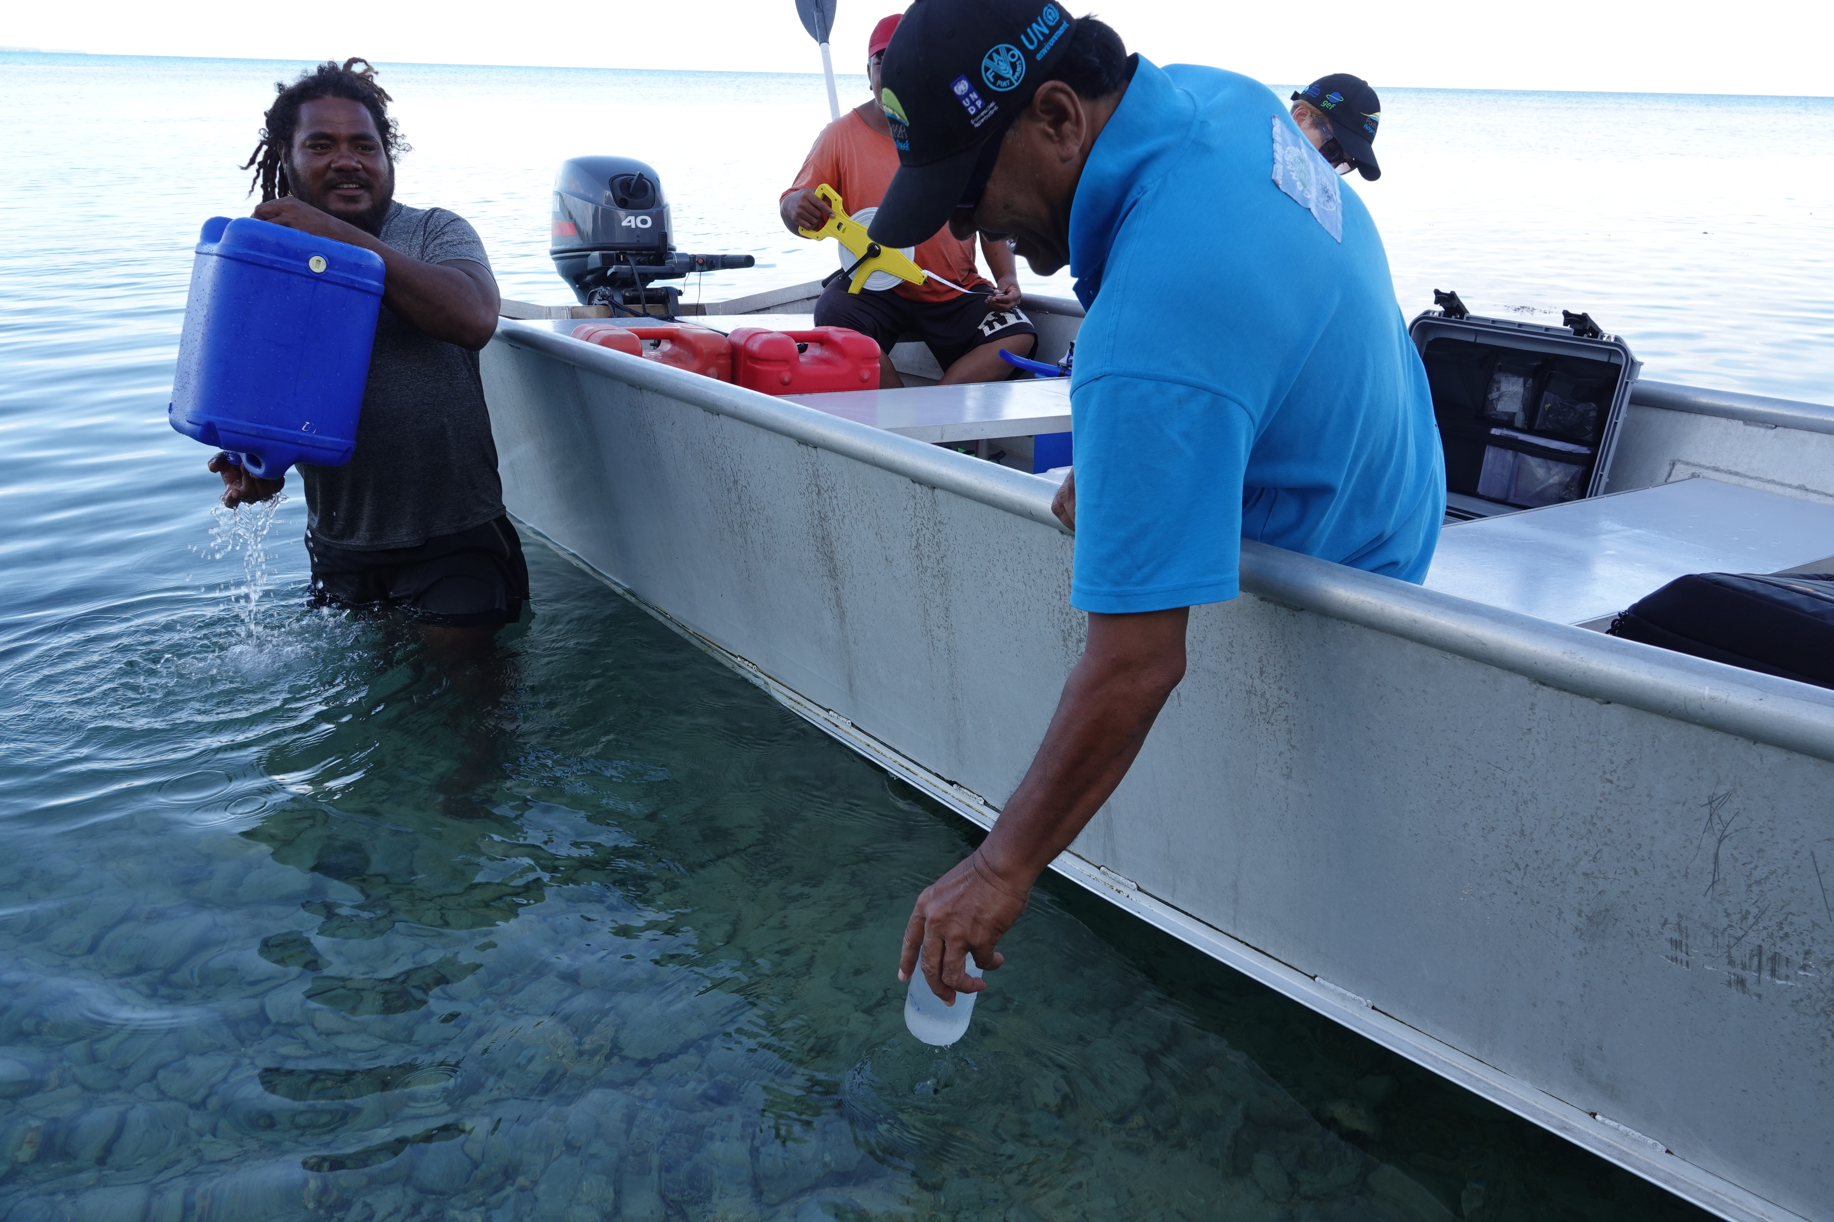
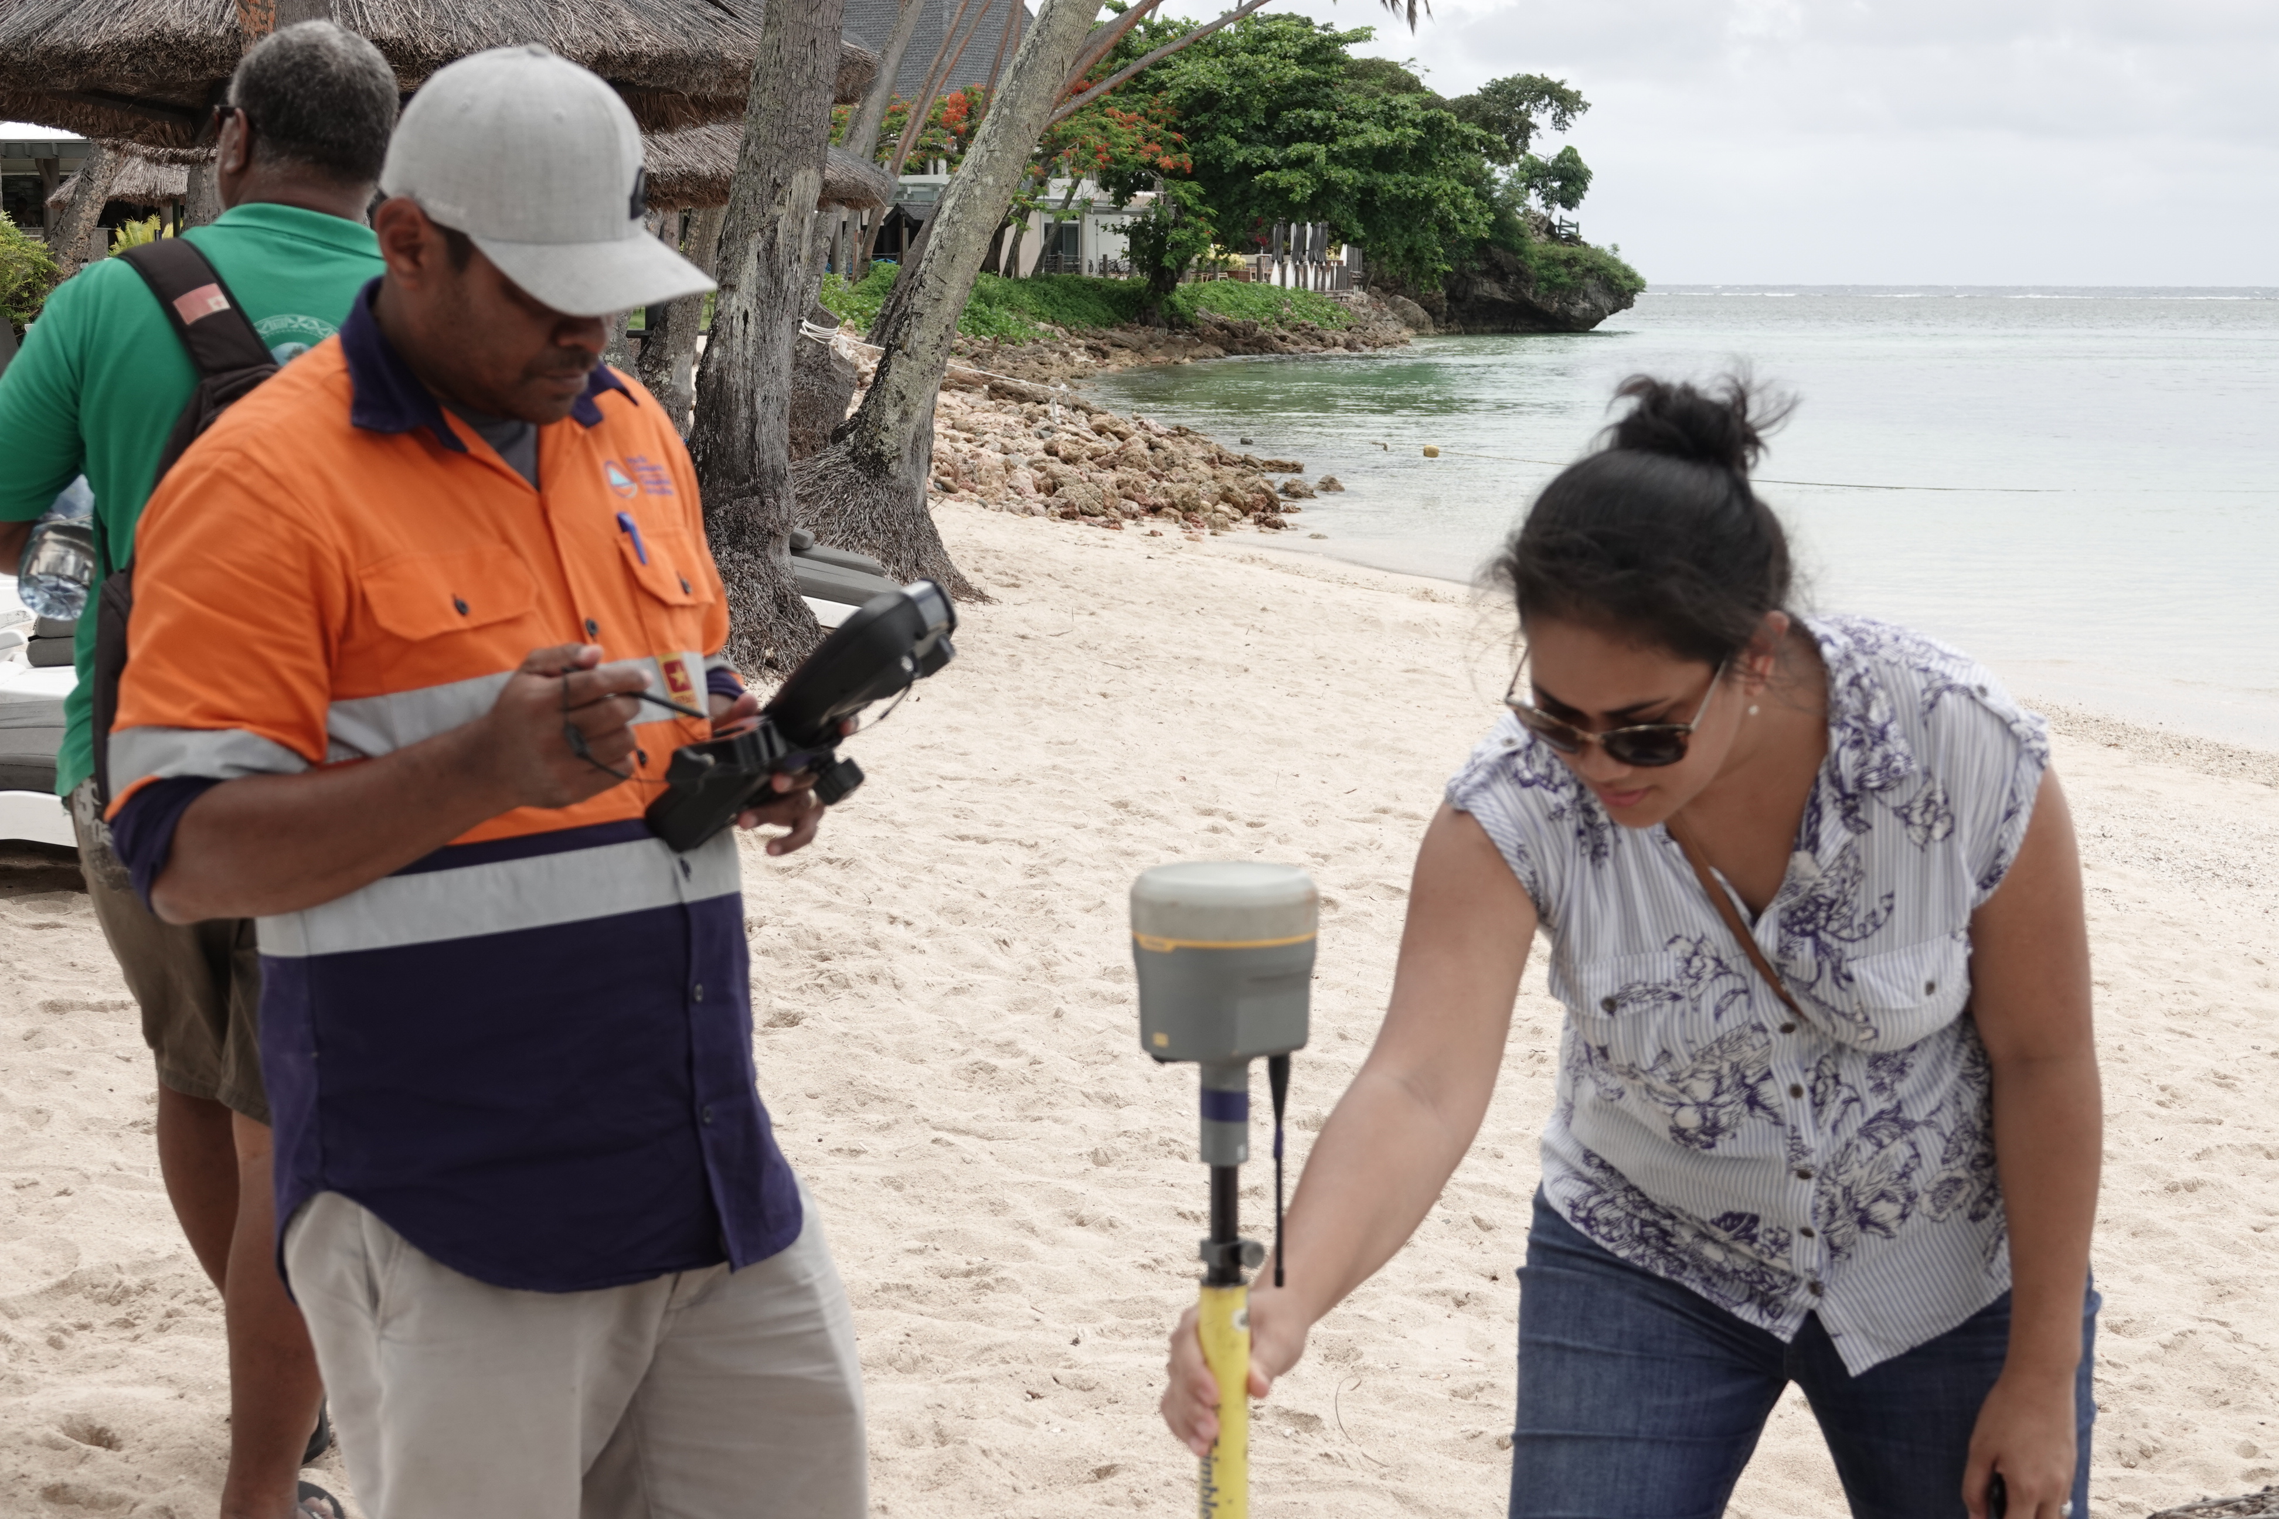
Where we want to be in the future?
Long-term

Slide 12
Note where we are in R2R project implementation following discussion and decisions taken last year at the RSTC and RSC meetings,
Discuss and agree on the options to progress implementation delivering results and outcomes under non-normal circumstances of COVID, and
Revise the Regional IW R2R Project MYCWP and its Monitoring Plan or Results Framework, under a 6-months no cost extension.

Slide 13
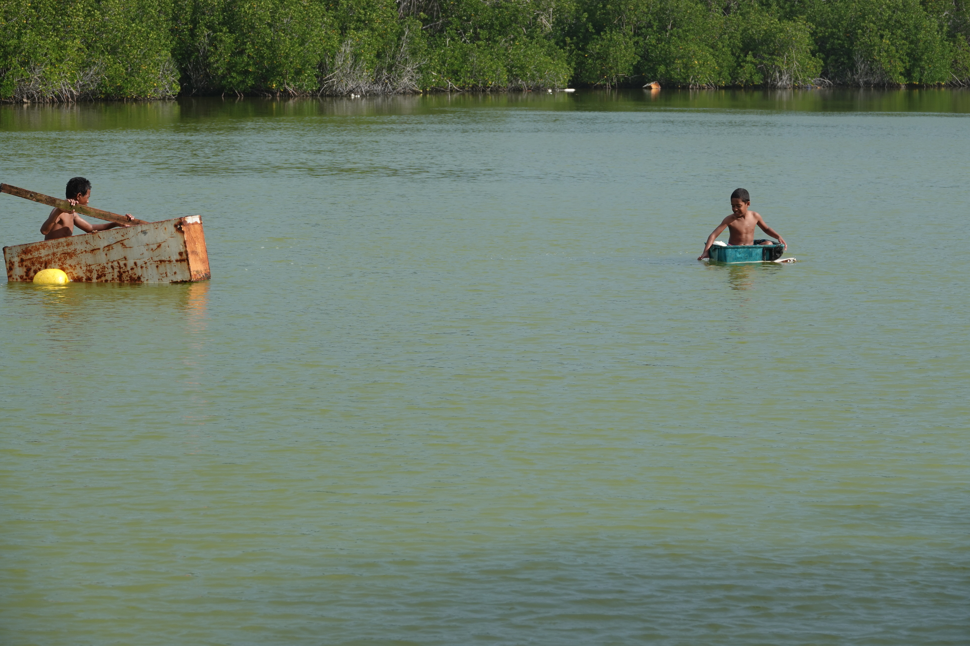
What we need to do in the short, medium and long-term?
Guiding questions
Given the new timelines of 6-months of no cost extension, what practical implications would that have on delivering the project outcomes? Focused discussion on realistic completion of priority deliverables.
Can we do things differently? Example: streamline the revised MYCWP and set up working groups that can be tasked to work on specific deliverables (TORs)

