Slide 1
Pacific Islands Ridge to Reef National Priorities – Integrated water, land, forest and coastal management to preserve biodiversity, ecosystem services, store carbon, improve climate resilience and sustain livelihoods
Project Management Information System (PMIS)
Session 4: Research and Information Management
Shaleh Antonio, Country Coordination and Monitoring and Evaluation Adviser
Radisson Blu Resort, Denarau, Nadi, Fiji, February 15, 2021

Slide 2
Outline of the Presentation
Background and Context
GEF Pacific Ridge to Reef Programme Initiative
Regional IW R2R Project
Coordination role of RPCU/SPC
Project Management Information System (PMIS)
Purpose, features and status of implementation
Issues and challenges
Conclusion and Recommendations

Slide 3
Participants are invited to:
Note the intent and purpose of the PMIS, its features and functionalities;
Discuss the status & progress of implementation in the establishment of the PMIS, and
Discuss and recommend clear directions in the utility and useful application of this platform in the Pacific region into the future.

Slide 4
The GEF Pacific Ridge to Reef Programme Initiative
and
Regional IW Ridge to Reef Project
An Overview

Slide 5
The Pacific Ridge to Reef (R2R) Programme Initiative
Program Title: “Pacific Islands Ridge to Reef National Priorities - Integrated Water, Land, Forest & Coastal Management to Preserve Ecosystem Services, Sequester Carbon, Improve Climate Resilience and Sustain Livelihoods”
Is a Multi-focal Area Ridge to Reef Programme
Financed by the Global Environmental Facility (GEF)
with objective:
“to maintain and enhance Pacific Island countries’ ecosystem goods and services (provisioning, regulating, supporting and cultural) through integrated approaches to land, water, forest, biodiversity and coastal resource management that contribute to poverty reduction, sustainable livelihoods and climate resilience”

Slide 6
6 GEF focal areas
Program facts
4 components
15 child projects
Fund Source: Global Environmental Facility
Lead GEF IA: United Nations Development Program
Other GEF Agency: UN Environment & FAO
Partners: 14 Pacific Island Countries & The Pacific Community (SPC)
Total budget: USD 90.4 million
Duration: 60 months

Slide 7
The GEF Pacific IW Ridge to Reef (R2R) Project
Project Title: “Testing: Pacific Islands Ridge to Reef National Priorities - Integrated Water, Land, Forest & Coastal Management to Preserve Ecosystem Services, Sequester Carbon, Improve Climate Resilience and Sustain Livelihoods”
Objective:
“To test the mainstreaming of R2R, climate resilient approaches to integrated land, water, forest and coastal management in the PICs through strategic planning, capacity building and piloted local actions to sustain livelihoods and preserve ecosystem services”

Slide 8
27 outputs
10 outcome indicators
Project facts
5 components
GEF ID: 5404
PIMS ID: 5221
Fund source: Global Environmental Facility
Lead GEF IA: United Nations Development Program
Executing Agency: Pacific Community (SPC)
Partners: 14 Pacific Island Countries
Total budget: USD 10.3 million
Duration: August 2015 to September 2021

Slide 9
The Programmatic Approach
The Regional
International Waters Ridge to Reef Project
Regional GEF Pacific Ridge to Reef Programme
National R2R STAR funded R2R Projects
Coordination,
Capacity building and knowledge sharing
Regional IW funded Pacific R2R Project
(RPCU)
UN Agency
PICs
PICs
Notes:
The linkages between National STAR and National IW R2R projects
Gain synergies across GEF multiple focal areas and Implementing Agencies
Coordination and integration for sustainable development
Building regional capacity and strengthening knowledge sharing.
Regional Programme Coordinating Unit (RPCU)
Hosted by SPC Geoscience Division
Possesses multi-disciplinary expertise
Facilitates the consolidation and sharing of knowledge
Supports the harmonization of results frameworks aligned with SAMOA Pathway and SDGs
Guides mainstreaming of gender, culture and engagement of young people in project delivery
Provides R2R coordination support executed through the Pacific Community (SPC)
Primary coordination vehicle for the national STAR projects and the regional program
Provides technical, operational, reporting and monitoring support as requested

Slide 10
Regional Programme Coordination Unit (RPCU)
Hosted by the Pacific Community Geoscience Energy & Maritime Division (GEM)
Provides technical, operational, reporting and monitoring support as requested
Facilitates consolidation and sharing of knowledge and expertise
Supports uptake of best practice management approaches in policy-making and planning
Supports the harmonization of results frameworks including relevant development indicators (e.g. SDG, Aichi Targets, etc.)

Slide 11
Rationale/Background: Harmonized Results Reporting
(Reference: Programme Framework Document for the Regional Ridge to Reef Initiative, Nov. 2013, page 38)
“… a special indicators component of the Regional project will test development and use of a simplified, yet integrated GEF reporting framework to avoid each country having to produce tracking tool submissions for as many as 5 focal areas.”
Indicator 4.1 of the Regional IW R2R Project provide for:
“Simple and integrated national and regional reporting templates developed based on national indicator sets and regional framework to facilitate annual results reporting and monitoring from 14 PICs.”
“Unified/harmonized multi-focal area results tracking approach and analytical tool developed, endorsed, and proposed to the GEF, its agencies and participating countries.”
Indicator 4.2 of the Regional IW R2R project provide for:
“Pacific R2R network established with at least 100 users registered, online regional and national portals containing among others, databases, rosters of national and regional experts and practitioners on R2R, register of national projects, repository for best practice R2R technologies, lessons learned, etc.

Slide 12
Harmonized Results Reporting Framework & Related Processes
Roles and Responsibility
Data attributes:
Programme
15 Projects
14 PICs
Users and audiences:
Responsible: Regional Program Coordinating Unit
Role: Executed the decisions of the RPSC on the website and associated database establishment, and coordinate with GEF-IA and STAR/IW project managers in ensuring system functionality
Overall contributions of 14 PICs to each of the GEF focal area outcomes and outputs of all the countries
Tagging the overall contributions of 14 PICs to each of the 20 Aichi Targets
Tagging the overall contributions of the programme to the relevant Sustainable Development Goals
Users: GEF Secretariat, Regional Programme Coordination Group, Regional Program Steering Committee, Regional Scientific Technical Committee, Regional Program Coordinating Unit
Audiences: GEF Implementing Agencies, GEF Country Operational Focal Points, others
Responsible: GEF Country Operational Focal Points/ Lead implementing agency/ies/NPSC/IMC
Role: Provide guidance and support in ensuring functionality of the system in-country especially resolve issues on access and data-sharing, …
Achievements of the country as regards the GEF focal area outcomes and outputs
Tagging the contributions of the country to the relevant Aichi Targets
Tagging the overall contributions of the country to the relevant SD-Goals
Emerging trends on innovative measures tested in-country (stress reduction and processes)
Users: GEF Country Operational Focal Points
Audiences: GEF implementing agency, Lead implementing agency, other government ministries/agencies of each PICs, NGOs and advocates, other stakeholders, and communities, …
Specific project contributions to the GEF focal area outcomes and outputs
Tagging the project contributions to relevant Aichi Targets, SD-Goals
Emerging trends on innovative measures tested in-situ particularly focused on stress reduction to NR
Project Management Portal: Planning-Monitoring and reporting of results of development measure to include such as but not limited to project logframe, Results indices, activity status, and relevant financial data/ information.
Users: GEF Implementing agency, Lead implementing agency, National Project Steering Committee (IMC), Project Management Unit/Office, …
Audiences: NGOs and advocates, other stakeholders, and communities
Responsible: Project Management Unit/Lead implementing agency, National Project Steering Committee (IMC), and GEF Implementing Agency
Role: Ensure provision of technical and financial resources as maybe required to ensure functionality of the system, and designate staff that will serve as focal point for website CMO and updating.

Slide 13
Approach for reporting results (refer to RSC 3 discussions)
Review of the individual project documents, particularly the end-of project indicators of both STAR (14 projects) and IW R2R (1 project with 14 PICs involvement through MOA);
Both stress reduction and process indicators will be mapped. Monitoring of results have to be recorded and analysed by comparing the indicators with the respective baselines. A Results Based Monitoring (RBM) system is available;
RBM system highlights the success factors and the impact triad (linking Science - Planning - monitoring/reporting – communication and knowledge management), including all available management and reporting tools and templates, guides and manuals and prototype dashboards for visualizing results.
Project website is established to serve as platform for ensuring real-time access of information for use by a wide stakeholder audiences. Please note that all GEF funded projects are required to establish project website (page 45 of Project Management Manual for GEF IW projects).

Slide 14
The Success Factors: Focus of the Results-based monitoring
(Adopted from the GIZ Success Factors Model): Presented and discussed in RSC 3
Steering
Role of clients and beneficiaries
Cooperation
Involvement of all program/ project stakeholders in generating results
Engagement of various stakeholders in program/ project implementation
Enable countries and partners to be mutually accountable in achieving project outcomes
Processes
Preciseness of the activities and ensure plausible link and causal relationship towards the project objectives
KM & Learning
Monitor risks, validate assumptions, and ascertain conditions set for this program/ project.
Strategy
PFD/ ProDoc providing clear indicators & parameters to be measured and tracked, etc.
Clear Institutional landscape and program stakeholders highlighting clear roles & contribution
Role of various stakeholders (i.e. SPC, the RPCU, National Project Managers, political partner agency/ies, development partners
Available RBM System or simple monitoring plan
Results orientation based on QQT indicators
...
On RBM, clear roles of stakeholders especially in the actual data gathering and analysis, and reporting
Document processes as building blocks for drawing lessons for steering, reporting, and knowledge management

Slide 15
Emerging Lessons drawn from experience in implementation of the Pacific R2R Programme Initiative (The Success Factors)
Note: As discussed in RSC 3, Townsville, Australia
Strategy. A results framework that provides clear (Quantity, Quality, Time and spatial dimension) targets of outputs and outcomes which will serve as basis for designing the various child projects for achieving the GEF focal areas.
Steering. A responsive steering body that provides clear guidance and can make decisions for achieving Programme outcomes (RPCG, RPSC versus NPSC).
Cooperation. A clear management structure that is promoting joint planning and implementation of development measures (i.e. Regional Programme Coordination Unit versus Project Management Unit/ Office)
Processes. Established systems, procedures and mechanism (planning, monitoring and reporting)
Learning and innovation. In a planned change process (based on the clear theory of change), a collaborative research and development agenda or concept for pilot testing, replication and upscaling available, and available communication, knowledge management strategy for documentation, packaging and communicating learnings and experiences for national and regional upscaling.

Slide 16
The Project Management Information System (PMIS)
An Overview

Slide 17
PMIS aims to:
facilitate results reporting of the GEF Pacific R2R Program and the Regional IW R2R project
provide real-time visualization (Dashboards) of the status of implementation (and management), outputs produced, and achieved outcomes.

Slide 18
Features of PMIS architecture:
MYCWP module
Results/Dashboards module
Harmonized results reporting (GEF Focal areas, SDG and Aichi)
Process and Stress reduction reporting module
Post graduate certificate/diploma statistics module
Training/ capacity building statistics module

Slide 19
Status of PMIS architecture
 | Module | Status
1 | Project Management Module (MYCWP) - for use by the 15 child projects & 14 national IW R2R projects | Completed
2 | Results/Dashboards
2.1 | Harmonized results reporting (GEF Focal areas, SDG & Aichi) | 40 % complete
2.2 | Process and Stress reduction reporting module | Not yet started
2.3 | Post graduate certificate/diploma statistics module | 80% complete
2.4 | Training/ capacity building statistics module | Not yet started
3 | PMIS visualization in the GEF Pacific R2R Website | Not yet started

Slide 20
The Project Management Information System (PMIS)
Sample Features

Slide 21
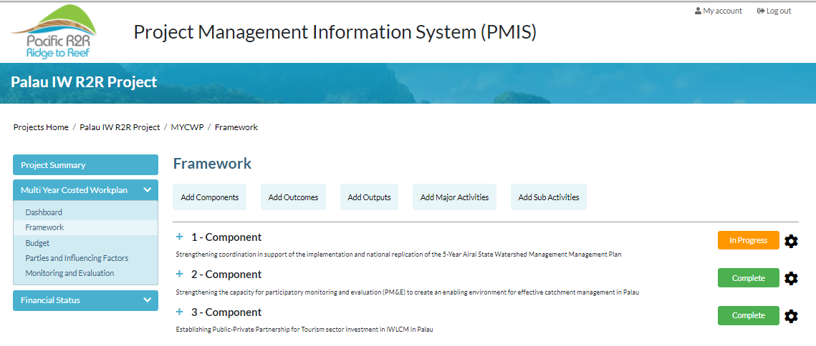
Project management module

Slide 22
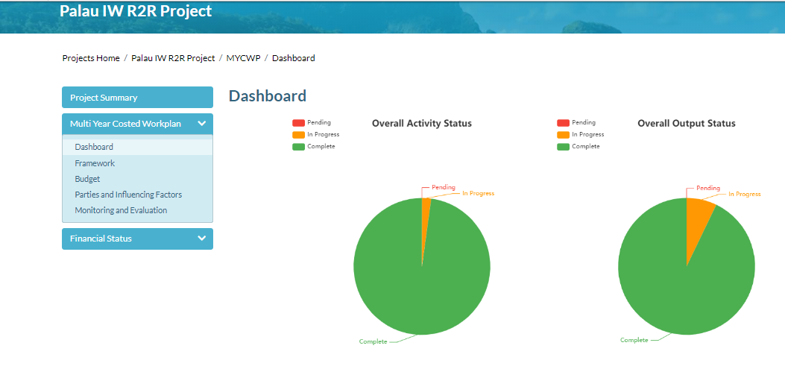
Project management module

Slide 23
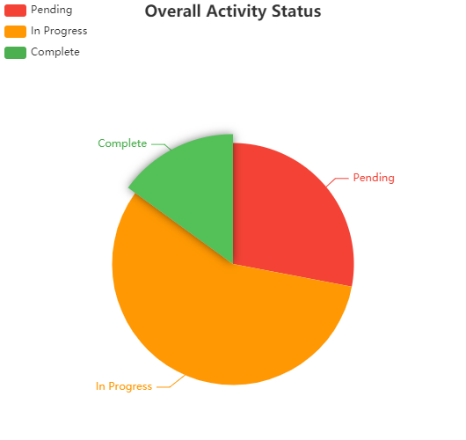
Project management module
Activity monitoring – Regional IW R2R project
Notes:
15% (15) complete
57% (57) in progress
28% (28) pending

Slide 24
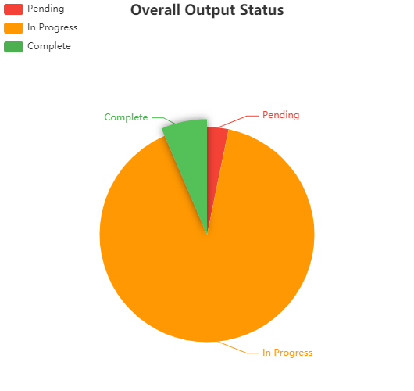
Project management module
Outputs monitoring - Regional IW R2R project
Notes:
7% (2) complete
90% (28) in progress
3% (1) pending

Slide 25
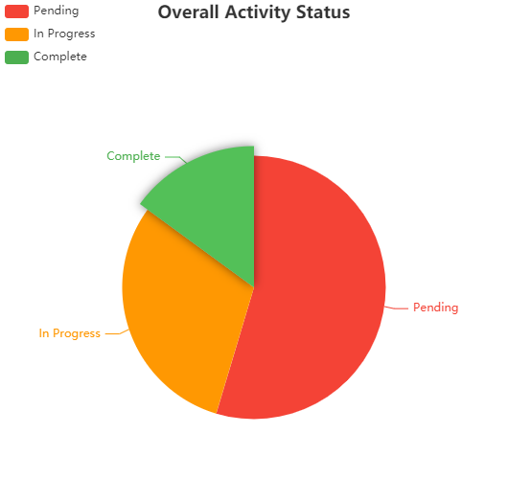
Project management module
Activity monitoring – MYCWP of national IW R2R (14 PICs)
Notes:
15% (145) complete
30% (295) in progress
55% (530) pending

Slide 26
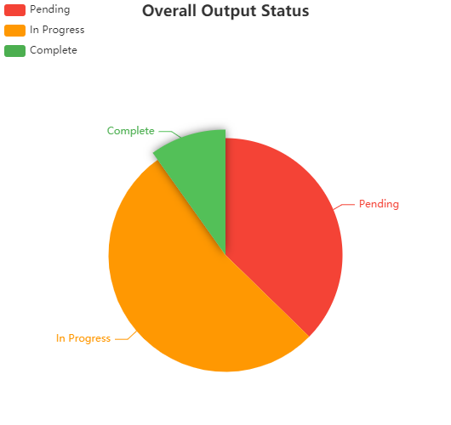
Project management module
Outputs monitoring – MYCWP of national IW R2R (14 PICs)
Notes:
10% (19) complete
53% (102) in progress
37% (72) pending

Slide 27
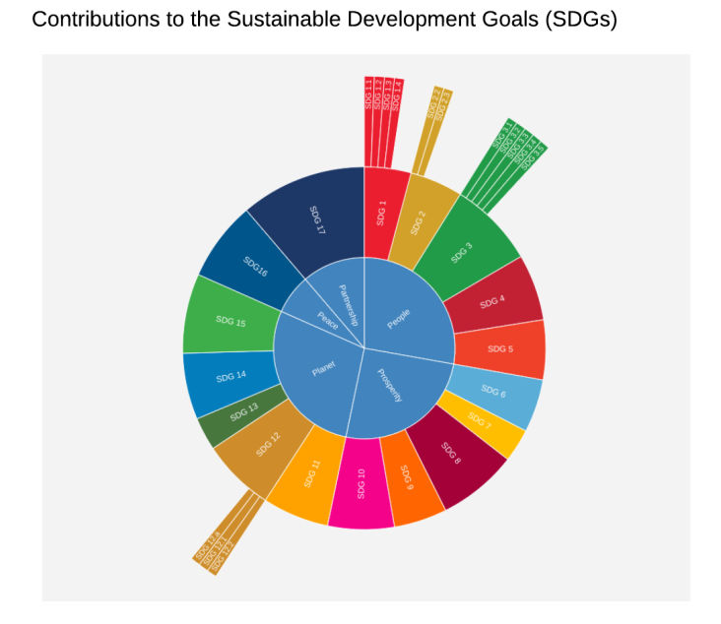
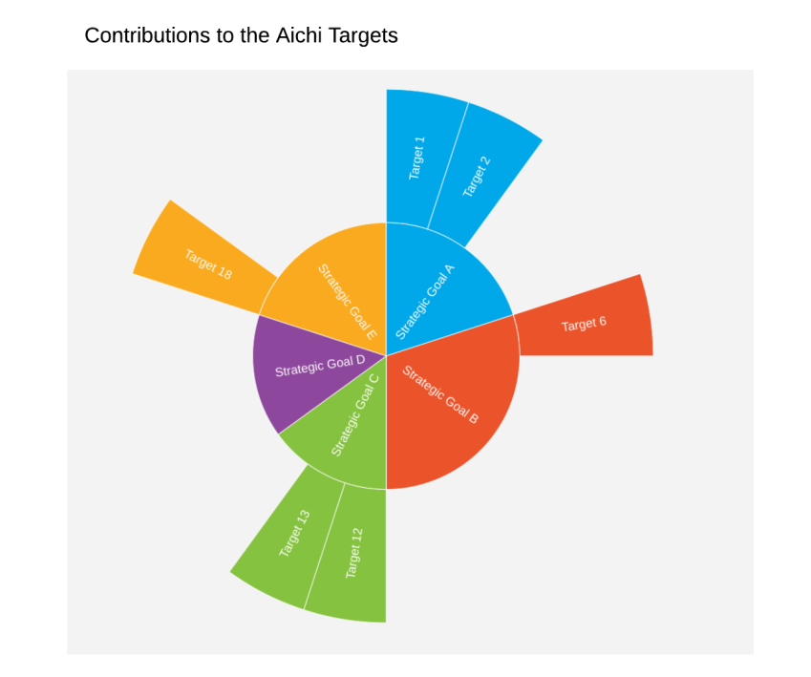
Results/dashboards (SDG, Aichi)

Slide 28
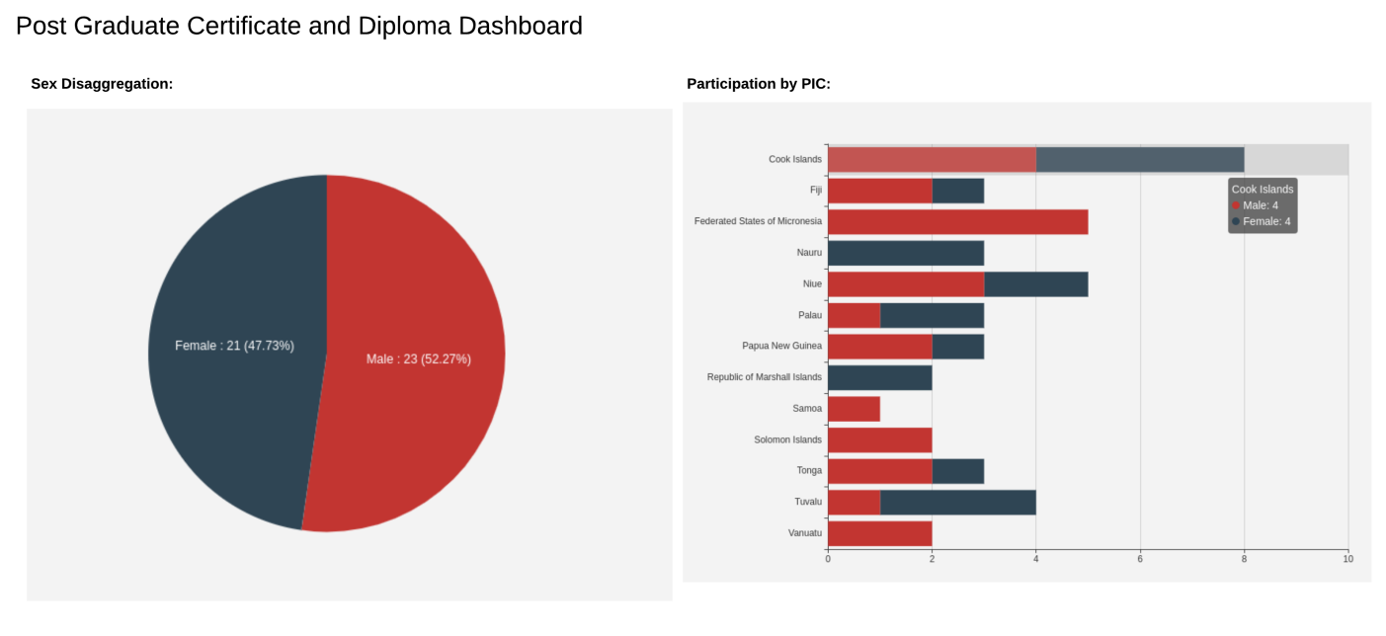
Results/dashboards (PGC)

Slide 29
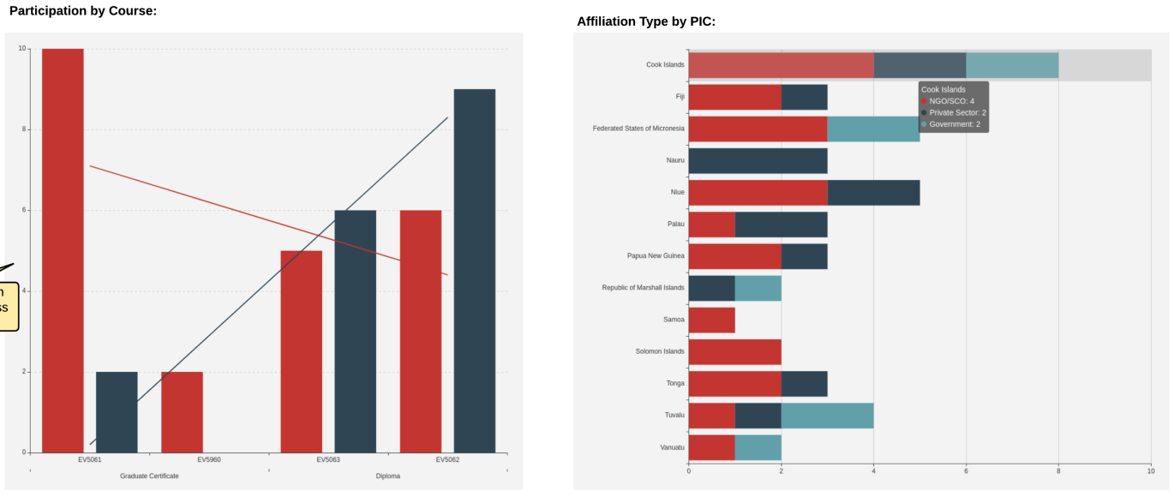
Results/dashboards (PGC)

Slide 30
Issues and challenges:
Delay in the construction of the remaining results/dashboards modules
Factors contributing to the delay are:
Complexity of the tasks
Disagreement on the basis for delivering the minimum viable product (MVP)

Slide 31
Conclusion and recommendations
PMIS is an important management tool and a platform for real-time visualization of results.
RPCU demonstrated the PMIS to UNDP, and in several regional and national meetings (project Steering Committees and Boards) for which it generated positive feedback and support for progressing further.
Progressing further however, requires resolution of the outstanding issues with the service provider. This is now handled by the SPC procurement and legal units.

Slide 32
Pacific Islands Ridge to Reef National Priorities – Integrated water, land, forest and coastal management to preserve biodiversity, ecosystem services, store carbon, improve climate resilience and sustain livelihoods
Presented by:
Shaleh Antonio, CCMEA
Presentation prepared by: Shaleh Antonio. CCMEA
Photo credits ___________________________
Layout Navneet Lal, Graphics and multimedia assistant
Template: Shaleh Antonio, CCMEA
References:
…
VINAKA
THANK YOU VERY MUCH

