Slide 1
Session 4: Research and Information Management
State of Coast Platform
Spatial Data Infrastructure
for the GEF Ridge to Reef Programme
Sachindra Singh
Geoscience, Energy and Maritime Divison (GEM)
Pacific Community (SPC)
Radisson Blu Resort, Denarau, Nadi, Fiji, February 16, 2021

Slide 2
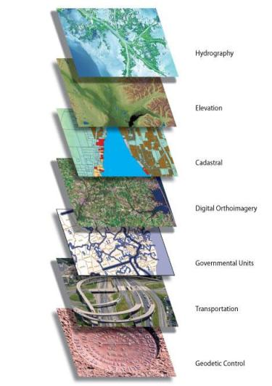
What is an SDI in the Pacific Context?
The term “Spatial Data Infrastructure” (SDI) is often used to denote the relevant base collection of technologies, policies and institutional arrangements that facilitate the availability of and access to spatial data. The SDI provides a basis for spatial data discovery, evaluation, and application for users and providers within all levels of government, the commercial sector, the non-profit sector, academia and by citizens in general.”
– SDI Cookbook
http://www.gsdi.org/gsdicookbookindex
An inter-connected set of systems that enables easy management, exposure & usage of information across all spatial data themes.

Slide 3
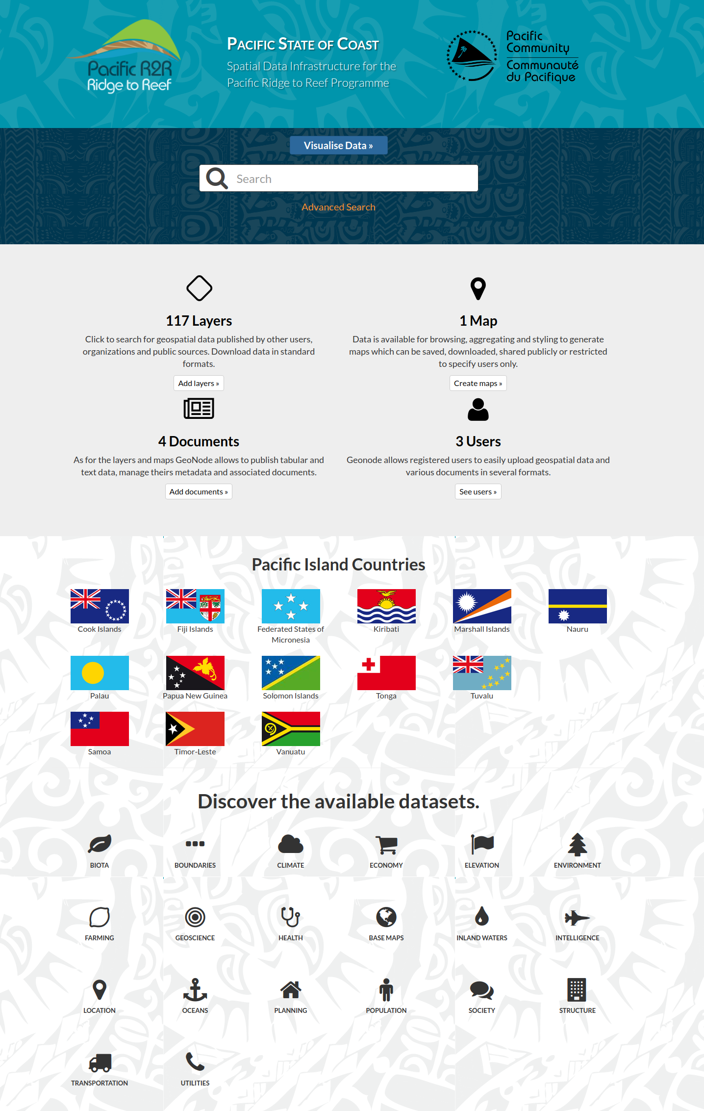
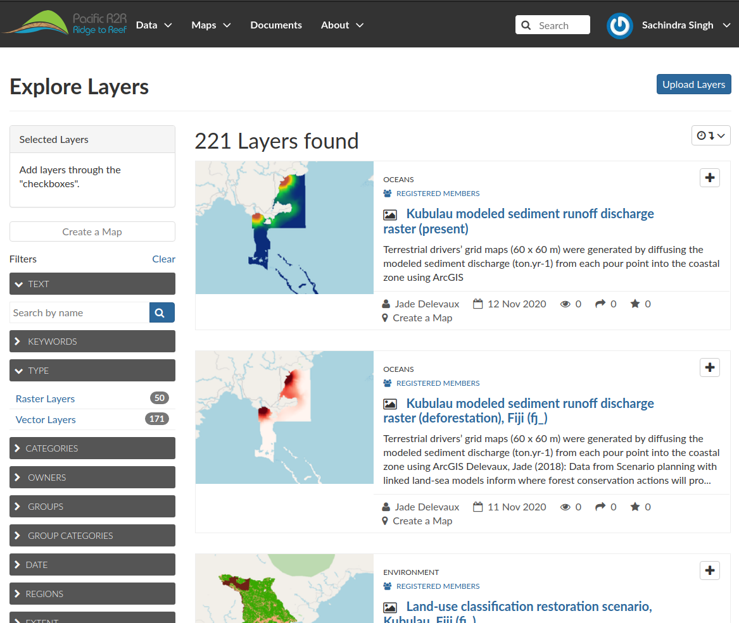
R2R State of Coast Platform: SDI for GEF R2R Programme

Slide 4
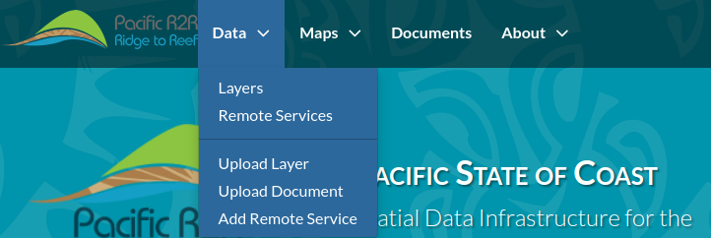
Key Use Cases
Spatial Data Sharing (between users, groups, public)
Related Documents, Reports and Assets (non-spatial)
Spatial Data Visualisation and Querying
OGC Metadata Compliance
Data Catalogue by Thematic Area, Country
Time Series Data
DataSheet Register by Indicators, Site
Interoperable (with regional and international data platforms)
Open Source (can be deployed at national project-level
with minimal costs)

Slide 5
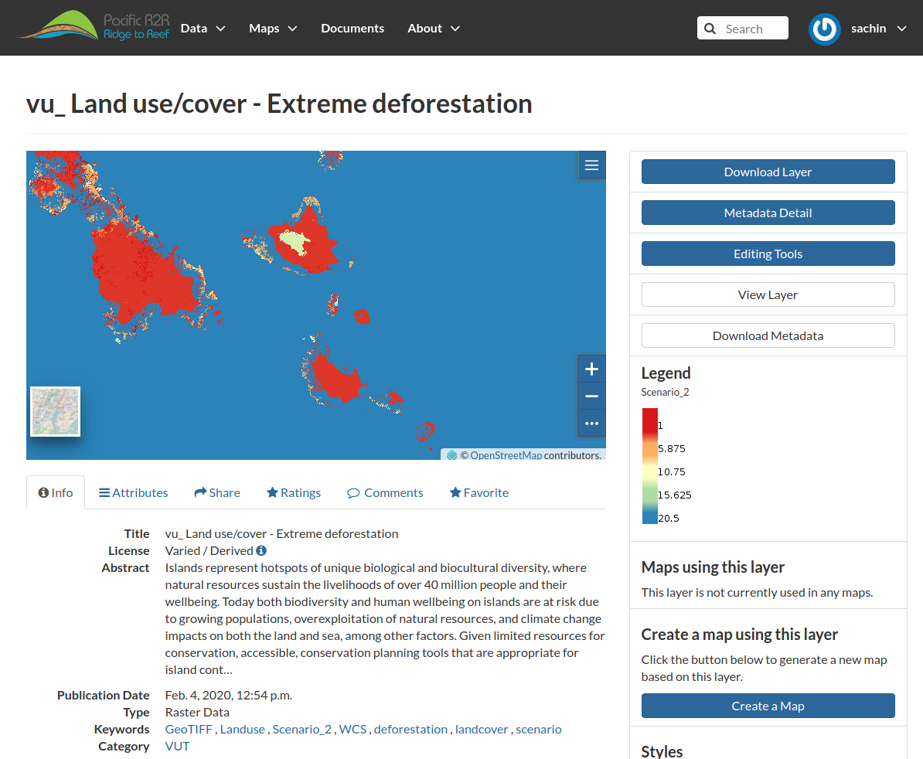
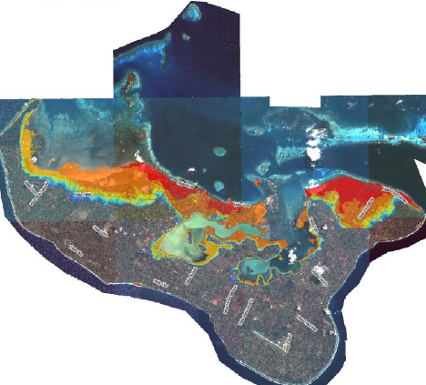
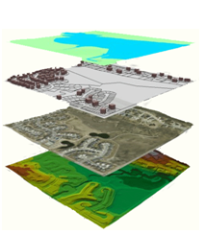
Spatial Data Sharing
Open Data
No Registration Required
(Only for Uploading, Modifying Data and Assets)

Slide 6
Data Statistics

Slide 7
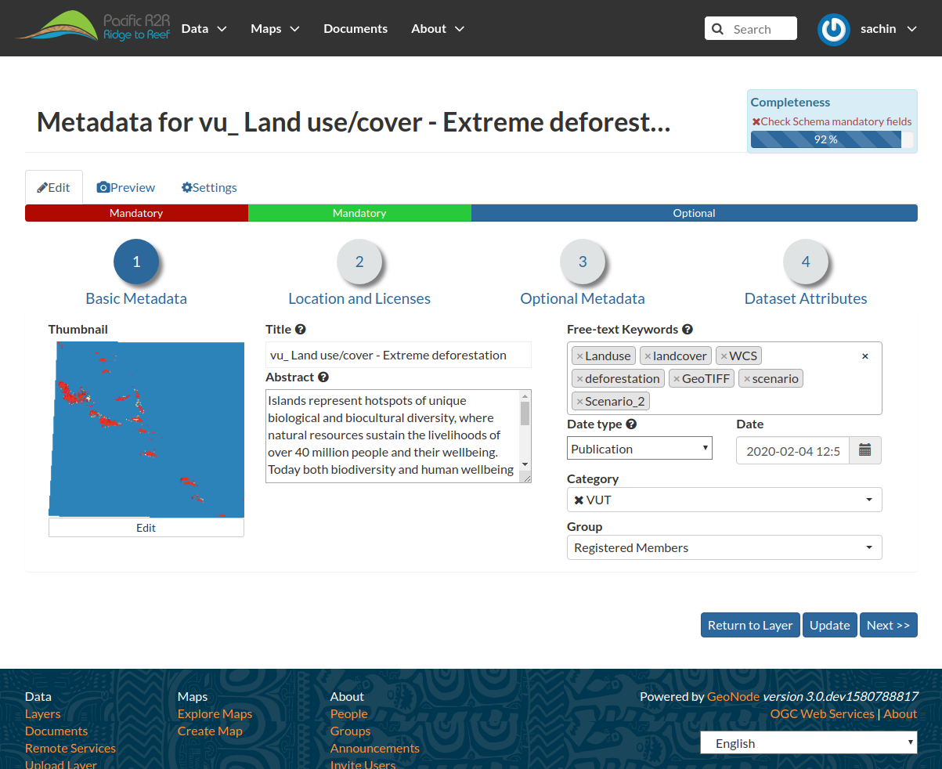
OGC-Compliant Metadata
Metadata is an important, but unfortunately oft overlooked component of Geospatial data.
Metadata is ‘data about the data’ and it’s vital to understanding to source, currency, scale, and accuracy of using GIS data.

Slide 8
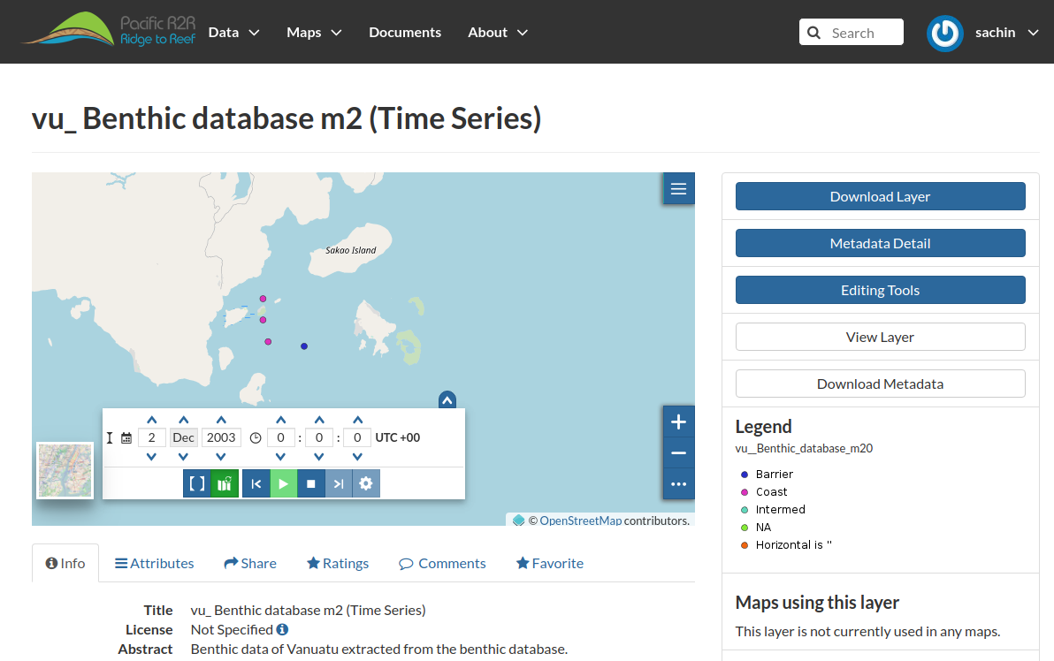
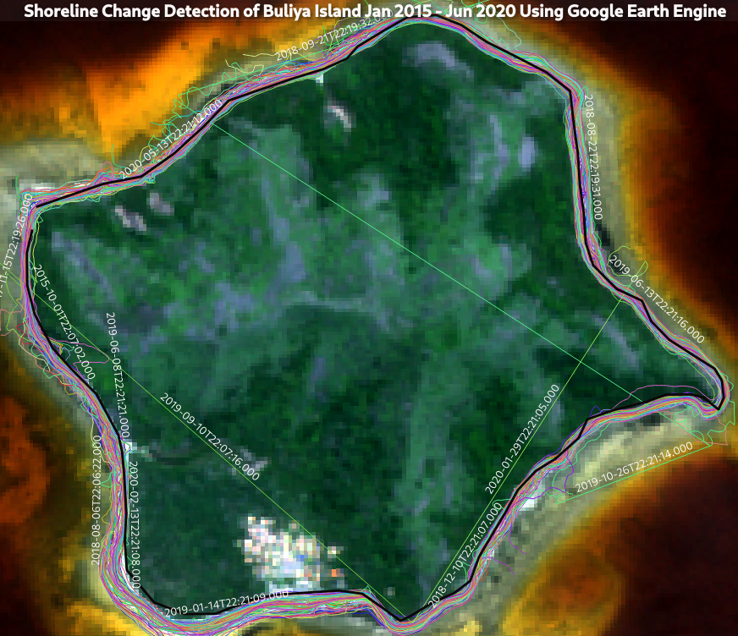
Spatio-Temporal (Time-Series) Data

Slide 9
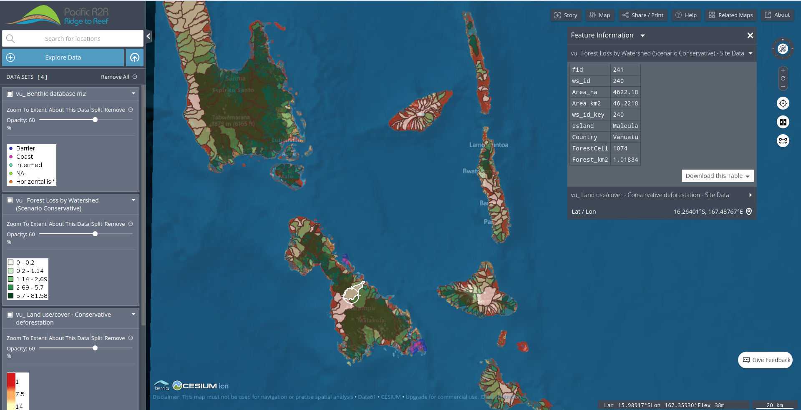
Mapping and Visualisation

Slide 10
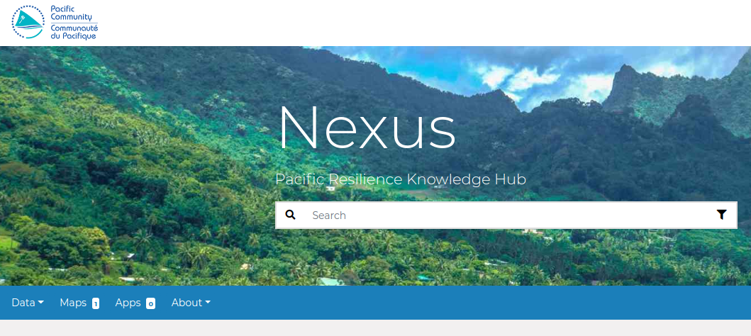
Data interoperable with Pacific Data Platforms
SoC builds upon industry standard open source components used within the Pacific Region
It is designed to be extended and modified, and can be integrated into existing platforms.
Instance Deployed in USP?

Slide 11
Challenges and Next Steps
Initial workshop(s) on SoC Platform functionalities focused on project managers, advanced technical trainings needed for project GIS/Data practitioners
Data Standardisation discussion/decision needed.
Departure of key Geospatial Technical Officer within GEM, partially dedicated to R2R State of Coast Platform
Replacement Position is awaiting Ministry of Foreign Affairs (FJ) approval prior to advertisement (next 2 weeks)

Slide 12
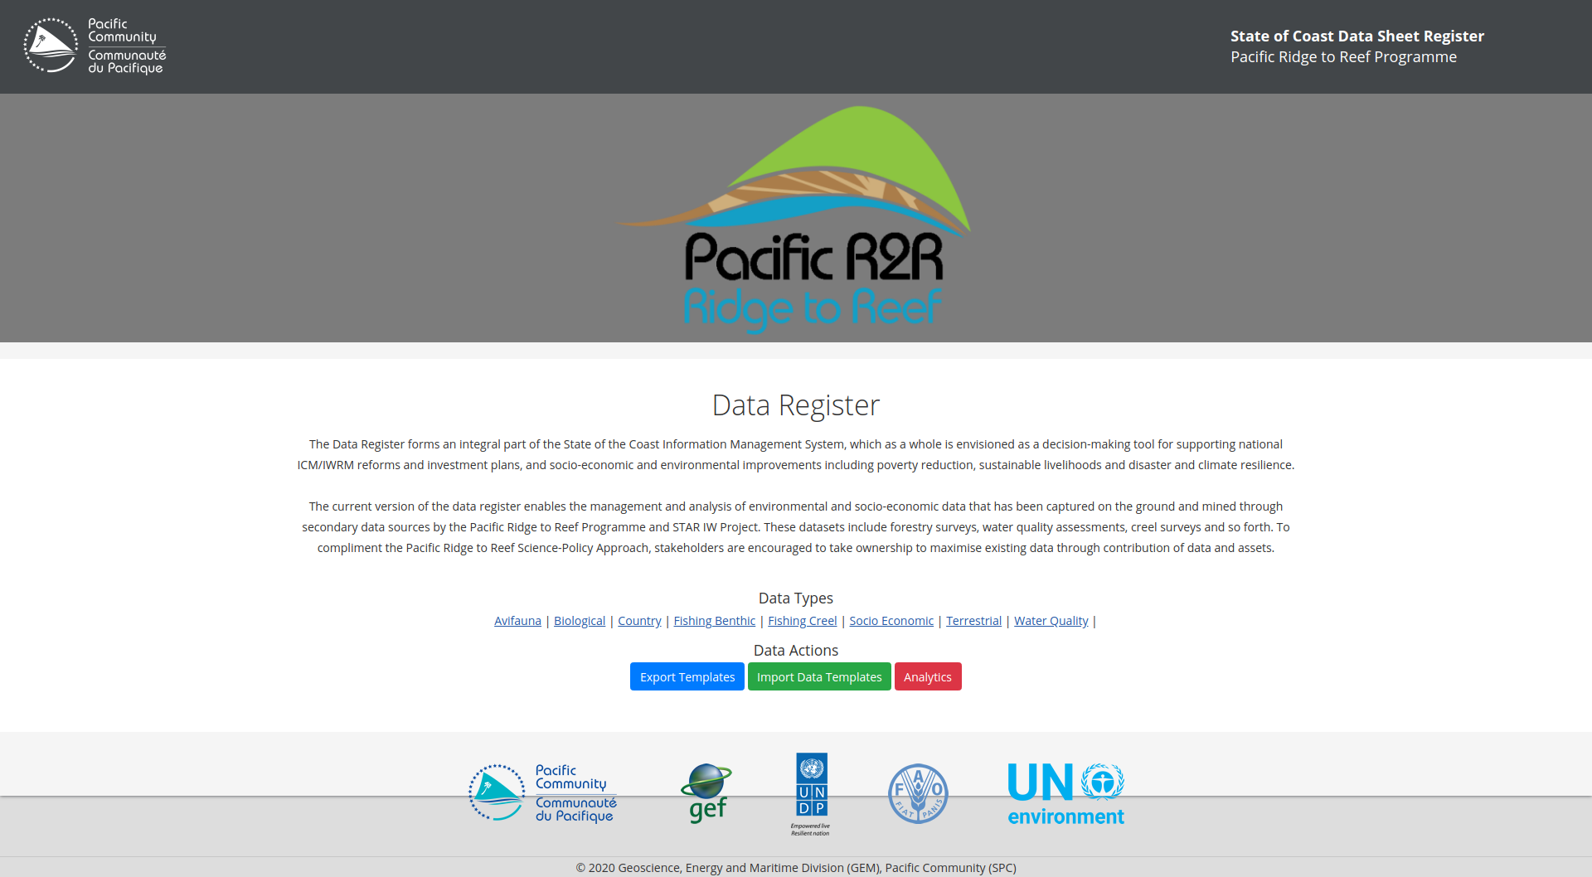
Standardisation: Data Register for Environmental Data
Enables management and analysis of environmental, socio-economic, habitat, natural resources and other data sets collated by Pacific Ridge to Reef Programme and STAR IW Projects in a standardised manner.
(Remote Training for GIS Practitioners Pending)

Slide 13
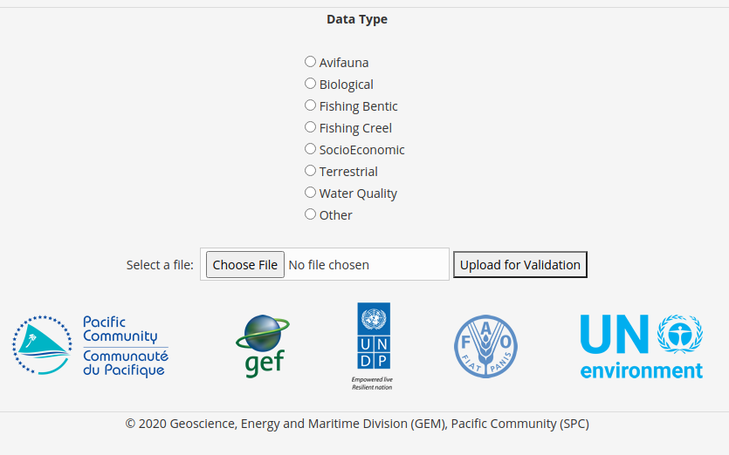
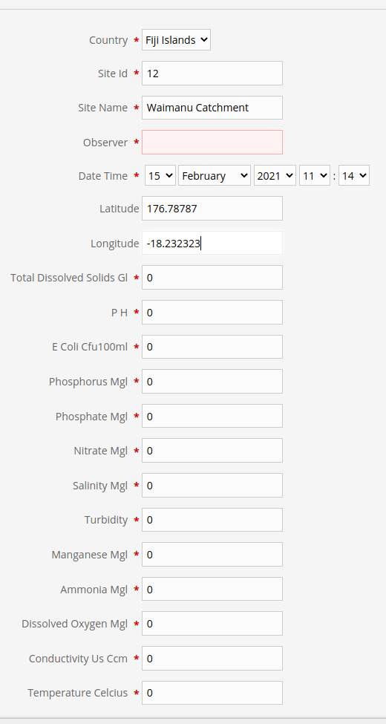
Standardisation: Data Register for Environmental Data
Enables management and analysis of environmental, socio-economic, habitat, natural resources and other data sets collated by Pacific Ridge to Reef Programme and STAR IW Projects in a standardised manner.
(Remote Training for GIS Practitioners Pending)

Slide 14
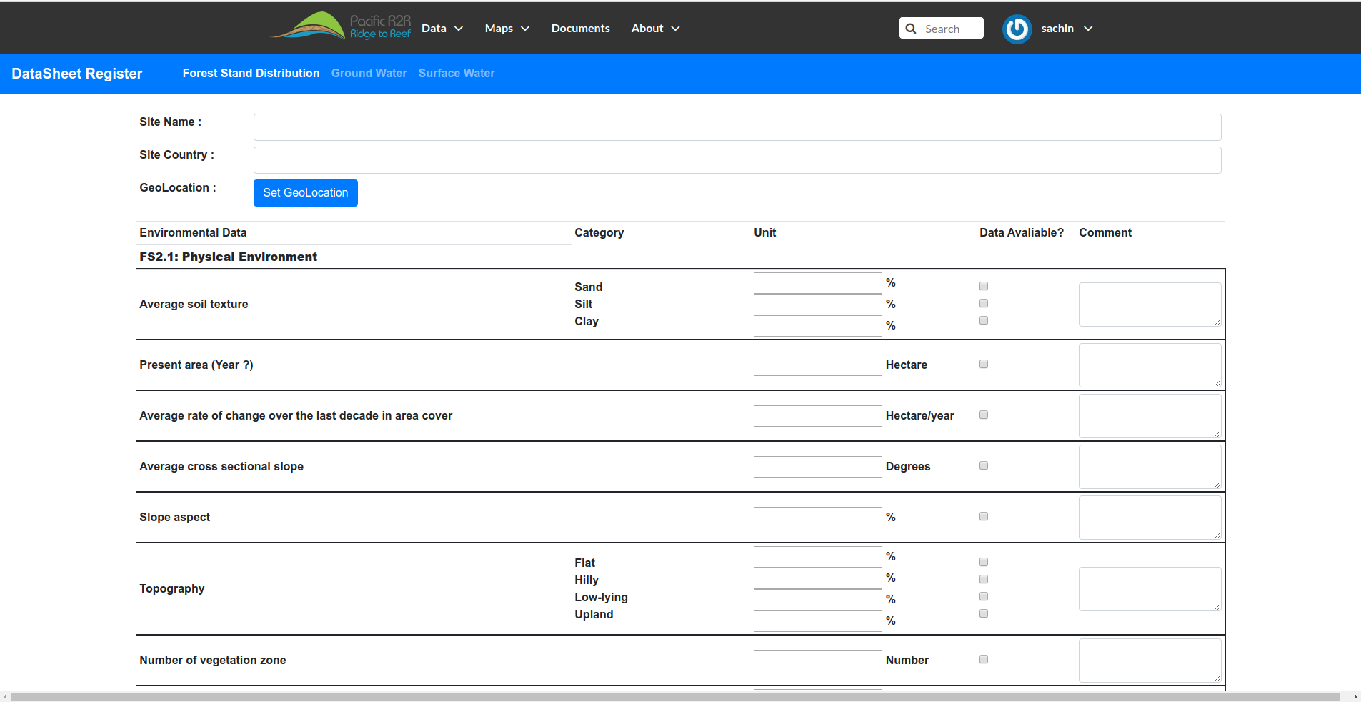
Capacity Building/Training Discussion
Modality: per national project, or sub-regional?
Identification of Participant's (GIS/Data Practitioners)
Unification of various field-collected, collated and analysed datasets
Training to approve R2R data templates (fields, attributes, validation etc.)

Slide 15
Recommendations
Review the latest updates of development and deployment of the GEF Regional R2R Spatial Data Infrastructure and its feature-sets including uploaded data, maps, documents, and map analytics features
Discuss and support pending workshop for project GIS practitioners and data managers in order to utilise and finalise population of R2R Environmental Data Register which enables management and analysis of environmental, socio-economic, habitat, natural resources and other data sets collated by Pacific Ridge to Reef Programme and STAR IW Projects in a standardised manner.
Vinaka
http://r2r.spc.int

