Slide 1
Regionally-led Project Outcomes: Lessons learned in several participating PICs

Slide 2
Summary
The paper provides a status review on the collection, writing and publication of lessons learned by countries on implementing the GEF Ridge to Reef Programme. It discusses preliminary findings and provides some suggestions towards progressing the work.

Slide 3
Background
Following the MTR recommendations, a framework was developed for compilation and development of lessons learned in R2R programme implementation. (RSC 4)
The framework was adapted from the GEF experience notes templates
The lessons learned were intended to be country-driven and countries were expected to develop and submit a “zero draft” lessons learned document based on the provided framework.
A TOR was developed to support recruitment of national consultants where needed.

Slide 4
Background
5. Country input and feedback was essential to providing a basis from which to package and write up successes (or shortcomings) and articulating lessons in R2R programmatic implementation.
6. In 2020, travel restrictions prevented RPCU staff from visiting countries and having face to face meetings with country project managers and other stakeholders. Limited feedback was received from countries, despite several extensions of the deadline.
7. A series of online workshops and other discussions were run by the RPCU Communications and Knowledge Management Advisor to support the lessons learned development process in 2020, and guide materials were developed to support country development and compilation of lessons learned.

Slide 5
Country submissions
As of 30 January 2021, the following countries have provided feedback to RPCU:
Cook Islands (IW & STAR)
Fiji (STAR)*
FSM (STAR)
Kiribati (STAR)*
Marshall Islands (STAR)*
*pre-RSC workshop
Nauru (STAR)*
Palau (IW & STAR*)
Tuvalu (IW)
Vanuatu (IW)

Slide 6
Lessons learned writing consultancy
RPCU recruited a consultant to provide editing and writing services to the project. A key task is to “package a minimum of 14 and up to 28 lessons learned publications” through the writing and editorial process.
Consultant actions:
reviewed content of the provided written country drafts (Cook Islands, FSM (STAR), Palau, Vanuatu and Tuvalu).
revised and developed a “sample format” for two documents
sought feedback from RPCU and the country and prepared second revision for consideration
collated the lessons into categories to assist with development of concept for regional publication
The sample has undergone a few iterations to accommodate the level of information provided in the country “zero drafts” and to address the need for a publication that will adequately convey project successes and lessons.

Slide 7
Summary of lessons
An initial summary of the lessons identified by countries is presented.

Slide 8
Summary of lessons learned
Category | Lesson learned (overview) | Country lesson/experience
Design Process
 | The need to address changing priorities and timing and review project design and activities before/early in the inception stage to ensure alignment with any altered national circumstances (institutional restructure, priorities, additional projects, etc) that may occur between proposal writing and project inception. | CI – changed institutional structure, priorities/mission of ICI versus the project outputs, capacity of agency, planned outputs completed under other initiatives → project LF no longer matched country situation Pa – changed state administration, new govt different priorities, loss of momentum among stakeholders
 | Project managers need the necessary skills to effectively identify, develop and implement adaptive measures throughout the project. | Palau Tuvalu
 | Recognise the value of having local consultants to carry out information and data collection and management. As they are “on the ground”, national consultants can be more effective in obtaining necessary documents and information than when requests are made remotely. | FSM CI (STAR)
 | Budget for changes in personnel (recruitment costs) and identify incentives for project managers and other staff to commit to the duration of the project. | CI

Slide 9
Community to Cabinet
 | A suitably appointed, high level joint steering committee is foundational to successfully coordinating and guiding R2R activities and providing the mechanism for inter-sectoral/cross agency coordination . | Palau Tuvalu Kiribati CI
 | Invest in stakeholder assessment and identifying potentially valuable partnership opportunities that may otherwise be overlooked. (e.g. significant expertise and capacity is held in highly active NGOs or the private sector) | Palau
 | Invest in building stakeholder understanding (at all levels) of activities and processes through targeted stakeholder-specific activities and allocate appropriate resources for this. This is particularly necessary for new processes, scientific concepts or concepts that may be seen as going against generally accepted norms and requires targeting stakeholder-specific activities (e.g. converting to dry litter piggeries in Tuvalu). | Vanuatu Tuvalu Palau FSM
 | Engagement of communities and other stakeholders can be facilitated by “champions” who have established credibility and trust. (How this is established varies by country – e.g use of the local dialect/language, display of cultural understanding, scientific expertise, a well-respected leader, or an NGO with a positive track record). | Vanuatu Palau CI

Slide 10
Community to Cabinet
 | Identify and/or develop appropriate platforms through which to maintain stakeholder engagement (e.g. establishing scientific and technical advisory committees and working committees that have representation from community and other stakeholders). | Vanuatu Palau
 | Establish partnership agreements and secure commitments through memoranda of understanding. | Palau
 | Build on existing legislative and regulatory frameworks to support cross-sectoral work and implementation of activities. | Vanuatu

Slide 11
Learning, Capacity building and Innovation
 | On the job mentoring and hands-on training was seen to be highly effective in imparting skills and confidence in participants. | Palau
 | JCU capacity building initiative created positive indirect results. | Palau

Slide 12
Observations/Additional considerations
Lack of environmental science lessons identified and articulated by the countries
Coordination between STAR and IW R2R projects was limited or non-existent
Identify what lessons from IWRM were incorporated
Highlight the successes and innovations

Slide 13
Country publication format

Slide 14
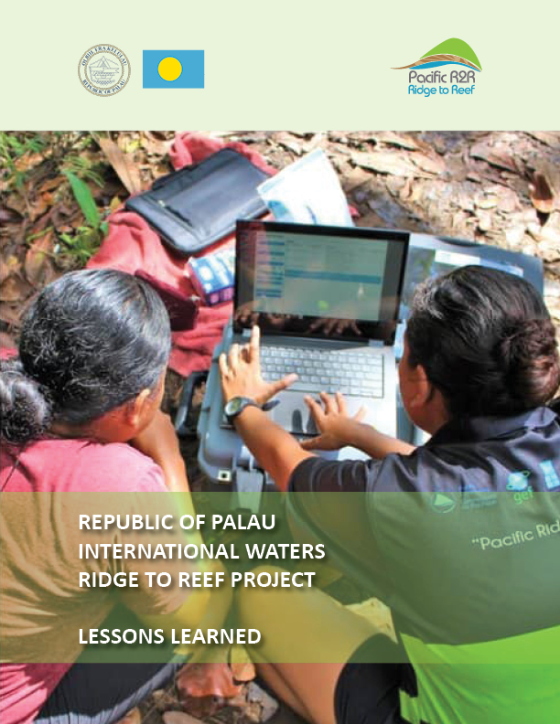
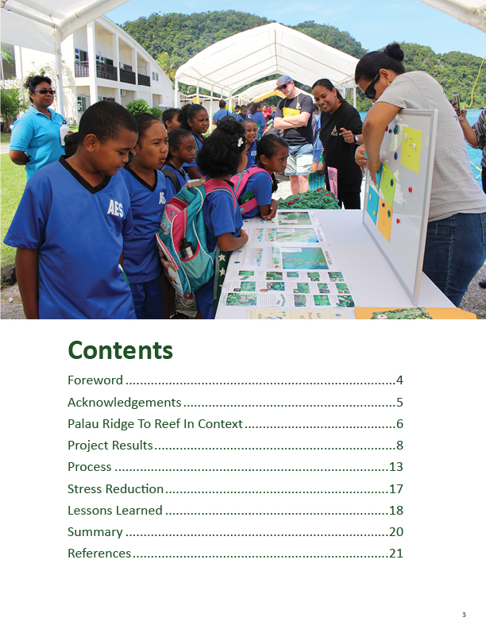

Slide 15
Next steps
Revise all current drafts using the new format
Reach out to countries for final opportunity to submit material (based on new format and with specific questions)
Plan for completion by end June
Timeline dependent on country submissions and national approval process

Slide 16
The R2R Technical Consultation is invited to:
i. Consider the status of lessons prepared by country project managers or national consultants, guided by the framework provided by RPCU to develop the lessons learned material;
ii. Discuss and provide clear advice on the proposed next steps towards the development and compilation of lessons learned into a publishable format; and
iii. Discuss and support the revised format for the Pacific R2R Programme Lessons Learned report.

