Slide 1
Pacific Islands Ridge to Reef National Priorities – Integrated water, land, forest and coastal management to preserve biodiversity, ecosystem services, store carbon, improve climate resilience and sustain livelihoods
Presentation to Regional Scientific and Technical Committee Meeting
Nadi
15-02-2021
Project name: RMI STAR R2R
Presenter: Francis Wele, Deputy Project Manager

Slide 2
Presentation Outline
Brief Project Background
Achievements To Date
Challenges
Lessons Learnt

Slide 3
Project Background
Five year (2017-2022) project with GEF grant of $3.9m
Using UNDP Direct Implementation Modality (DIM)
Support the Reimaanlok: National Conservation Plan
Three Components:
Component 1: Expanding and Sustaining RMI Protected Area Network
Component 2: Improved Governance for Integrated Atoll Management
Component 3: Knowledge Management
Five pilot sites: Wotho, Mejit, Likiep, Aur, Ebon
Project Partners: Mayors/MICS/IOM/CMI/HPO/Jojikum Youth Group
Currently undergoing mid-term review.

Slide 4
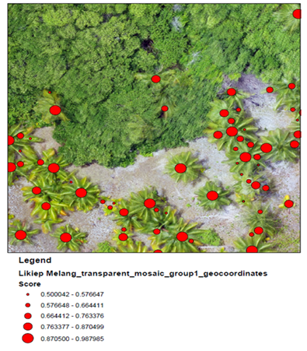
Achievements: To Date
Component 1: Expanding and Sustaining RMI Protected Area Network
Marine Survey
MICS and MIMRA conducted survey in Likiep and Mejit
Data Analysis: University of Guam using CoralPoint Count Software
Terrestrial Survey
Using drones
Support from University of Hawaii Spatial and Data Analysis Lab (SDAV)
Aerial Images: four sites (Aur, Mejit, Likiep and Ebon)
Using tree counting software and Orthomosaics maps- deliver high quality outcome
Identify target objects (fruit-bearing trees) with >85% certainty

Slide 5
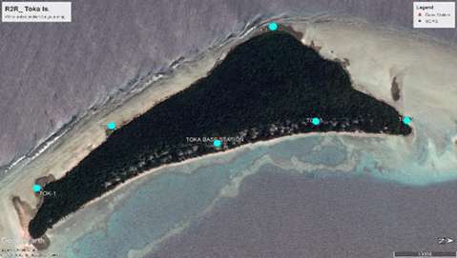
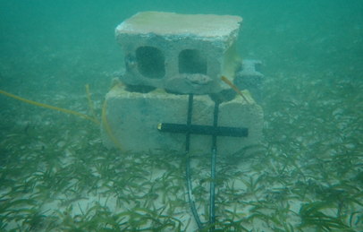
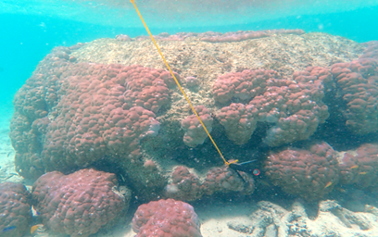
c) Flood Risk Assessment
Visual representation of sea level rise and impact
Geodetic survey: establish ground control points
Tide Gauges: providing mean sea level data with Info on tidal amplitude (from highest to lowest tide in a specific period of time- 3 months
Support work from the United States Geographical Survey (USGS) and PICASC to develop a flood risk model using various climate change scenarios of sea level rise
Notes:
Pacific Island Climate Adaptation

Slide 6
d) LEAP Survey: map community risk and develop local early action planning
e) National Spatial Analytic Facility: repository for Reimaanlok data
f) Regularize the PAN setup: Setting up of the office and role is to manage the Protected Area Network in all of RMI.
g) Agroforestry Certificate: College of the Marshall Islands develop a 15 Credit agroforestry course- 11 students attended and graduated from the course

Slide 7
Challenges
Travel restriction due to Covid
Inability for experts to travel
Inability for partners to travel to the country
Lack of qualified personnel in country
Transportation problems
Unforeseen circumstances: outbreak of Dengue Fever
Poor or Lack connectivity

Slide 8
Lessons Learnt
Covid changes way of doing business- adapt to the ‘new normal’
Difficult to meet set timelines for the project, need to think outside the box.
Absence of project staff on the ground impose great difficulty in progressing the work.
Build capacity and utilize local people.

Slide 9
Pacific Islands Ridge to Reef National Priorities – Integrated water, land, forest and coastal management to preserve biodiversity, ecosystem services, store carbon, improve climate resilience and sustain livelihoods
Presented by:
________, Program manager/coordinator
Presentation prepared by: ____________, _________
Photo credits
Layout Navneet Lal, Graphics and multimedia assistant
Template: Shaleh Antonio, CCMEA
References:
STAR Project Document
VINAKA
THANK YOU VERY MUCH

