Slide 1
USP-IAS Fiji R2R Project Component 2 Update
2nd R2R Regional Steering Technical Committee Meeting
15-17 February, 2021 – Nadi, Fiji

Slide 2
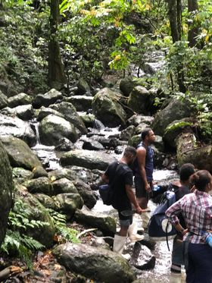
Tunuloa BIORAP and PA status consultations– a rapid biodiversity assessment, archaeological survey of the Tunuloa catchment and Mataqali consultations to confirm interest to formalize existing Terrestrial Protected Area
Field dates:
2-13 November 2020 – Fieldwork
Partnerships:
Ministry of Forestry, National Trust of Fiji, Fiji Museum, Cakaudrove Provincial Office, NatureFiji-MareqetiViti, Rabi Island Council

Slide 3
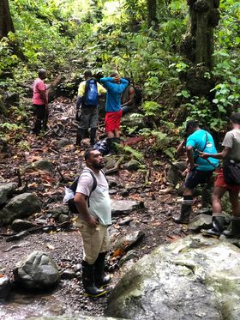
Bio-Rap overview
Flora:
Rare and threatened native species, especially the endemic species
Preliminary checklist of bryophytes; has not been done for this area
Vegetation mapping
Fauna: avifauna, mammals, Herpetofauna, and insects
Freshwater biodiversity: invertebrates and vertebrates
Archaeological survey: cultural significance of the study area

Slide 4
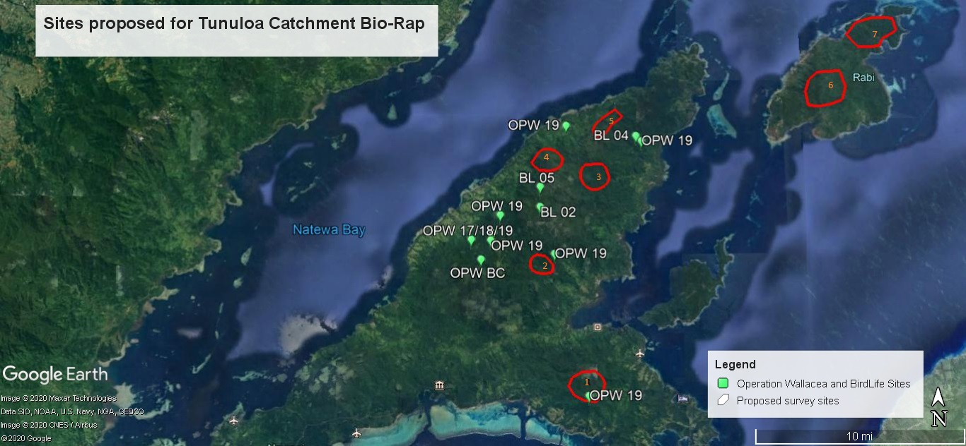
1. Dakuniba: Reported presence of Papilio natewa; highest peak on SE
2. Buca headwaters: lowland forest; water source for villages
3. Koroivonu headwaters: lowland forest; water source for villages
4. Wailevu: upland forest; highest peak
5. Navetau: upland forest; connected to Wailevu
6&7. Rabi: never previously studied; particular interest in Silktail presence, if any

Slide 5
Study Objectives
Document the different vegetation types and habitat types present in the Upper Tunuloa study area
Carry out a multi-taxa biodiversity assessment of the Tunuloa catchment
Carry out an associated archaeological survey to assess the time-depth historical cultural importance of the area
Discuss the community protected area status, mataqali commitment to the PA, benefits and any emerging issues arising from the PA.

Slide 6
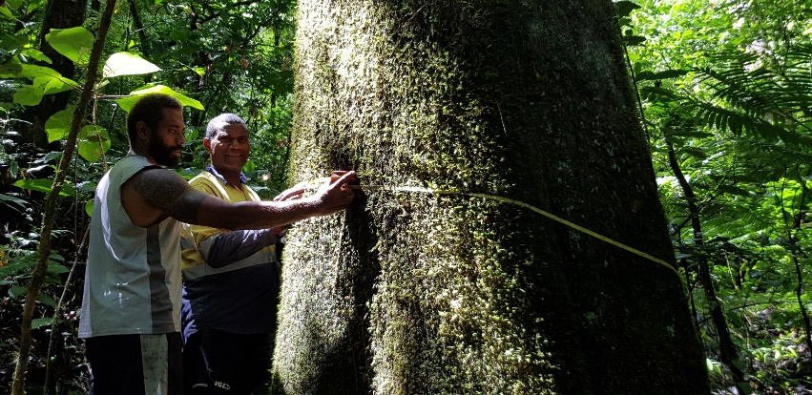
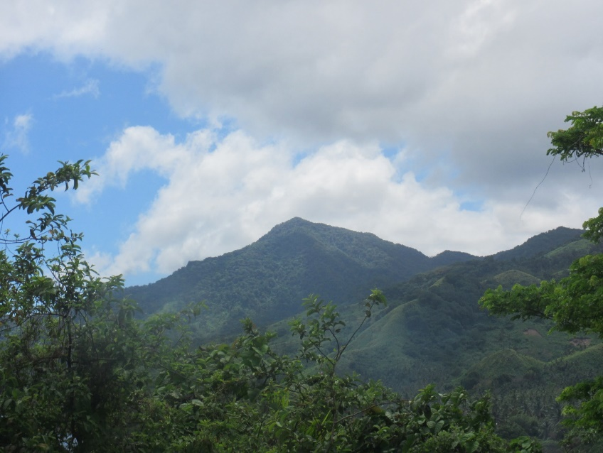
Vegetation survey
The assessment of the vegetation focused almost exclusively on the different forest types.
Slope and Ridge top - forested area found on slopes with gradients ranging from 10 to 85 degrees and those found on top or along ridges of mountains or ranges.
Flat - forested areas with gradients ranging from 0 to 10 degrees. These areas also included raised river flats and flood plains.
The quantitative assessments of different forest types-Tuiwawa (1999), uses between four and ten 10m x 10m plots to sample and record tree and other plant species along a transect.
170+ species of vascular plants (ACSmith)
Endemic-significant species present : e.g. Ma/Anita (Pterocymbium oceanicum) with dbh of 100+ cm

Slide 7
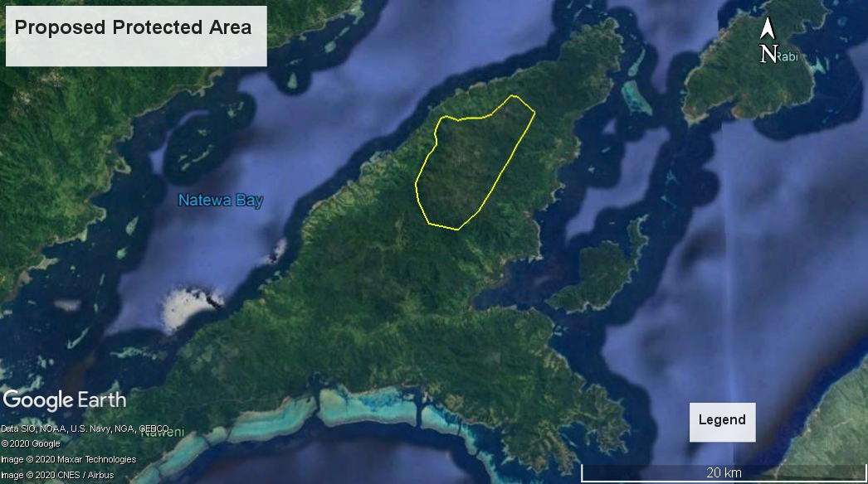
Proposed Protected Area – Natewa Tunuloa
(with remaining intact-virgin forest + ecosystem services)

Slide 8
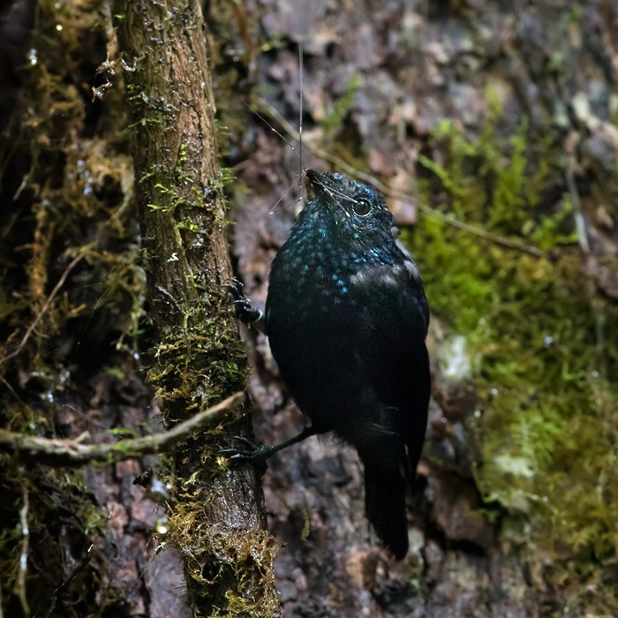
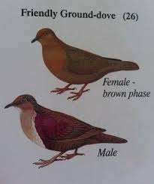
Bird surveys
Natewa – Tunuloa : 28 (Birdlife), 38 (Operation Wallacea), Bio Rap 2020 (34)
2 significant species: Natewa Silktail (Vu) + Friendly Ground-dove (Vu)
Natewa Silktail Habitat : Abundant in Lowland + Upland primary forest
Friendly Ground Dove: Lowland forest + Dry forest + Upland forest system
Rabi: 20 species recorded (no significant species)

Slide 9
Natewa Silktail Primary Habitat

Slide 10
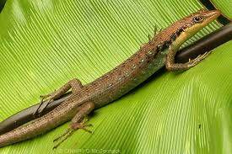
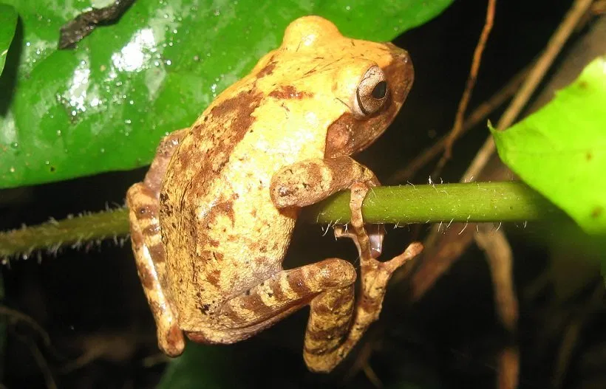
Herpetofauna surveys
Herpetofauna were assessed using sticky traps, night transect active search, and daytime active and opportunistic search. Sticky traps were placed at 50m intervals along a 1km transect and left overnight.
Natewa Tunuloa
16 different species- 4 were endemic, 9 were native and 3 were introduced species.
A significant find was recorded at the Buca headwaters where the skink Emoia Trosulla was found. This particular species was thought to be extinct from Vanualevu and Viti levu due to predation from Rats and mongoose.
The presence of the Fiji ground frog, and the skink E.trossula of particular conservation interest and highlights the need for more research and monitoring..
Rabi
13 species- 3 were endemic, 7 were native and 3 were introduced species.
This would be the first records of terrestrial herpetofauna on Rabi island.

Slide 11
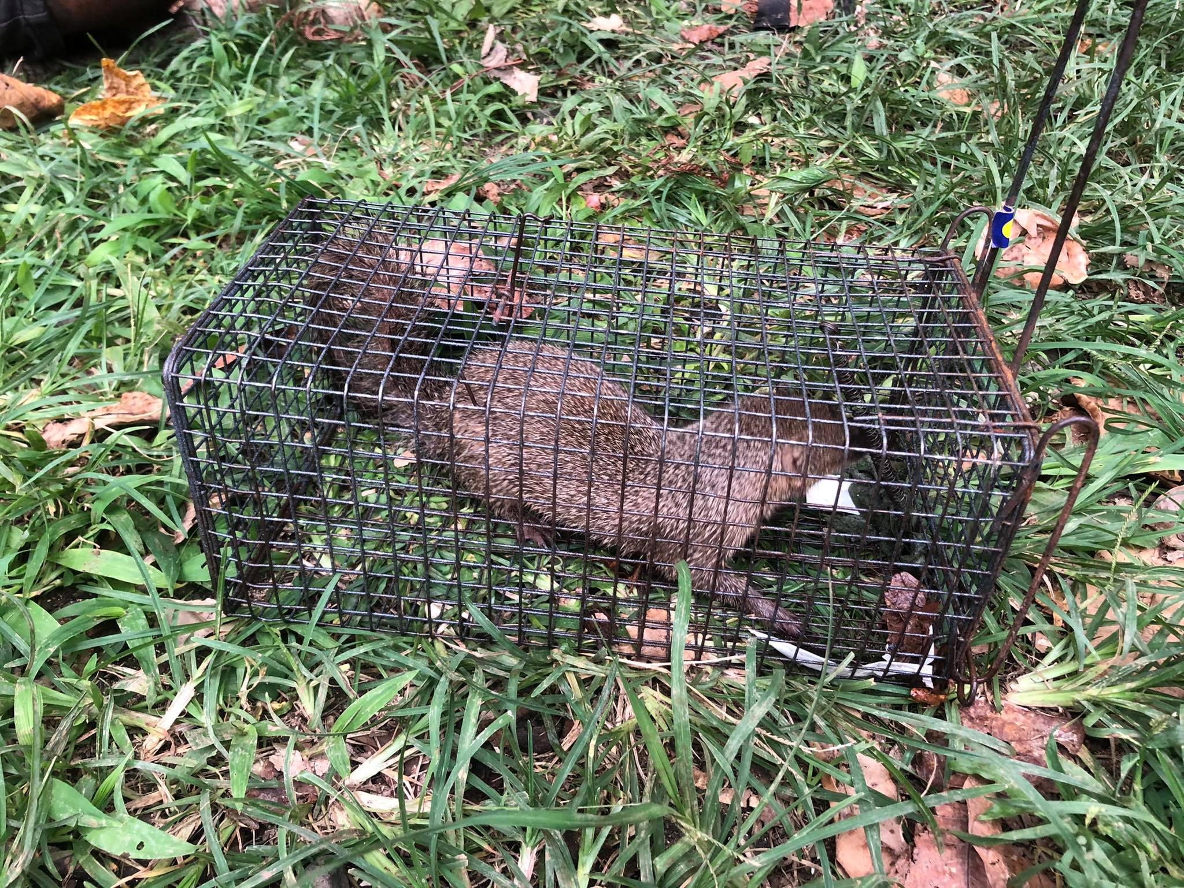
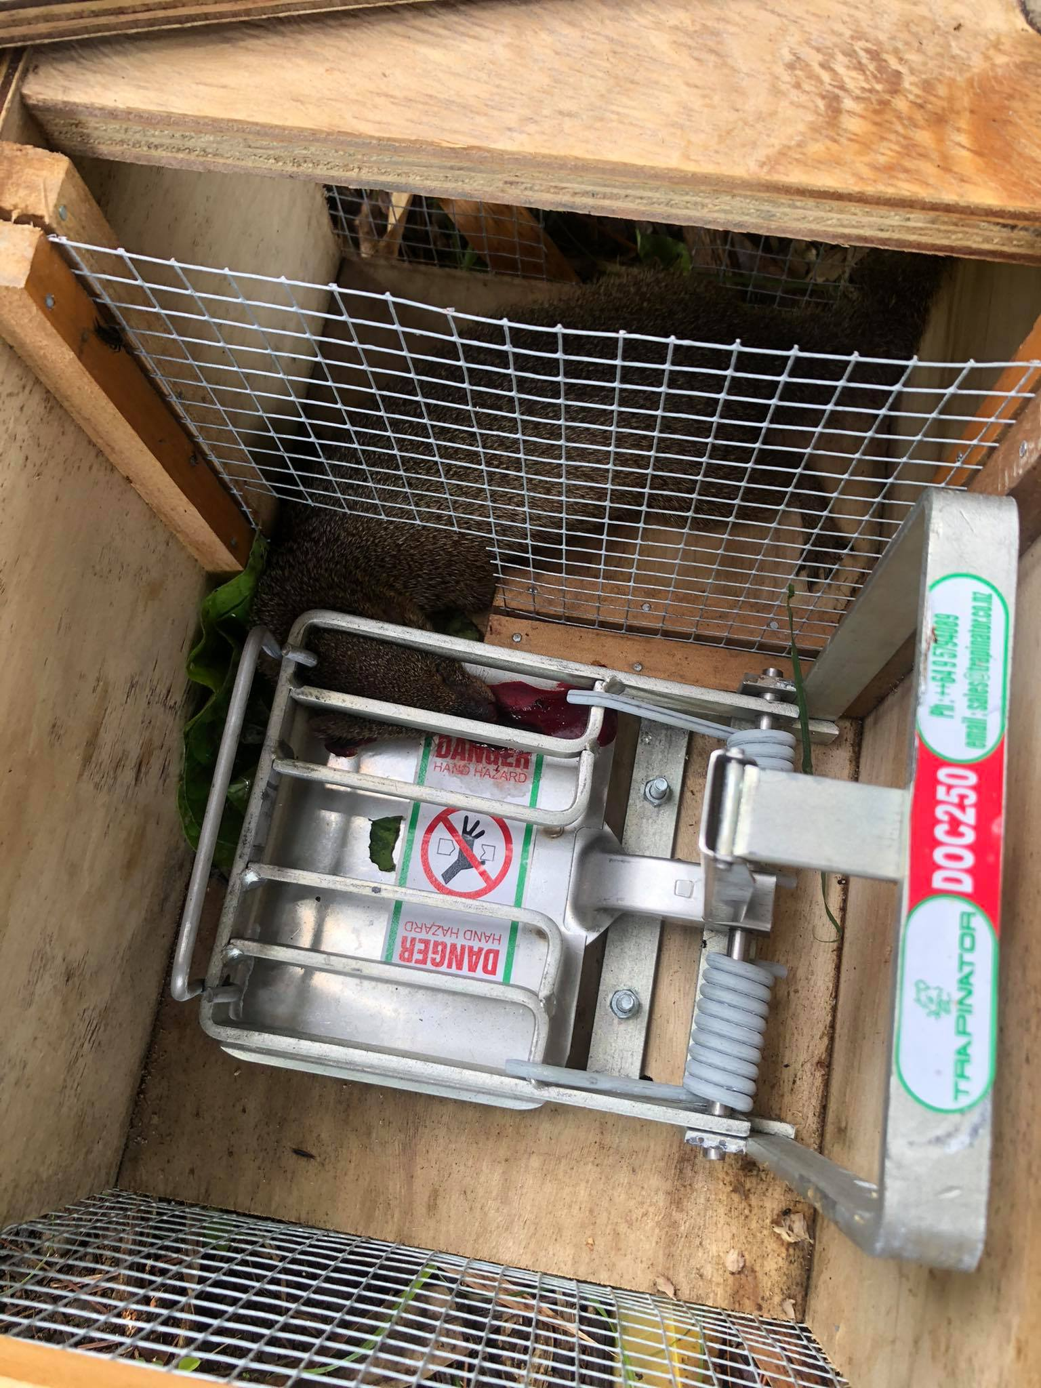
Mammals survey
The mammal surveys followed the methods developed by the Pacific Invasive Initiative (Resource Kit for Rodent and Cat Eradication).
The trapping stations were placed together with the herpetofauna survey stations. Each station contained two snap traps and a mammal cage baited. A total of 16 stations were established, 50m apart, to cover a large section of the different sampling localities
Increasing numbers of invasive mammals to the ridge.
Mongoose recorded in Rabi with previous surveys highlighting very little numbers.
Presence of both bat species (P. tonganus & P. samoensis) in the Tunuloa and Rabi study areas.

Slide 12
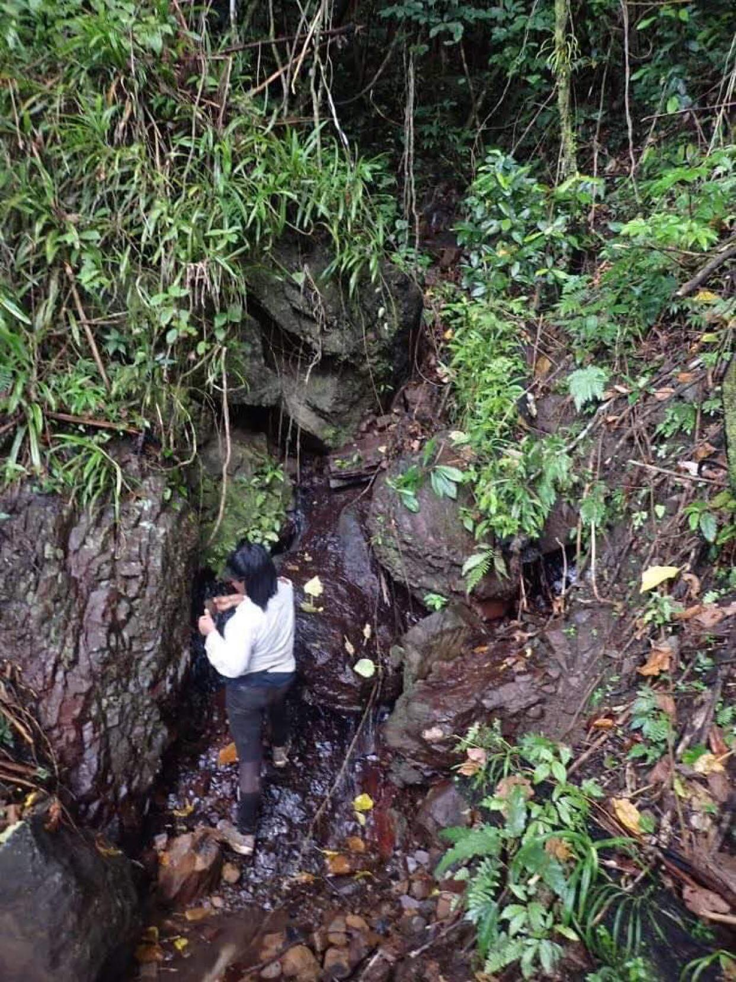
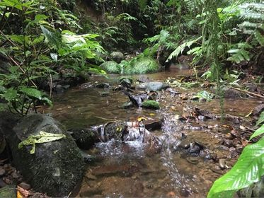
Freshwater surveys
A Smith-Root LR 24 backpack electro fisher used & standardized electrofishing effort of multiple habitat types that include run, ripples and pools. Stunned fish were collected using hand nets and a hand held beach seine net (1 mm² mesh) for sorting and identification.
Gobies previously reported in Buca river was found in Colo-Levu- endemic Orange-Spotted Scaleless Goby, Schismatogobius chrysonotus.
A nesobasis hotspot- genus of damselflies endemic to Fiji.
The streams draining the forest systems within the designated boundaries supported a good diversity of target species.

Slide 13
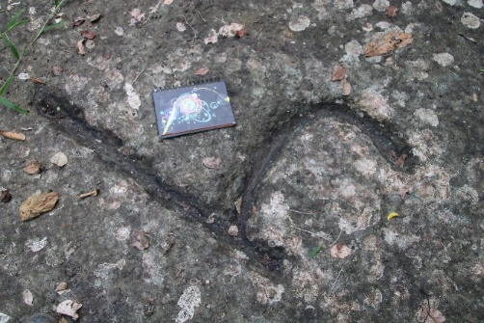
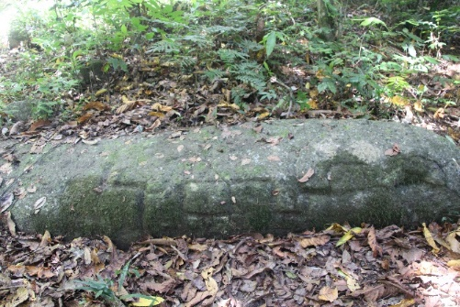
Archaeological Survey
Natewa – Tunuloa : 12 sites previously documented by the Fiji Museum (1938, 2012, 2015, 2016).
A total of 21 sites mapped in 2020
most are fortification features (ridge ditch or trenches cut perpendicular to the ridge line)
Hill forts
Old village sites
Sacred sites
Cave burials (Ivakasara)
Chiefly burial mound (Sautabu)
Cemetery
Petroglyphs
Historical
Mythical and
Ancestral mound (Yavutu)
Rabi: 14 sites all of which are hill fortification features
Petroglyphed stones at Dakuniba

Slide 14
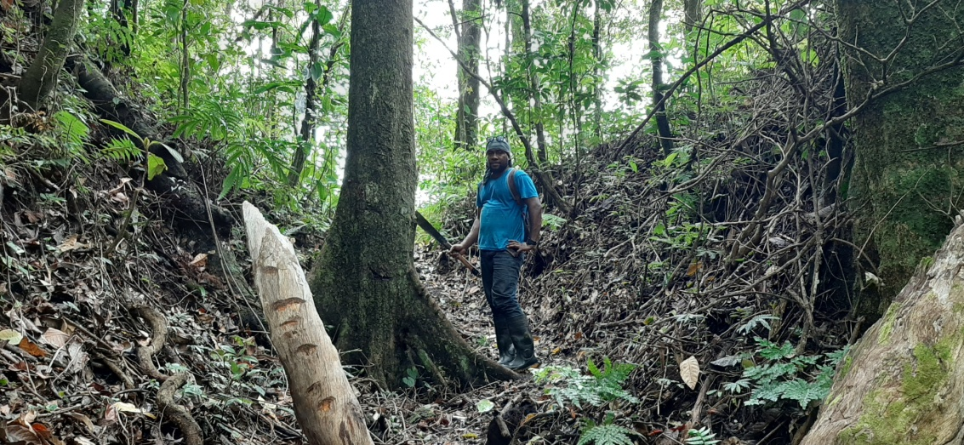
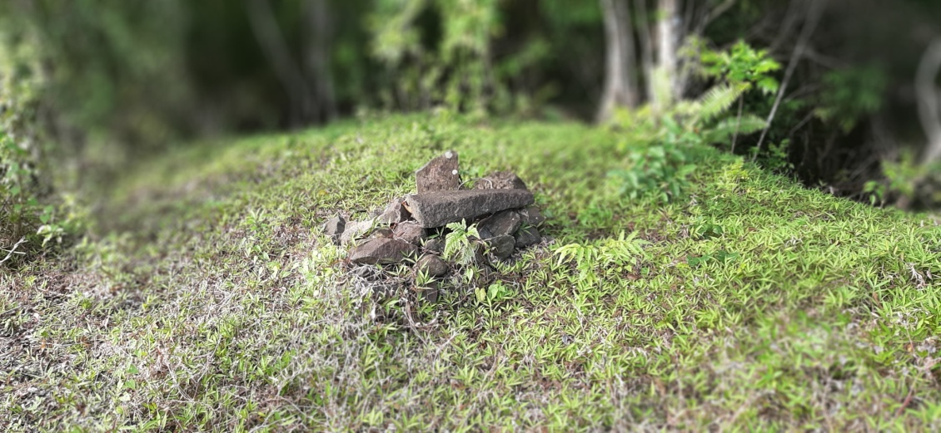
Remains of the Lalagavesi, Vunisavisavi village
Ridge-ditch, Muana Village
Burial, Dakuniba Village

Slide 15
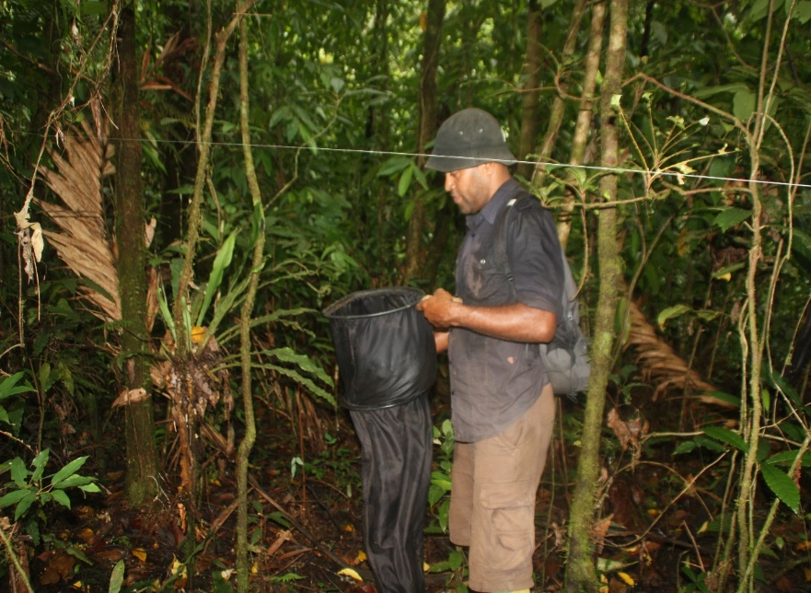
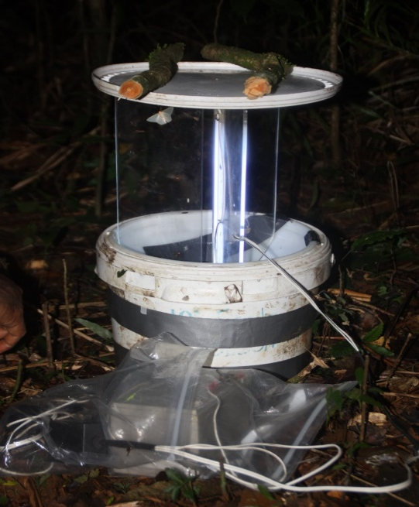
Entomology surveys
Key habitat types (i.e. within gully, slopes and ridges) with 50m transects sampled within each vegetation sub-plots and leaf litter sampling was undertaken at 50m intervals using 1m² quadrats. Nocturnal surveys targeting night active insects were sampled using light traps.
A total of 682 insects were sampled from the different sampling techniques employed. The most abundant taxa sampled were the Coleoptera (beetles) recording 21 families sampled within the assessment areas.
The richness of Coleopteran families within the sampled sites suggests that the forest system is in good health.

Slide 16
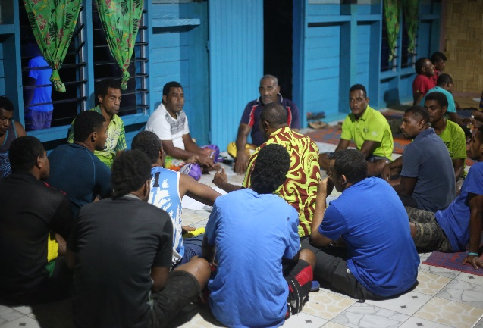
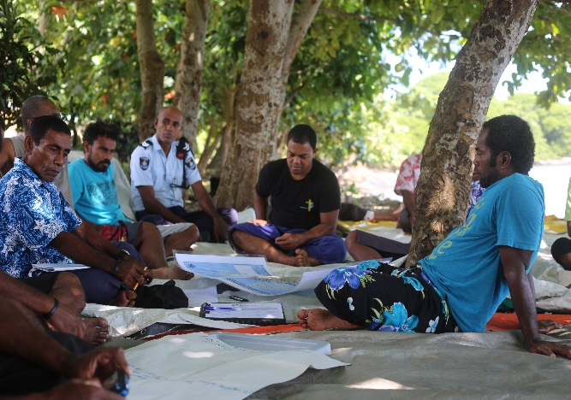
Community consultations to formalize terrestrial Protected area
The consultations targeted the 11 mataqali’s in the Peninsula that signed the community agreement with BirdLife International to protect 600ha of primary forests.
Key benefits from the CCA highlighted by the different Mataqali’s during consultation were:
Increased biodiversity (terrestrial and marine ecosystems)
Increased soil fertility
Improved water supply to villages (quality and quantity)
Assistance through alternative livelihood projects
Some of the key challenges raised across the different mataqali's were:
Land tenure ship and Protected Area management
Natural resource impoverishment
Livelihood interventions - status, scale, management and effectiveness

Slide 17
Vinaka

