Slide 1
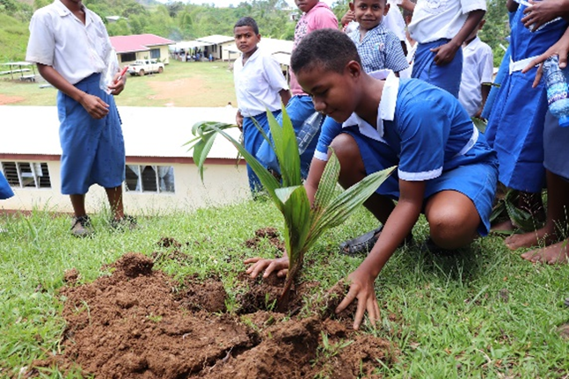
Project Title: Implementing a Ridge to Reef approach to Preserve Ecosystem Services, Sequester Carbon, Improve Climate Resilience and Sustain Livelihoods in Fiji
Presentation by: Sustainable Forests and Landscapes Management Pillar, SPC Land Resources Division
15th February 2021

Slide 2
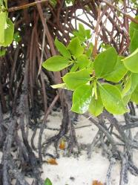
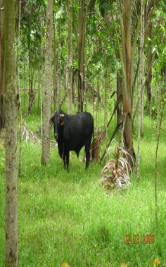
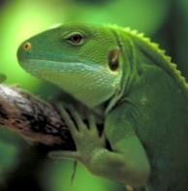
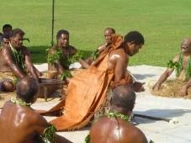
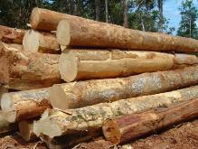
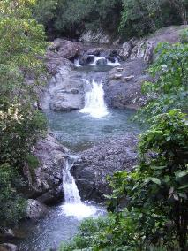
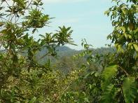
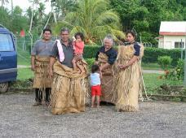
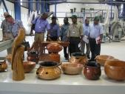
BACKGROUND
FORESTS & LANDSCAPES
SOCIAL, CULTURAL & HEALTH BENEFITS
ECONOMIC BENEFITS
ENVIRONMENTAL SERVICES
(also including carbon sink & sequestration)

Slide 3
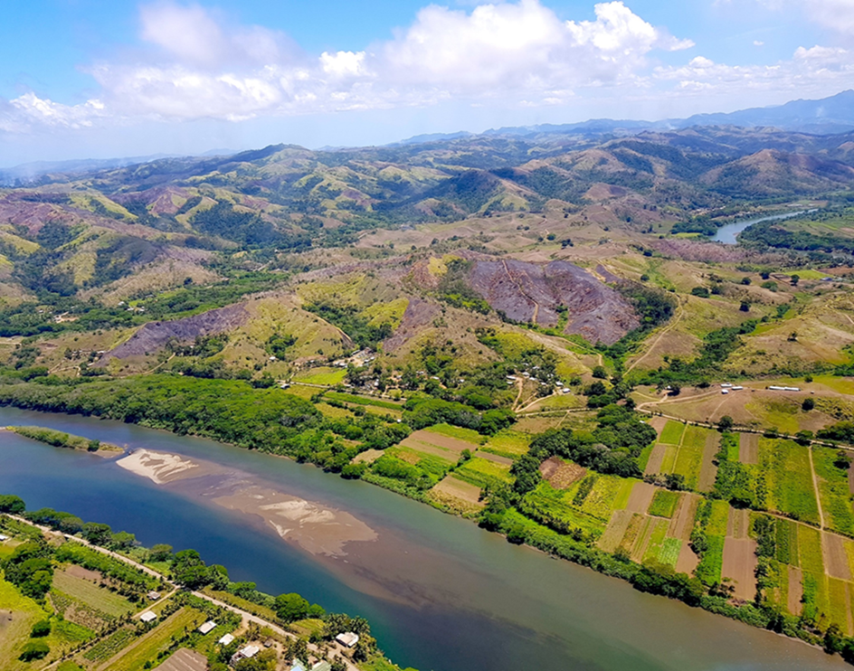
Background –Management Issues
DEFORESTATION, FOREST AND LAND DEGRADATION
  Unsustainable logging and land use practices
  Impacts of natural events
  Impacts of climate change
  Impacts of Fires
  Impacts of invasive species
INEFFECTIVE RESOURCE MANAGEMENT
  Outdated legal & policy framework
  Lack of or inadequate capacity & resources
  Lack of Land Use plans leading to unco-ordinated development activities
  Lack of up to date data (forest area, degraded areas etc)
Please insert a relevant image
Photo credit: Dr Robin Yarrow

Slide 4

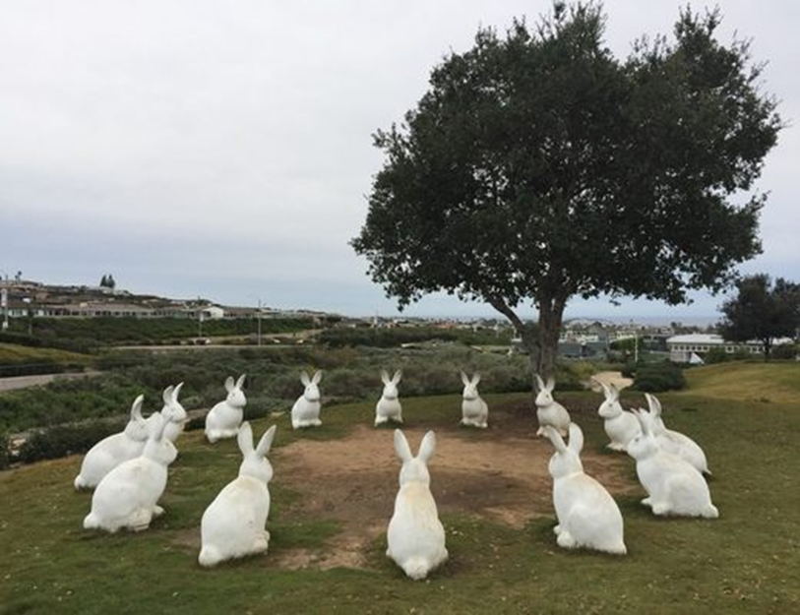
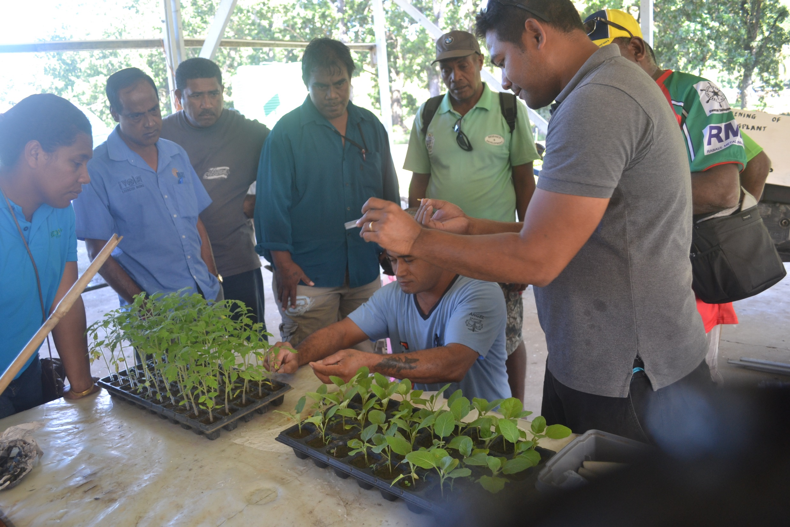
Opportunities
International conventions and treaties, SDGs, Bonn challenge, etc
Regional and national priorities
SPC, LRD development goals and objectives
Commitments
Sustainable Landscapes
Prevent Biodiversity Loss
Adaptation and Mitigation to Climate Change
Economic development
Food security and livelihood
Natural Resources
People

Slide 5
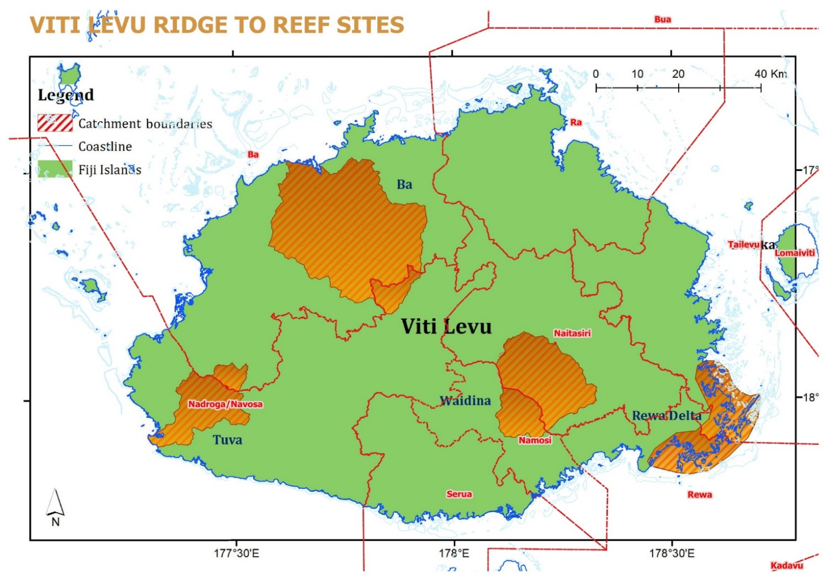
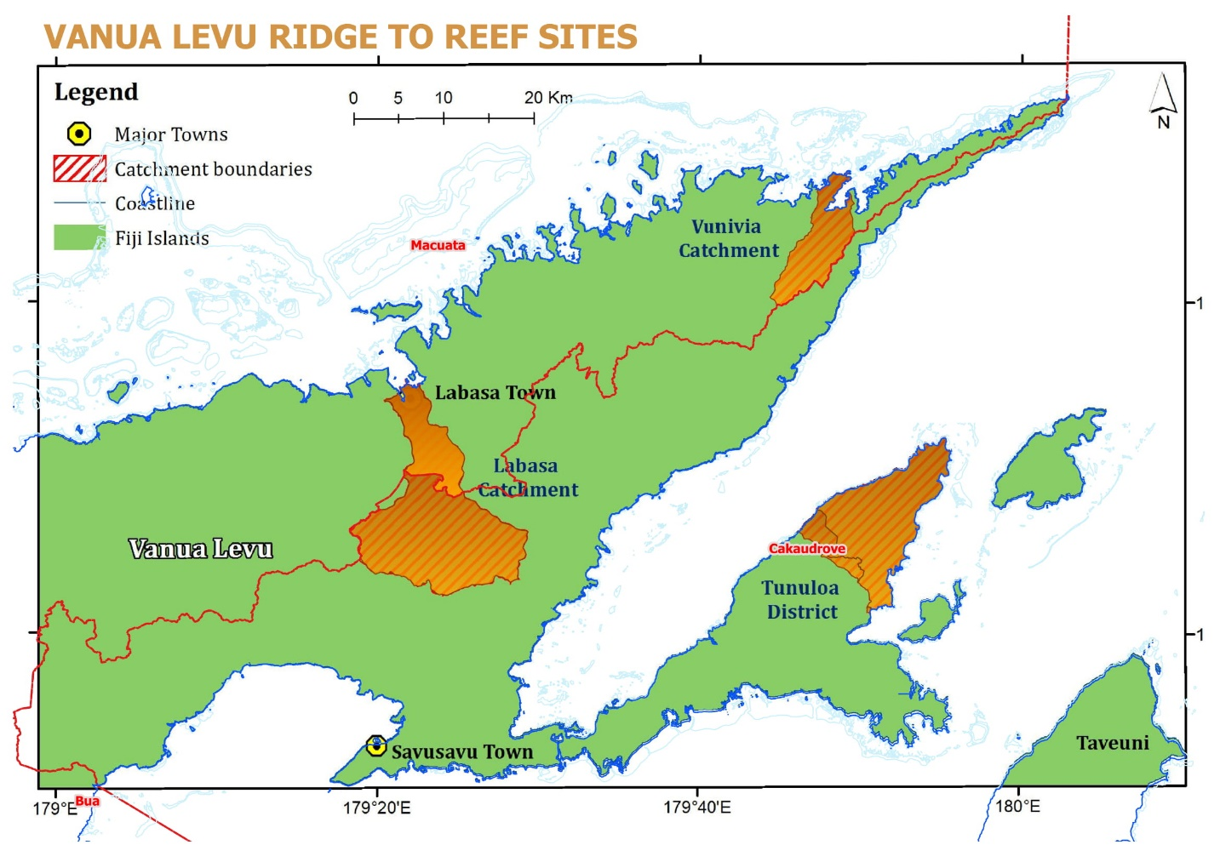
Project sites
1
2
5
3
4

Slide 6
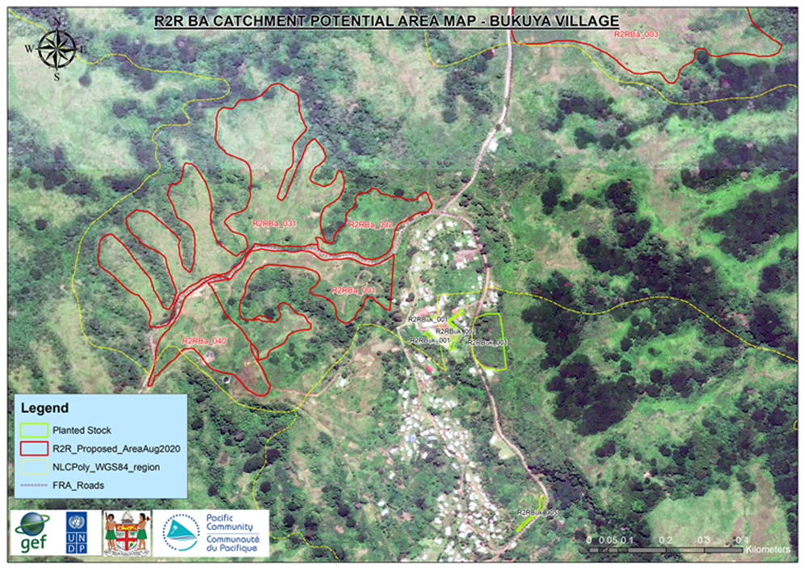
Addressing the issue – Participatory land use planning
Participatory and inclusive Land Use Planning
Development of reforestation plans
  Enrichment planting
  Protection planting
  Assisted Natural Regeneration
  Production planting (Fruit orchards, woodlots)
  Agro Forestry

Slide 7
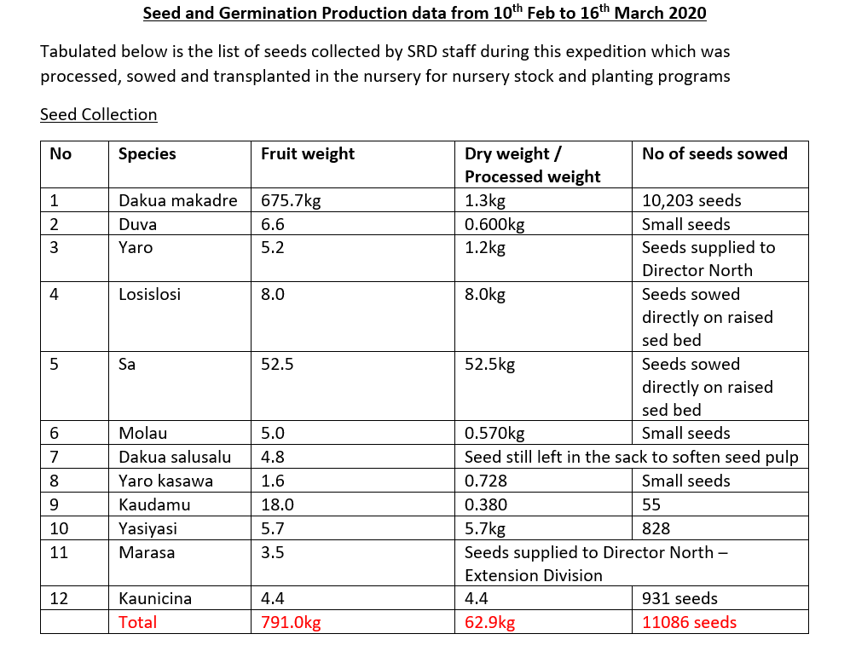
Addressing the issues - Seed technology
Phenology Surveys
Seed technology trainings
Tree climbing and seed collection trainings to centralise activity
Development of protocols for long term storage of tree seeds

Slide 8
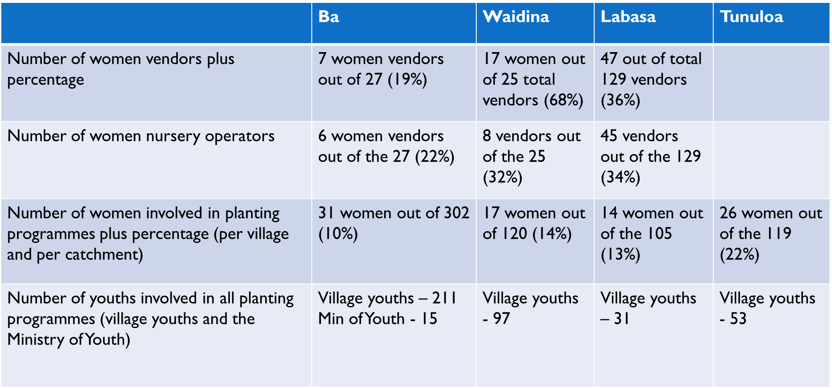
Addressing the issues - reforestation

Slide 9
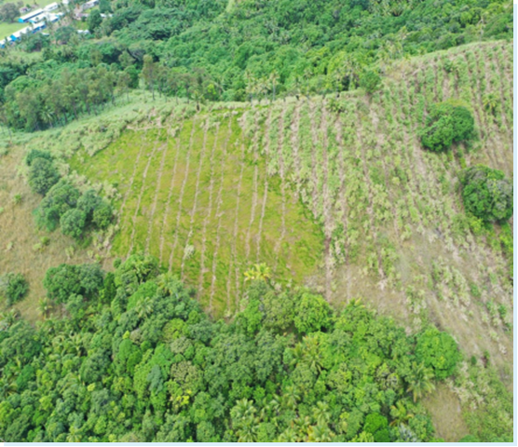
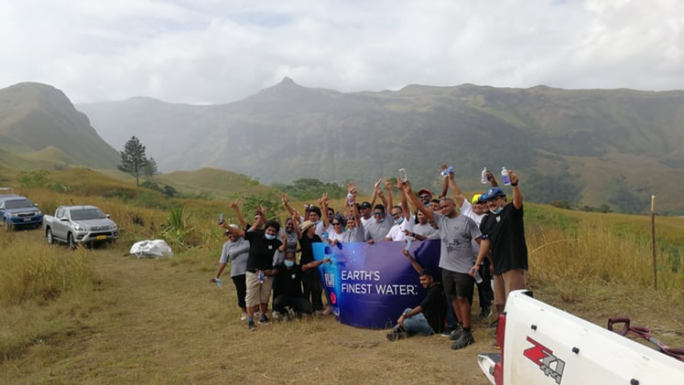
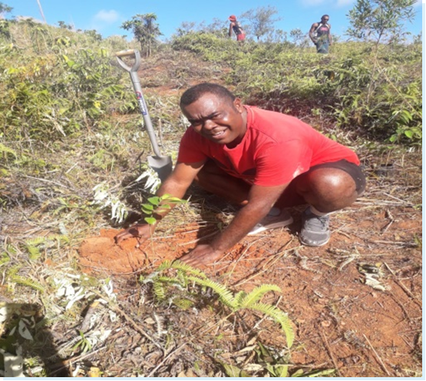
Reforestation in Partnership with communities, government and private sector
FIJI Water Ltd assisted with reforestation work in the lower and mid catchment
Opposition Member of Parliament leading his community with tree planting activities

Slide 10
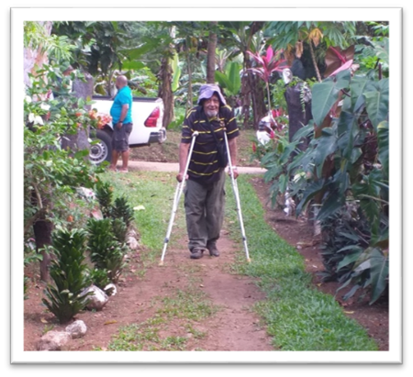
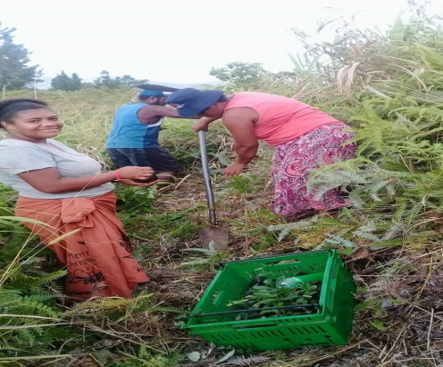
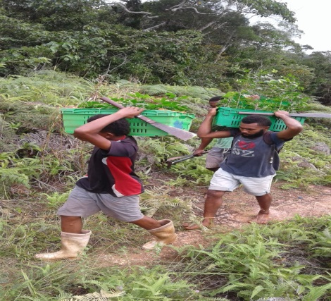
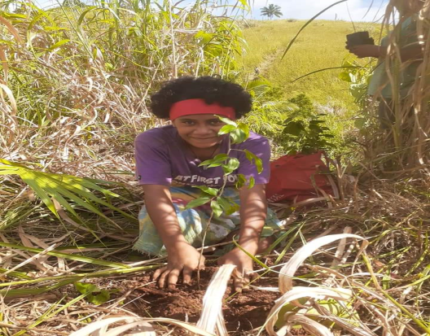
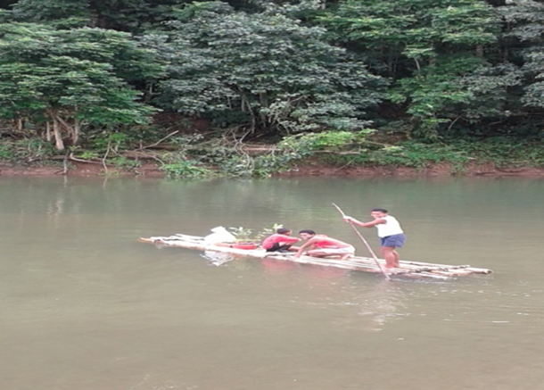
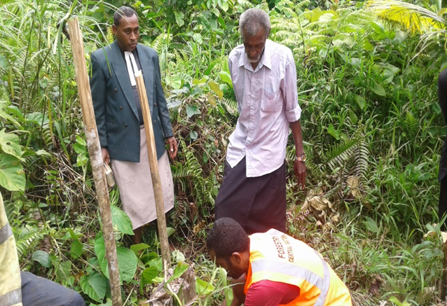
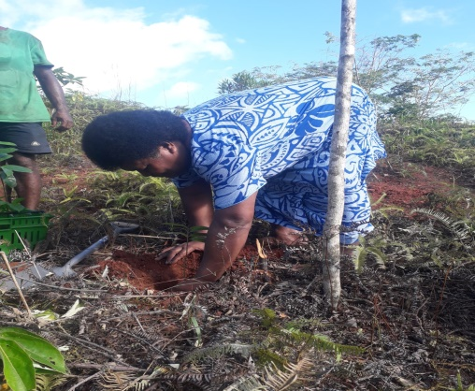
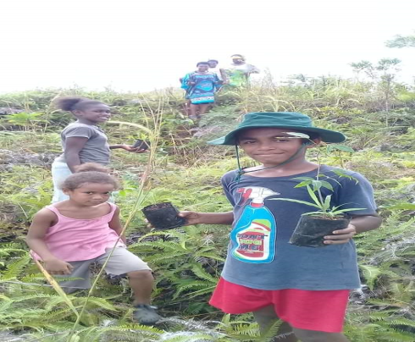
Inclusive community engagement – Men, women, Youth, children, disabled and the church

Slide 11
Addressing the issues - Policy and regulatory frameworks
under review
  Forestry Bill
  Forest harvesting Regulation
  Fiji Code of Harvesting Practices
  Sawmilling regulation 1992
  Timber Preservation regulation (1985)
  Value adding facilities
Under development
  Code of Practice for Wood Processing
  National Strategy for Non Wood utilisation
  Monitoring Protocols for COHP

Slide 12
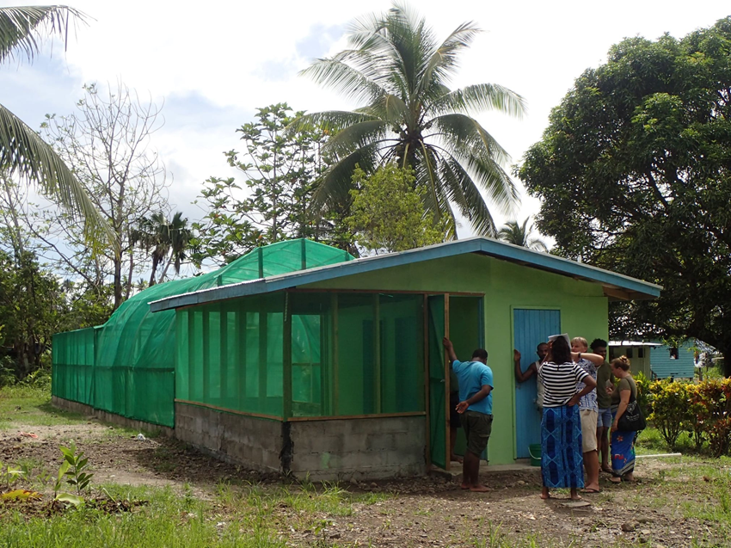
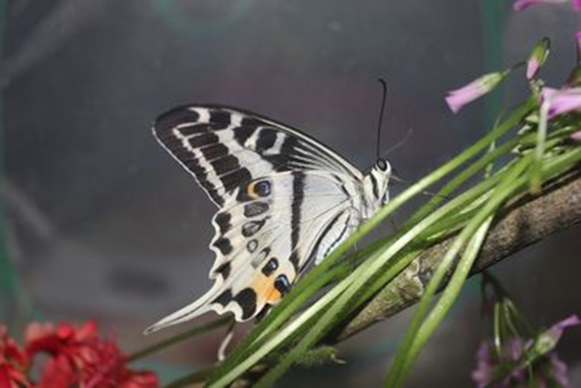
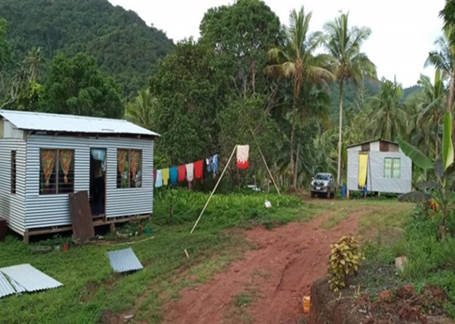
Addressing the issues - Livelihood programmes
Seedling Vendor – Mr Viliame Tamanitoakula
1st PO - $14,000.00
2nd PO - $9000.00
4 houses have been built
Vusaratu, tourism center, butterfly breeding house and
tree nursery

Slide 13
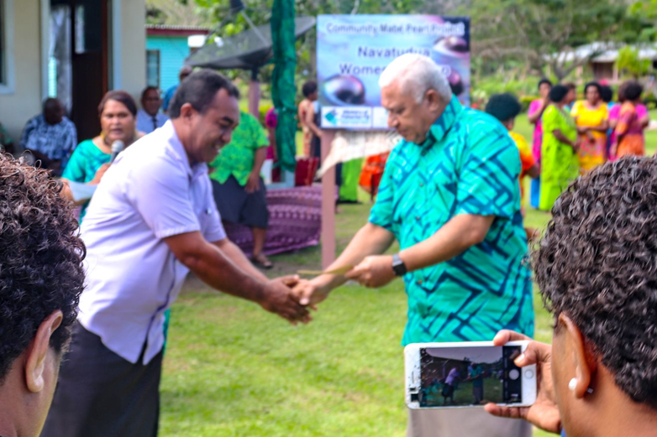
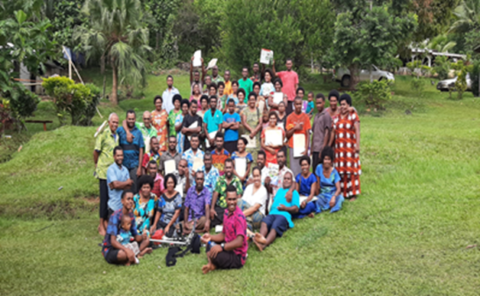
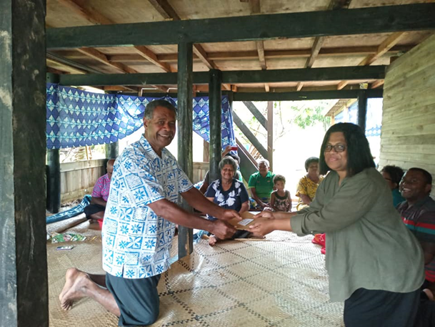
Addressing the issues - livelihood
Division | Number of communities | Amount Paid FJD
Northern | 16 | 22,322.75
Western | 3 | 19,393.63
Central/Eastern | 5 | 10,500.00
TOTAL | 24 | 52,216.38

Slide 14
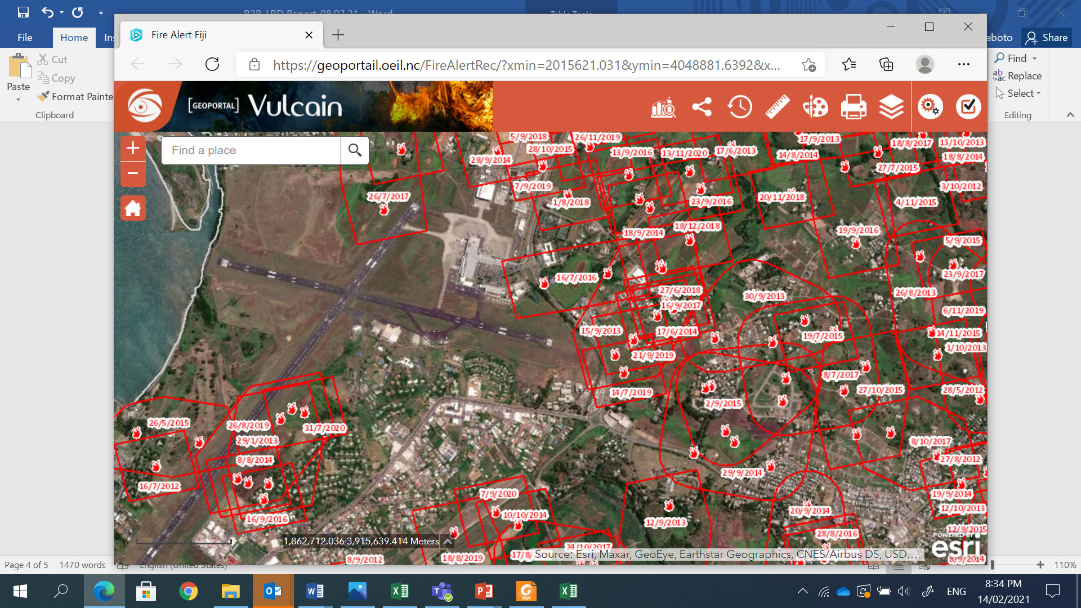
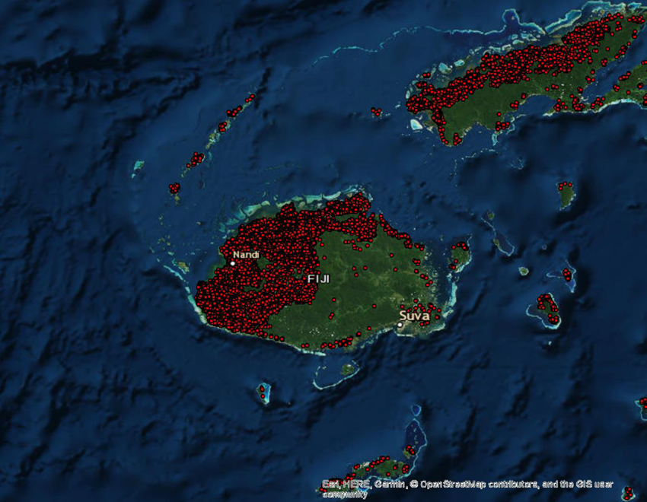
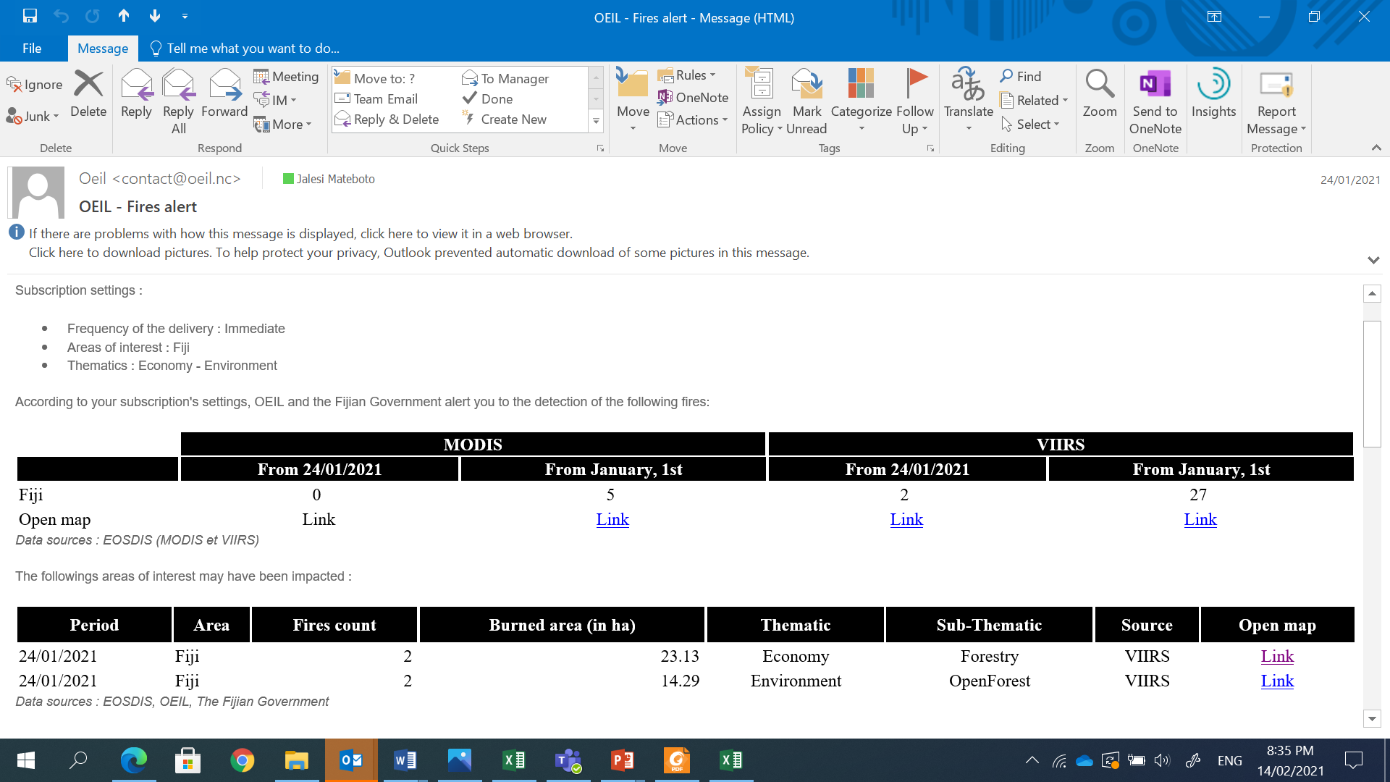

Addressing the issues – fire alert & Monitoring system

Slide 15
Lessons learnt
Community based resources management involves different ways of thinking and working.
  It requires looking after the people, noting their long term views, taking account of the social, economic, environmental and cultural effects of decisions, and encouraging participation and partnership, the awareness, education and organization of stakeholders, and the winning of trust
  Understanding of the sites, history, soil types, ph level, rainfall, species suitability, threats etc
  Linking of initiatives to the community development plans and alignment of projects to government priorities

Slide 16

Thank You

