Slide 1
Pacific Islands Ridge to Reef National Priorities – Integrated water, land, forest and coastal management to preserve biodiversity, ecosystem services, store carbon, improve climate resilience and sustain livelihoods
General Highlights & Updates
Sam – Program Coordinator

Slide 2
Regional IW R2R
27 outputs
10 outcome indicators
Project components
5 components
National Demonstrations to support R2R ICM/IWRM approaches for island resilience & sustainability
Component 1
Island-based investments in human capital & knowledge to strengthen national & local capacities for R2R ICM/IWRM approaches, incorporating CCA
Component 2
Component 3
Mainstreaming of R2R ICM/IWRM approaches into national development planning
Component 4
Regional & national R2R indicators for reporting, monitoring & adaptive management & knowledge management
Component 5
Ridge to Reef regional & national coordination

Slide 3
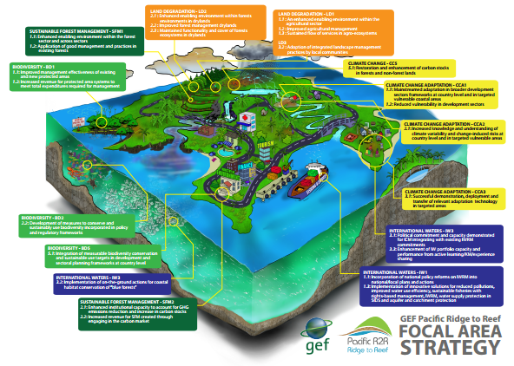
Guide questions
How are the research findings contributing the success rate of the country project contributions to the overall GEF Pacific R2R Programme? Say something on short-medium impacts and benefits to local communities.
Identify priority challenges and suggest possible mitigation measures?
Discuss possible lessons learned (from conceptual design to analysis of results & reporting) that could be further explored as regional strategic lessons useful in the consideration of upscaling future R2R investments?

Slide 4
Outcome 1.1Successful pilot projects testing innovative solutions involving linking ICM, IWRM & CCA (linked to STAR via larger Pacific R2R network)
Baselines & scoping
Rapid assessment of priority coastal area (RapCA) reports.
14 national projects are in various stages of testing or demonstrating methodologies and processes that contribute to their respective stress reduction targets.
Approved revised national logframes (incl. end of project targets) to ensure relevance and alignment with current national priorities and opportunities.
Approved revised national MYCWP & budget.
Notes:
Let me take you through details of key outcomes in brief relevant to the work of the RSTC

Slide 5
Outcome 1.2: National diagnostic analysis for ICM conducted for prioritizing and scaling up key ICM/IWRM reforms and investments
Diagnostic analysis for ICM planning
Site diagnostic analysis reports
Island diagnostic analysis reports
Spatial prioritization procedures for characterizing & prioritizing coastal areas closed to completion
Published the procedures and with trials continuing
Published the regional guidelines to implement the procedures

Slide 6
Outcome 3.1: National and regional strategic action frameworks for ICM/IWRM endorsed nationally and regionally
National state of the coast reports
National strategic action framework
Regional strategic
Strengthening and improving domestic planning frameworks reflecting R2R best practice and investments supported by other external fund sources.
SPC notes that actual harmonization is beyond the project scope as this encroaches on national policy-making processes.
Notes:
The technical document that informs the formulation of Strategic Action Framework is available. The project plan to support the formulation of six State of the Coast Reports by the end of the project.

Slide 7
Outcome 4.2: National & regional platforms for managing information & sharing of best practices & lessons learned in R2R established
Website upgrade currently underway.
Further updates on details supporting this outcome will be covered during sessions – e.g. communications capacity-building efforts, R2R advocacy, participatory M&E, IW: Learn twinning and exchange activities
Pacific State of Coast Spatial Data Infrastructure for the Pacific Ridge to Reef Programme is now accessible online, http://r2r.spc.int/
- science portal and spatial data infrastructure officially launched at the 6th RSC meeting, October 2020.

Slide 8
Outcome 5.1: Effective program coordination of national and regional Ridge to Reef projects
Staffing & Consultants.
Results-based monitoring system (MTR, Terminal Evaluation)
Virtual support & strengthen capacity of national PMUs or support PSCs.
Reflection & planning workshop
Service delivery to clients and project countries

