Slide 1
Tonga IW R2R Pilot Project
Subregional Cluster Meeting
Suva, Fiji
13th – 15th November, 2017
Notes:
Insert your country name
Insert your department logo next to SPC logo

Slide 2
Presentation Outline
Management Arrangement
Project Sites on Map of Tonga
Site Specific
Coordination Mechanism
Components Output & Status
Partnership Established
Challenges So Far
Photo Journal
Notes:
Please add in the details asked for and any other interesting information

Slide 3
Niue IW R2R Project Management Arrangements
Lead Agency | Natural Resources Division
MOA Signed | 1st September, 2016
R2R Focal Point | Department of Environment
IW Project Manager | Silia Leger
Pilot Project Site | 4 Project Sites
Notes:
Please add in the details asked for and any other interesting information

Slide 4
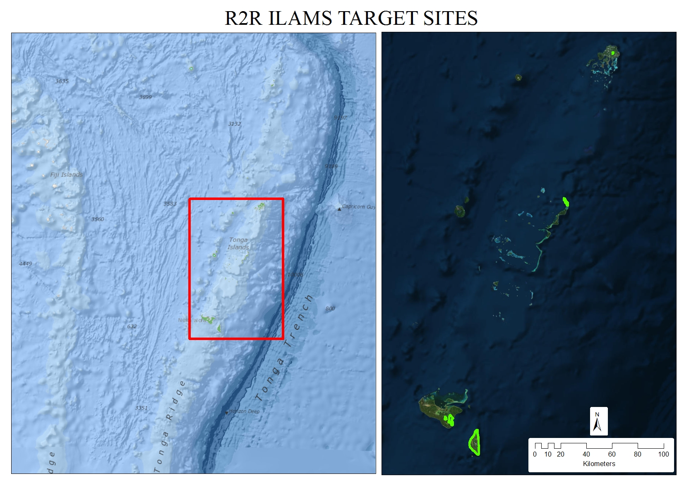
Project Sites in the Map of Tonga
Notes:
Insert a map and photos of demo project site

Slide 5
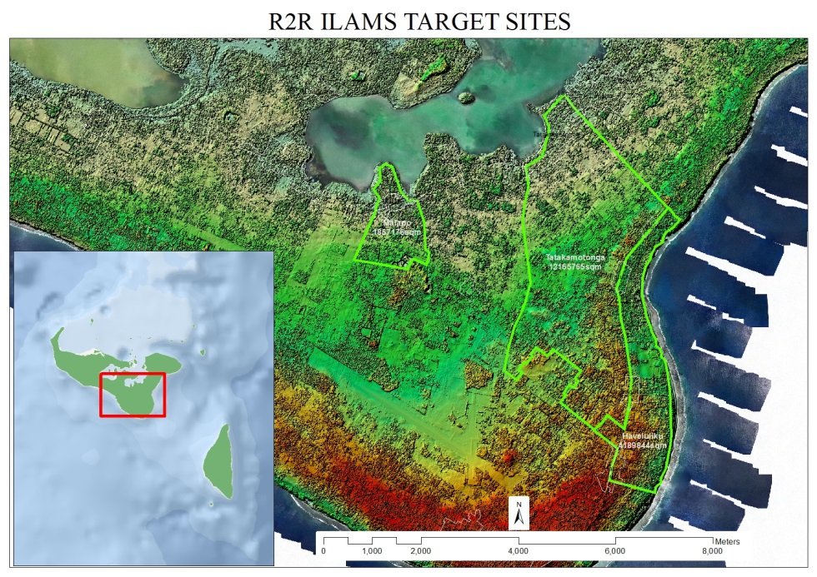
Pilot Project Site – Haveluliku (Tongatapu)
Notes:
Insert a map and photos of demo project site

Slide 6
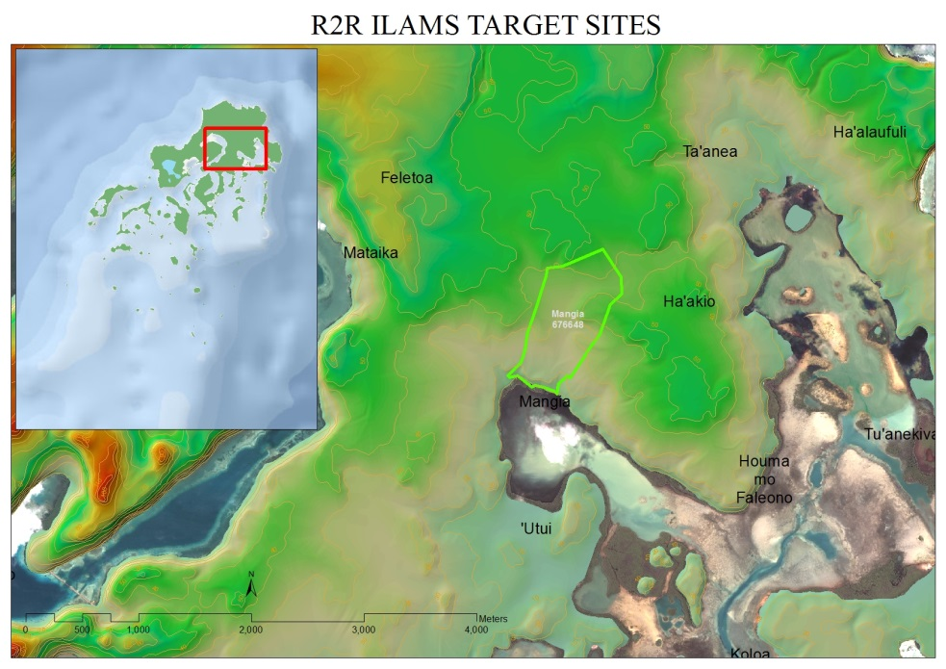
Pilot Project Site – Mangia, Vava’u
Notes:
Insert a map and photos of demo project site

Slide 7
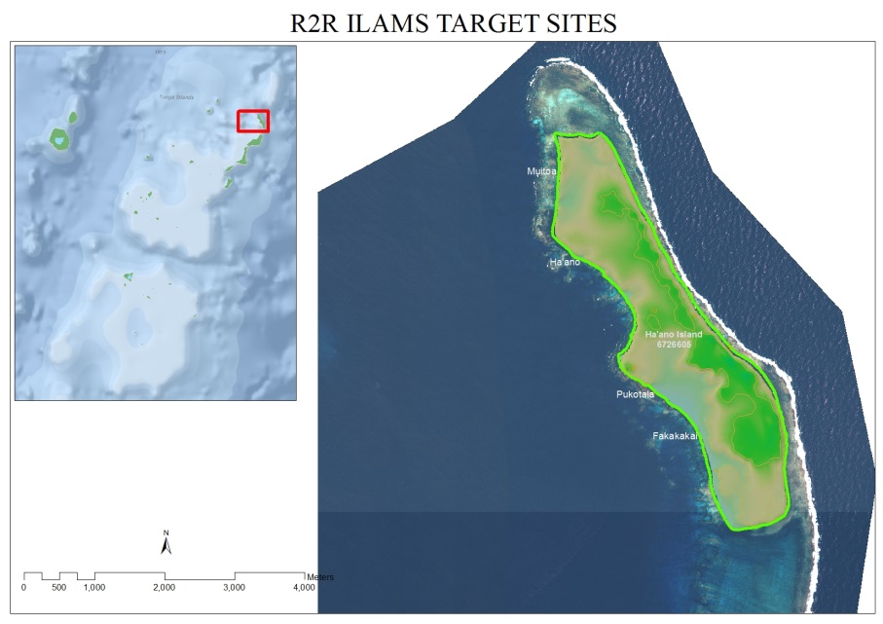
Pilot Project Site – Ha’ano, Ha’apai
Notes:
Insert a map and photos of demo project site

Slide 8
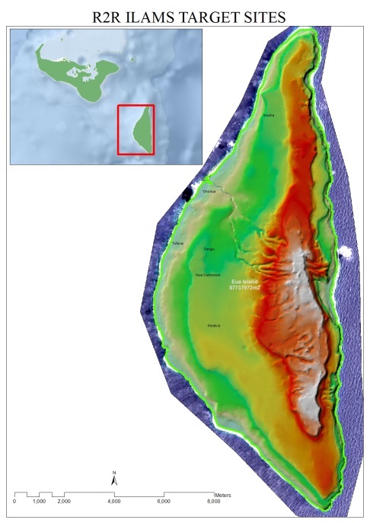
Pilot Project Site – Ta’anga, ‘Eua
Notes:
Insert a map and photos of demo project site

Slide 9
Coordination Mechanism
Combining the Committees of ILAM & STAR
Ministry of Lands, Survey & Natural Resources
Ministry of Health (CEO)
Ministry of Internal Affairs (CEO)
Ministry of Agriculture, Food & Forestry (CEO)
Ministry of Education and Trainings (CEO)
Ministry of Tourism (CEO)
Ministry of Infrastructure (CEO)
Fisheries Department (CEO)
Environment Department (Director)
National Spatial Planning Office (Director)
ILAM PM
R2R National PM
IW R2R PM
Notes:
Insert the name of your inter-ministerial committee – if you also have a project demo committee include a separate slide for this
Insert ALL the members of your inter-ministerial committee
Provide an organogram (picture) of how the committee is structured, including linkages with the STAR project where applicable. (RMI structure is used here as an example, please delete and insert your own).
Place the organogram on a new slide if it will not fit nicely

Slide 10
Coordination Mechanism
Cabinet (Ministers)
National Advisory Committee (CEO Levels)
Technical Working Committee
Notes:
Insert the name of your inter-ministerial committee – if you also have a project demo committee include a separate slide for this
Insert ALL the members of your inter-ministerial committee
Provide an organogram (picture) of how the committee is structured, including linkages with the STAR project where applicable. (RMI structure is used here as an example, please delete and insert your own).
Place the organogram on a new slide if it will not fit nicely

Slide 11
Component | Outcome | Activities | Progress
1. Monitoring the effectiveness of stress reduction measures and management models of the IWRM/IWCM Project to inform scaling up and donor investment in ICM | 1.1 Improved data collection for monitoring effectiveness of improved sanitation systems for environmental stress reduction | Survey and assessing toilet systems, testing water and providing recommendations. | Planning Stage/Ongoing
 | 1.2 Enhanced knowledge base for decision making by agencies and communities on appropriate sanitation treatment systems in low-lying island setting | Developing an online database that contains toilet system information. | Planning Stage/Ongoing
 | 1.3 Evidence based scaling up of eco-sanitation through optimal design and operation of systems to meet international standards for water safety and use of human compost in Tonga | Designing, analysing and recommending appropriate eco-sanitation systems. | Planning Stage/Ongoing
2. Scaling up and donor investment of stress reduction measures and approaches for coordination and management models through local and national capacity building | 2.1 Sustainable sources of funding available for community maintenance of improved sanitation systems | Identification, facilitating community and establishing CSMF. | Planning Stage
 | 2.2 Community capacity for accessing donor funds strengthened through innovative awareness and training | Identification and facilitate community of waste management systems good practices. | Planning Stage
 | 2.3 Strengthened national replication of IWCM/IWRM coordination and management planning model | Establish links for GEF Small grants Programme and facilitate Community | Planning Stage
 | 2.4 Environmental and public health safeguarded via targeted reductions in nutrient and pathogen contamination at three priority coastal sites in Tonga | Implement regular testing and construction of DEMO eco-sanitation. | Planning Stage
3. Establishing Coastal Zone Managements Plans via identification of critical fisheries habitats and coastal areas at three priority sites in Tonga | 3.1 Strengthened information base for planning, monitoring and evaluation of priority coastal management areas in Tonga | Develop Coastal Zone Management Plans. | Planning Stage
 | 3.2 Enhanced knowledge of linkage between land based pollutants and the status of coastal fisheries habitats | Land Use Analysis and monitoring current impacts. | Planning Stage
 | 3.3 Strengthened cross-sectoral coordination in the planning of coastal and fisheries management areas to support sustainable use of in shore fisheries in Tonga | Establish a National Coastal Health Committee. | Planning Stage
Tonga IW R2R Project Components
Notes:
Insert only the component, the outcome and the activity related to that outcome.
Only for your national components, not for the regional components
For the PROGRESS column please indicate one of the following – Not started, planning stage, ongoing, completed – as some projects have only just started there may be quite a lot not started and that is okay

Slide 12
Tentative 3 Year Workplan

Slide 13
Progress So Far…
Initial Cash Advanced Received
Procurement of Administrative Equipment
On-going desktop research and individual stakeholder meetings
Natural Resources website under construction
Weekly meeting with Water Section and Coastal Section
Initial Project Sites Visit
Inception Workshop
National Advisory & Technical Working Committee Meeting
Looking forward to…

Slide 14
Partnerships Established
The IW R2R Project looks forward to develop and strengthen partnerships with
ILAM & Fanga’uta Catchment Project
Line Ministries & Departments who are members of the Technical Advisory Committee
5 Villages
NGOs and other Stakeholders
Notes:
Insert in the lines, the name of the organisation, the purpose of the partnership and people involved where applicable

Slide 15
Challenges so far…
Planning and scoping activities with a limited budget/resources. And although, we plan anyways, there is disheartened over whether our proposed plans and budget will be accepted or not.
Notes:
Insert the significant challenges that the project has faced, these may include setting up the steering committee, engaging with stakeholders, preparing reports or workplans.
Please be judicial when selecting your challenges, if they have been with the RPCU and have been resolved, do not include here.

Slide 16
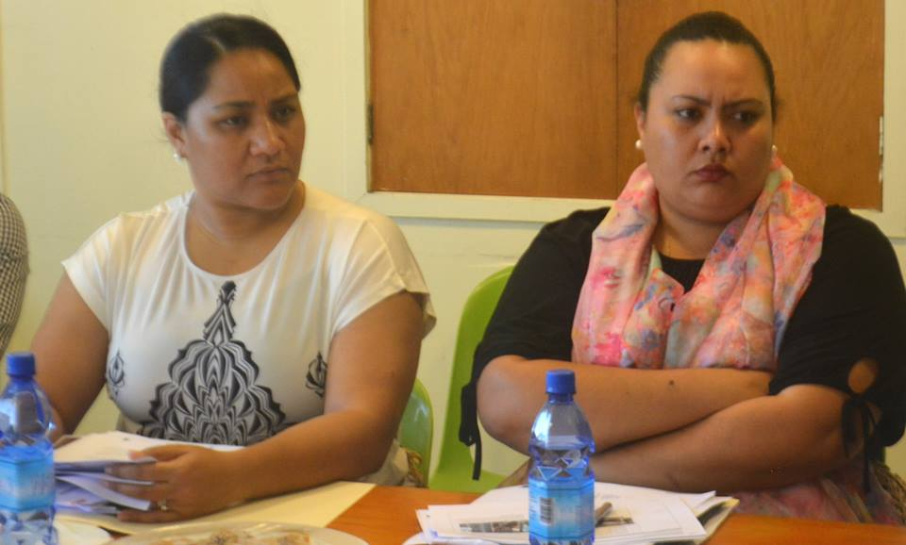
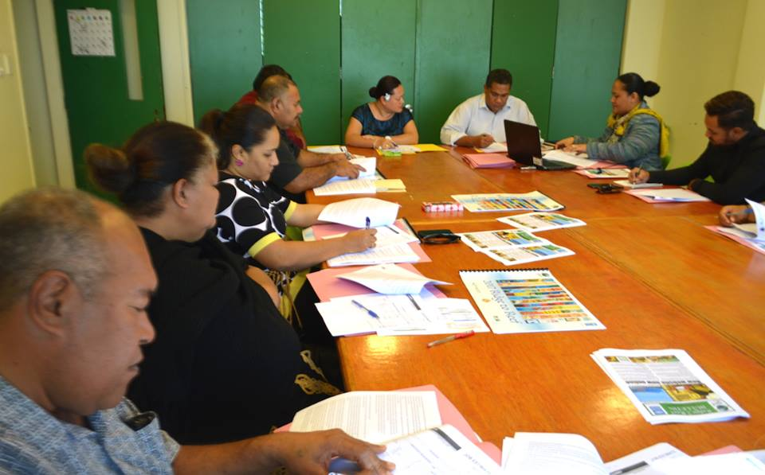
Photo Journal
Notes:
Please insert 6 HIGH QUALITY photos that depict your stakeholder activities, on-ground works, monitoring, planning etc…

Slide 17
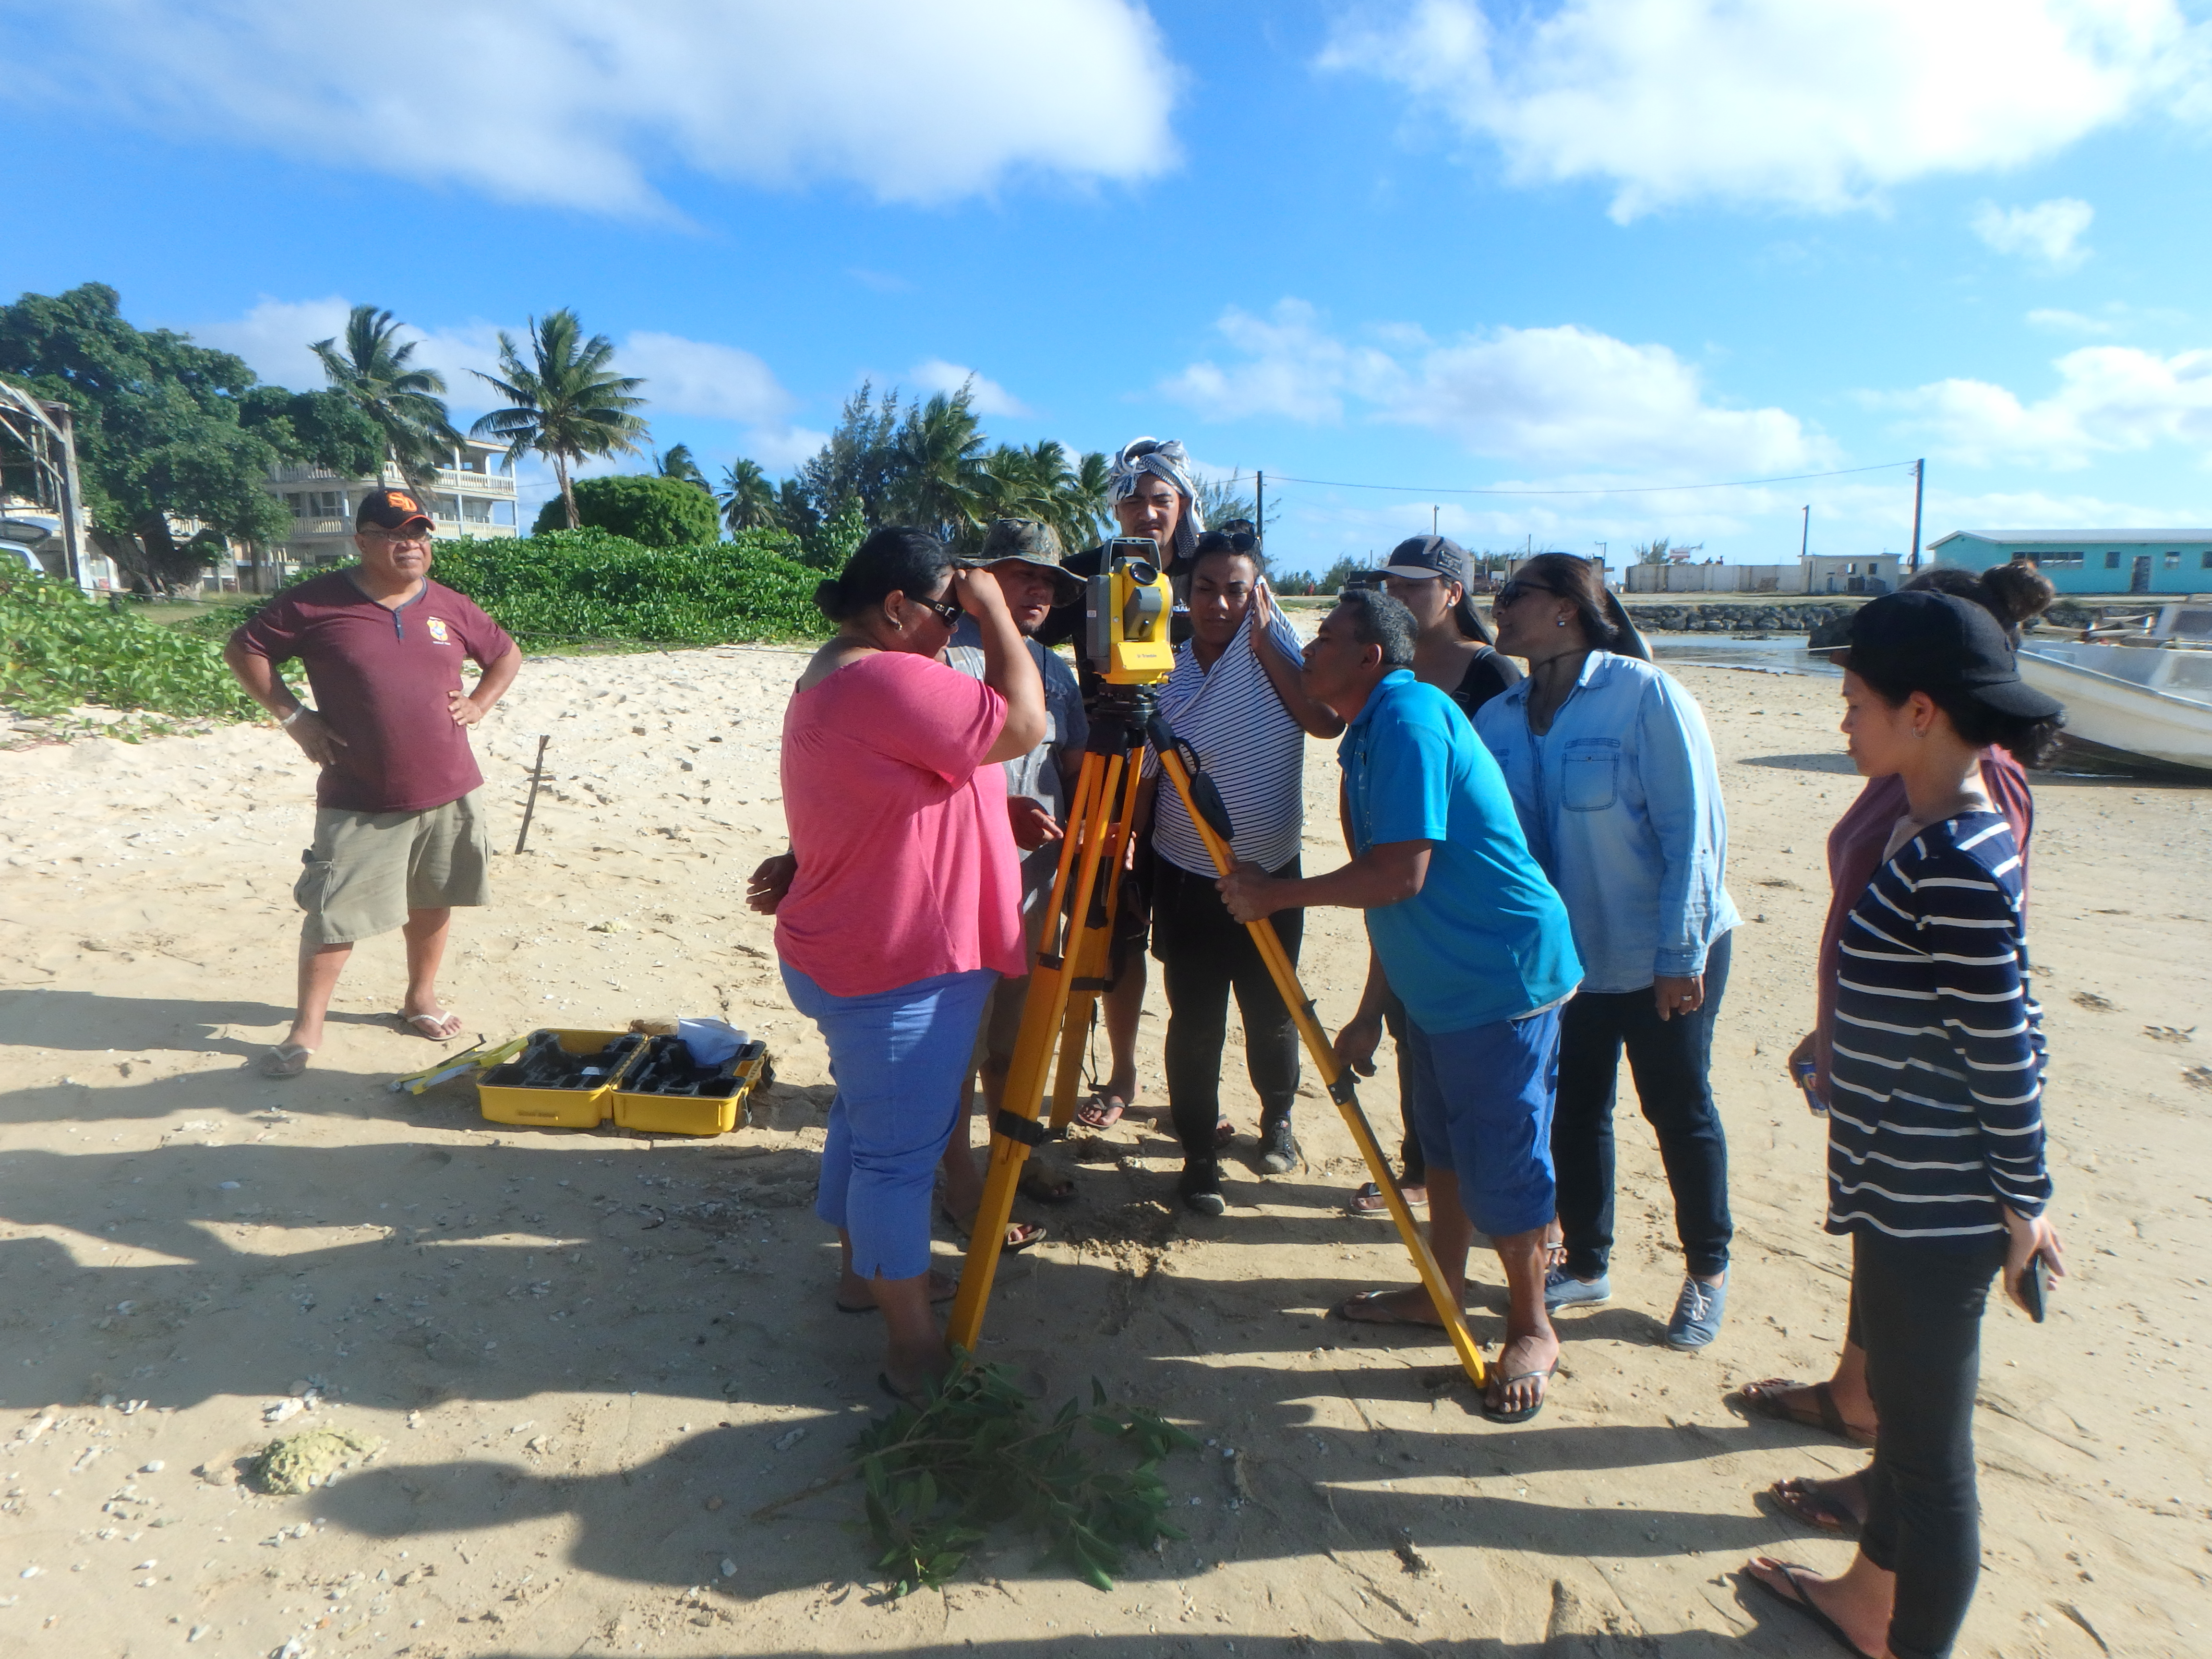
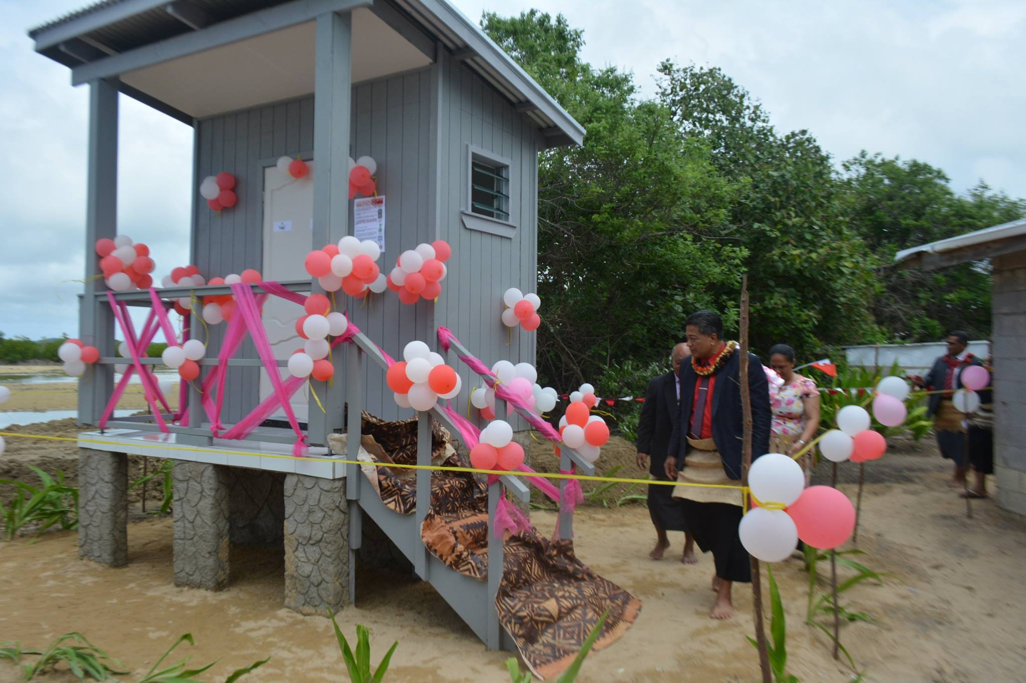
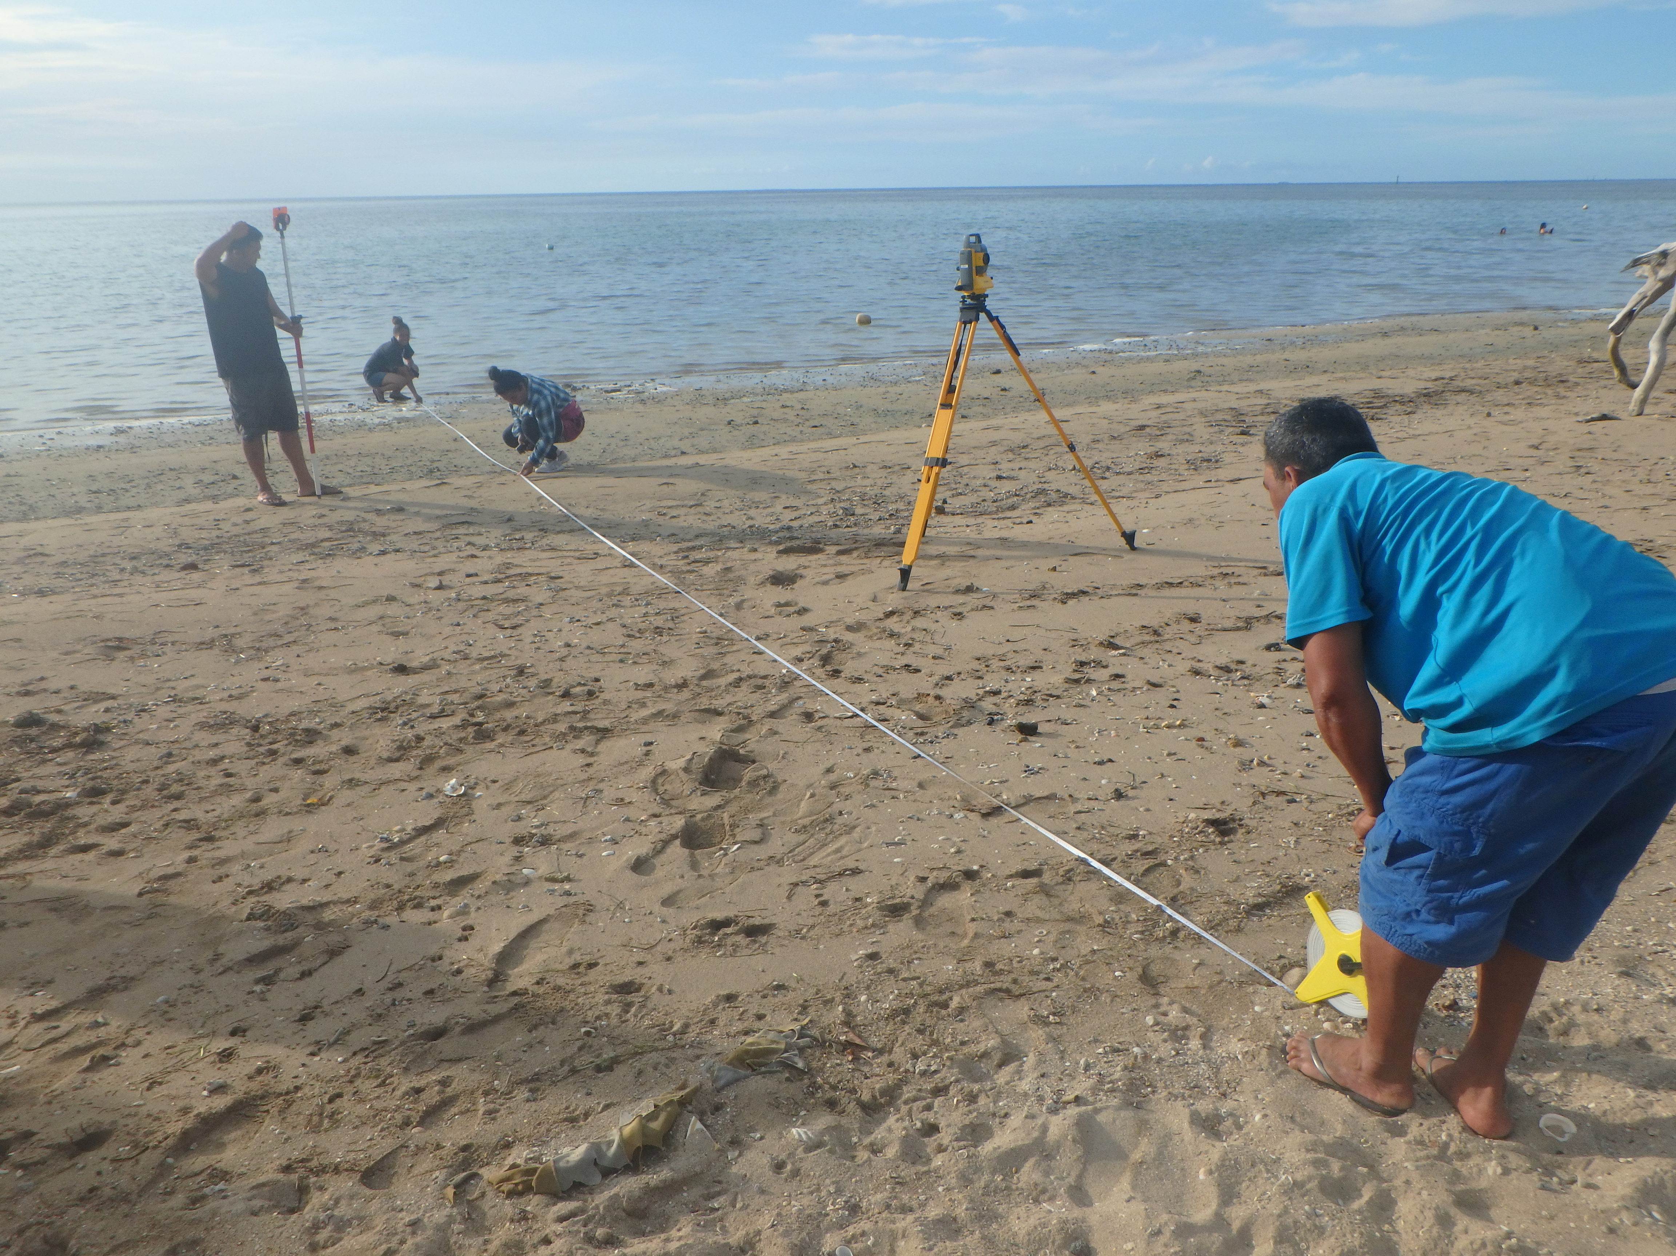
Photo Journal
Notes:
Please insert 6 HIGH QUALITY photos that depict your stakeholder activities, on-ground works, monitoring, planning etc…

Slide 18
Malo ‘Aupito!!
Notes:
Insert your thank you message

Slide 23
