Slide 1
KIRIBATI IW R2R PROJECT
OUTLINE OF PRESENTATION:
PROGRESS
RESULTS FRAMEWORK
STEERING COMMITTEE (Composition and Terms of Reference)

Slide 2
PROGRESS
1ST payment (initial cash advance) of USD15,000.00 received in September 2017.
Setting up and equipping the Project Management Unit
Identification of project and project site (piggery waste management and production of bio-gas)
Revising the Results Framework
Project Steering Committee (members and terms of reference)
Work plan and budget (ongoing)
Inception meeting/workshop (pipeline)

Slide 3
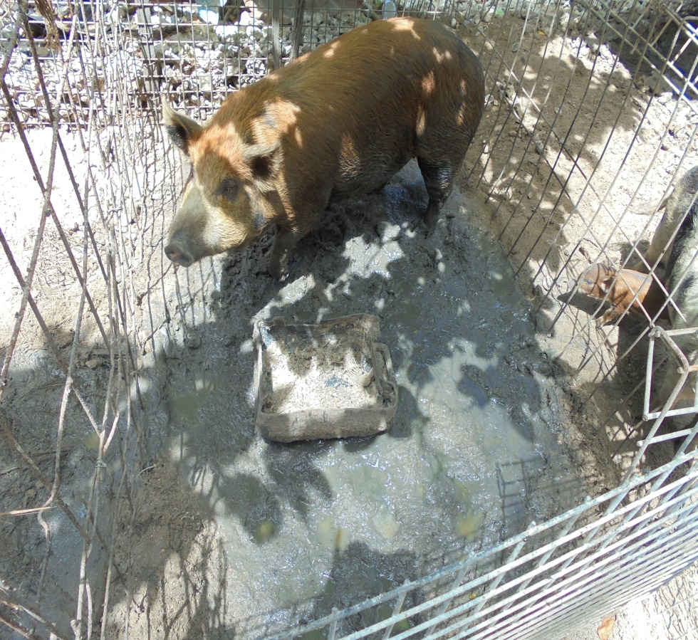
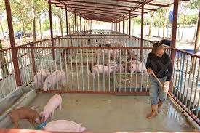
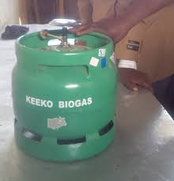
PROJECT .. Concept diagram
Improving piggery waste management via piloting of best waste management practices including proper facility and sustainable renewable energy source

Slide 4
RESULTS FRAMEWORK
Component 1: Local capacity for sustainable piggery waste management stimulated through effective community
Outcomes: 1.1 Volunteer piggery waste management networks are formally established towards increasing community awareness, maintaining cleanliness and hygienic status within communities, forming enhanced culture of environmental protection 1.2 Improved donor support for increased householder uptake of piggeries waste management. 1.3 Effective management tools (guidelines and manuals) developed to support sustainable uptake of piggery waste management
Targets End of Project Community-based Network of piggery waste management established Partnerships with Small Grants Programme, Piggery waste management facilities established within pilot communties Innovative and locally appropriate system operating, and maintenance manuals for piggery waste management available.

Slide 5
RESULTS FRAMEWORK …CONT..
Component 2: Demonstration of innovative approaches to piggery waste management on South Tarawa, Kiribati
Outcomes: 2.1 Improved community piggery waste management via piloting of best waste management practices. 2.2 Improved piggery waste management through sustainable renewable energy source. 2.3 Improve environmental and public health status.
Targets at End of Project: Piggery waste management system is in place within piloted communities. Sustainable small scale biogas design is operational. Piggery effluent is processed into biogas.

Slide 6
RESULTS FRAMEWORK .. CONT..
Component 3: Information management and community awareness increased in support of piggery waste management
Outcomes: 3.1 Improved access to information and understanding of piggery waste management in piloted communities. 3.2 Improved knowledge based management for decision making for effective project’s delivery. 3.3 Improve national capacity for ground water testing and analysis.
Targets at End of Project Enhance skills of individuals in piloted communities to successfully implement the piggery waste management. Database is in place and operational. Web-based information about the project is available and accessible by the general public. Strengthened capacity at the national level.

Slide 7
PROJECT STEERING COMMITTEE
Members:
1. Agriculture and Livestock Division of MELAD
2. Land Management Division of MELAD
3. Energy Division of MISE
4. Public Health Services of MHMS
5. Health Statistics Section of MHMS
6. Ministry of Internal Affairs
7. National Economic Planning Office
Teinainano Urban Council (TUC)
Secretariat: Environment and Conservation Division of MELAD
Director of ECD
Project Coordinator

Slide 8
PSC Terms of Reference
The Project Steering Committee will provide guidance and oversight for the implementation of the project. The responsibilities of the PSC shall include, but not be limited to:
Review, approve and amend the results framework, including the Monitoring and Evaluation (M&E) framework, the budget, and the implementation plan;
Monitor compliance with the Project’s objectives;
Discuss progress and identify solutions to problems facing any of the project´s partners;
Review and approve the Annual Work Plan (AWP) and the consolidated financial and progress reports;
During the life of the project, review proposals for major budget re-allocation such as major savings or cost increases, or for use of funds for significantly different activities;
Review evaluation findings related to impact, effectiveness and the sustainability of the project;
Monitor both the budget and the prompt delivery of financial, human and technical inputs to comply with the work plan;
Ensure the participation and ownership of stakeholders in achieving the objectives of the project;
Ensure communication of the project and its objectives to stakeholders and the public;
Approve the project communication strategy and public information plans;
Facilitate linkages with high-level decision making;
Convene ordinary meetings to consider the progress made by the project; and
Convene, if necessary, extraordinary meetings.

Slide 9
PSC Terms of Reference
Frequency of Meetings
The Project Steering Committee shall meet on a quarterly basis.
Special meetings can be called anytime when there are special issues or any other matters that need urgent discussion.
Quorum Requirements
A minimum of six of Project Steering Committee members inclusive of Secretariat members is required for the meeting to be recognized as an authorized meeting for the recommendations or resolutions to be valid.
The quorum must contain at least four member(s) from the Project’s Steering Committee members and two member(s) from the Project Team members or the Secretariat.

Slide 10
THANK YOU

