Slide 1
Tuvalu IW Regional R2R Project
Sub Regional Meeting 13th to 16th November

Slide 2
National Project Steering Committee
Membership is the same as that for the GEF STAR Project Board and consist of the Head of the Implementing Partner Agency (who is also the GEF Operational Focal Point), the nominated R2R Focal Point, the GEF Implementing Agency representative, a representative of civil society and a representative of the private sector.
The regional NPM will provide secretarial services to NPSC, including preparation of agendas, circulation of minutes and reports for consideration to members
The NPSC has an ad hoc group that can provide specialised focus and or inputs to the implementation of the Project such group will be coordinated by IW Project Manager to ensure coordination of project activities

Slide 3
Members-Stakeholders
Chairman :- Secretary of Home Affairs
1. Department of Lands
2. Department of Agriculture
3. Department of Environment
4. Department of Environmental Health
5. Department of Coastal Fisheries
6. Attorney General’s Office
7. Funafuti Kaupule
8. Tuvalu National Council of Women
9. Tuvalu Association of Non-Government Organisation
10. Public Works Department
11. STAR National R2R Project
12. TNPSO
13. Solid Waste Agency of Tuvalu
14. Gender Department

Slide 4
TOR of NPSC
Plays a critical role in project monitoring and evaluations by quality assuring these processes and products, and using evaluations for performance improvement, accountability and learning
It ensures that required resources are committed and arbitrates on any conflicts within the project or negotiates a solution to any problems with external bodies.
Advocates for the project and report on project progress to Heads of Agency and Cabinet and takes on responsibility for progressing whole-of- government issues associated with the projects outcomes
Secure the necessary level of cooperation from their colleagues and associates, including the securing of country-specific information and resources necessary for successful project activities.

Slide 5
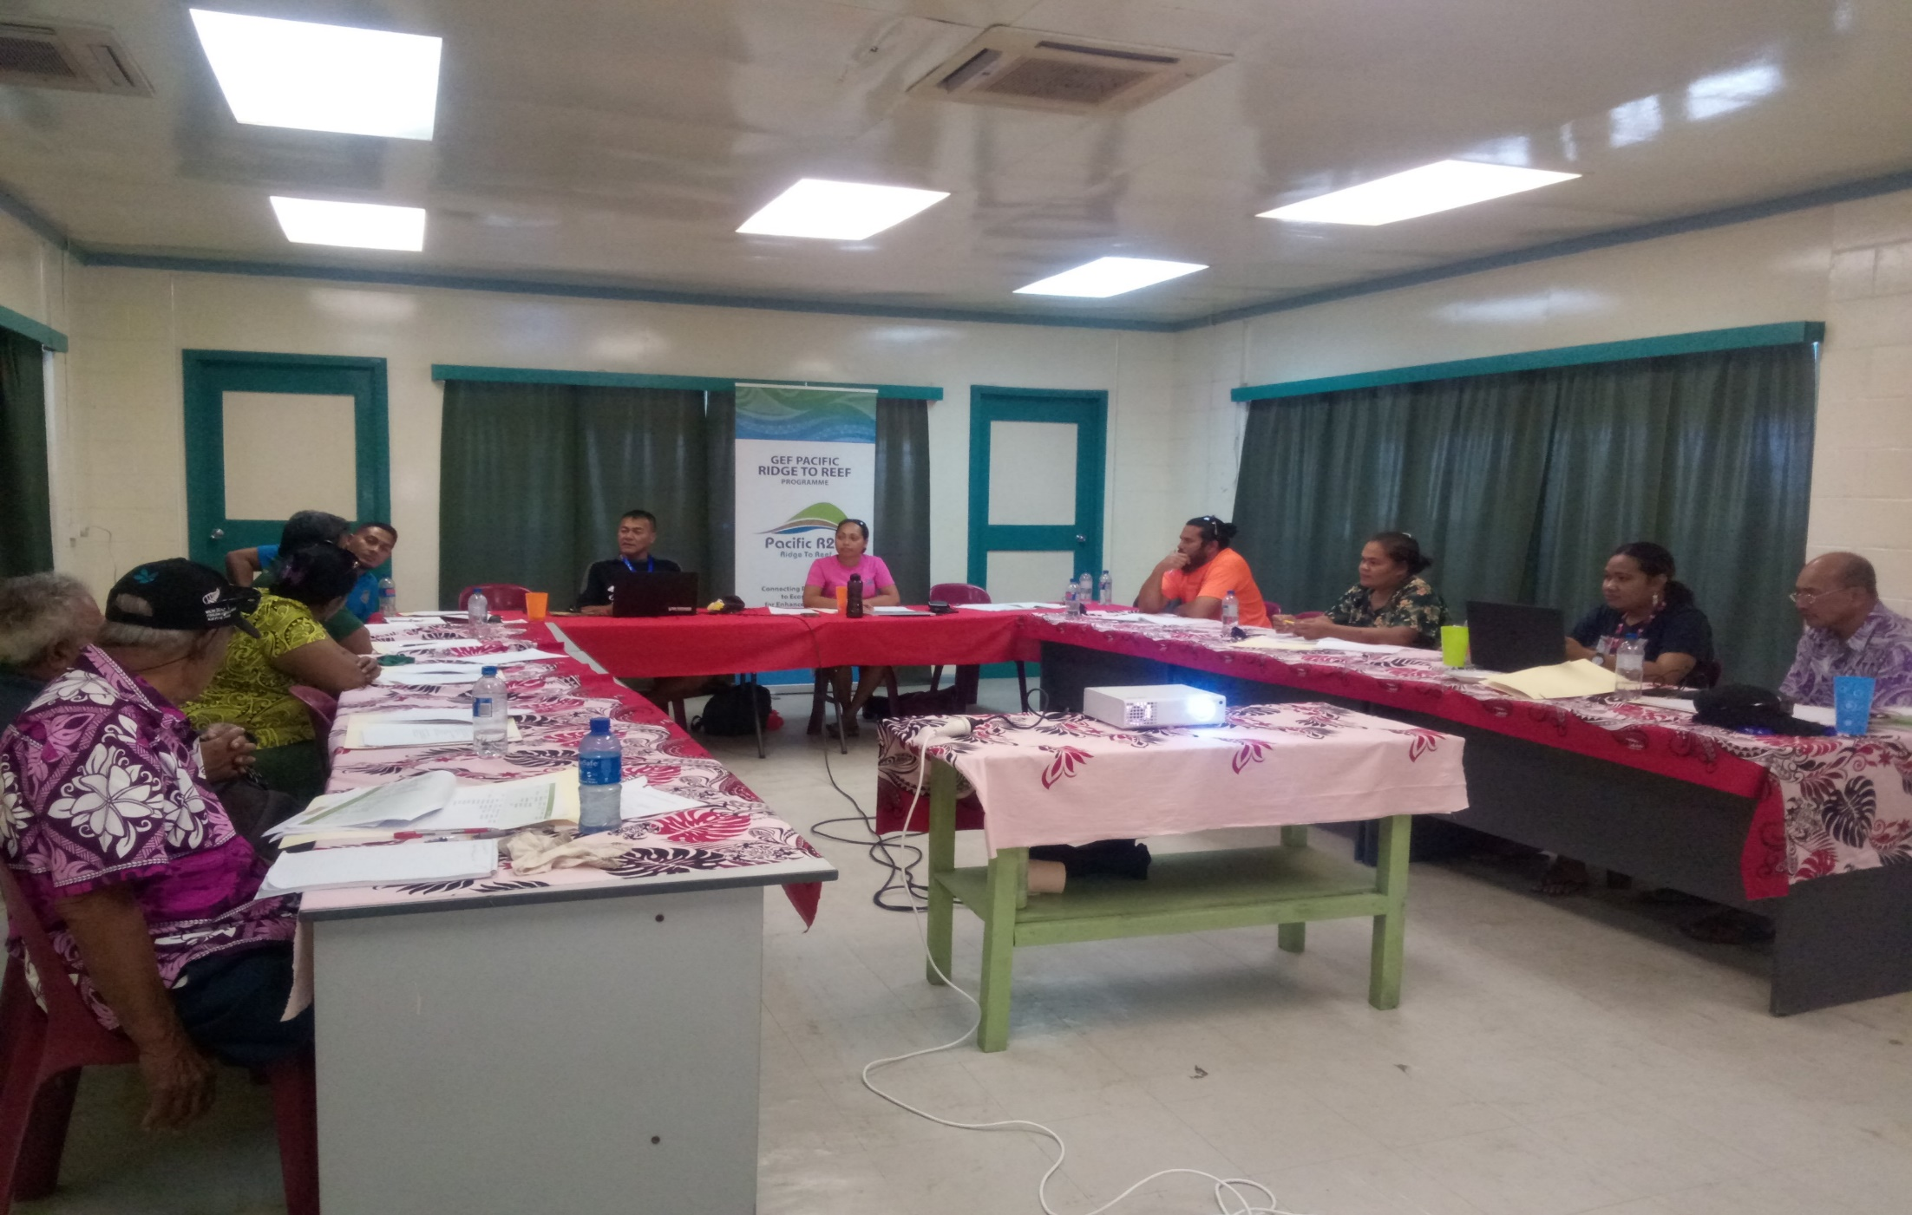
Tuvalu IW R2R NPSC

Slide 6
Challenges
Accessing to the Small Grant Project:
The National Focal Point is the Tuvalu Association of Non Government Organisations and there has been some issues with the GEF SGP. Consulted with the Department of Environment which is the Political Focal Point and still working on this matter to resolve.

Slide 7
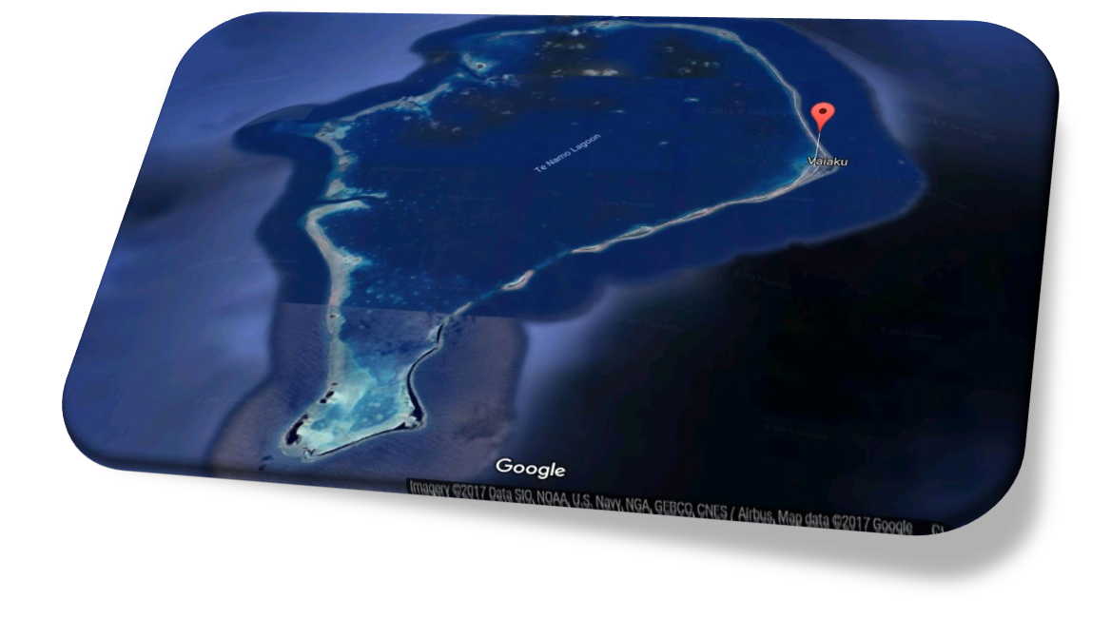
Networking - Consultation with potential Individuals
A
C
B

Slide 8
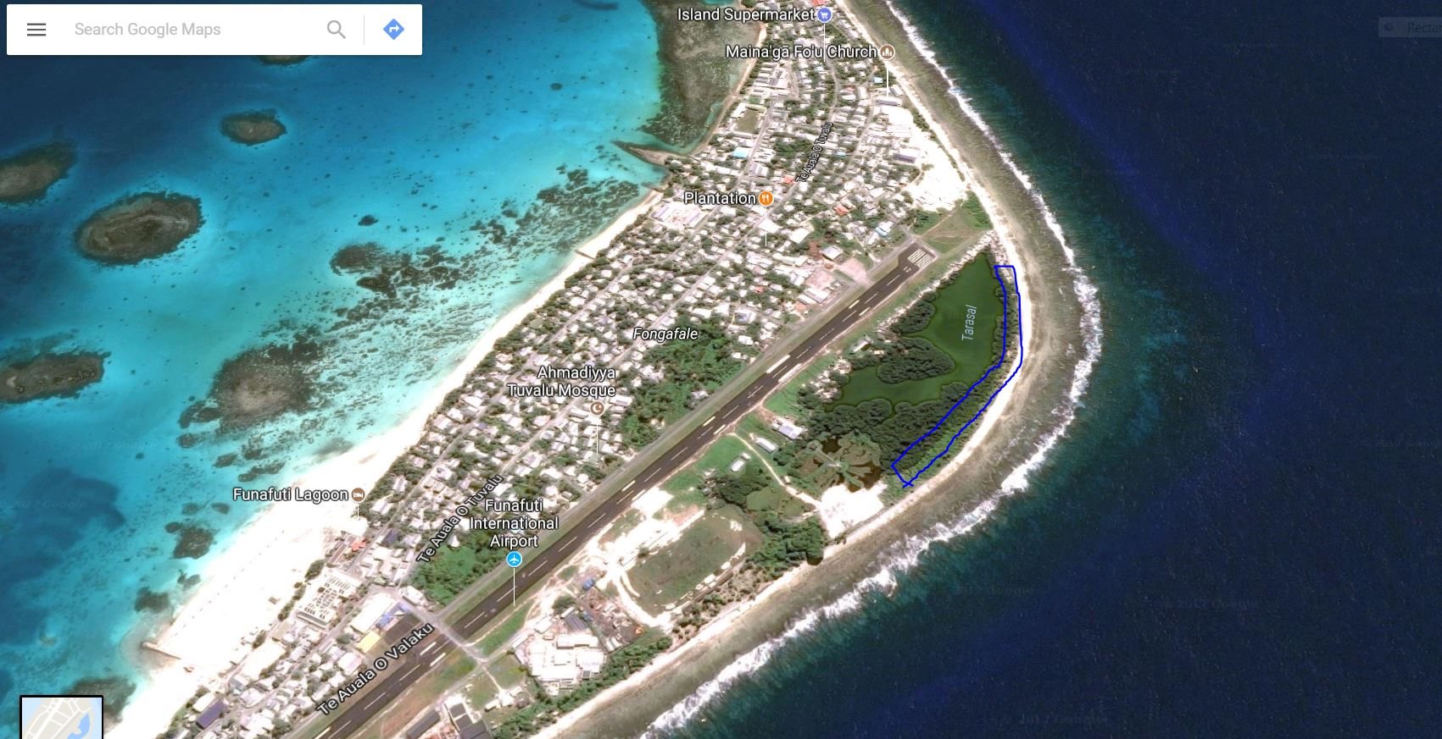
Networking - Consultation with potential Individuals
C

Slide 9
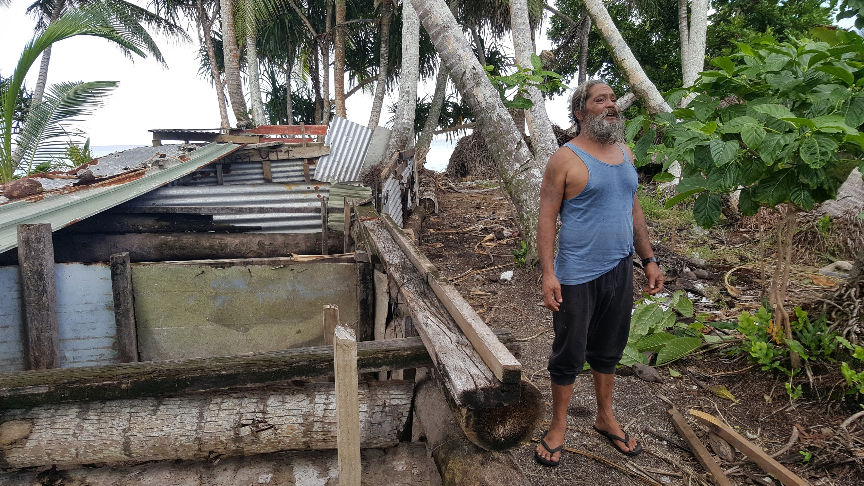
Networking - Consultation with potential Individuals

Slide 10
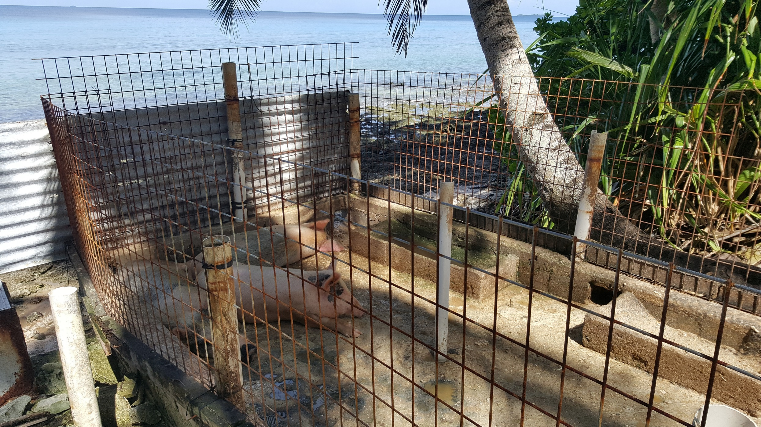
Networking - Consultation with potential Individuals

Slide 11
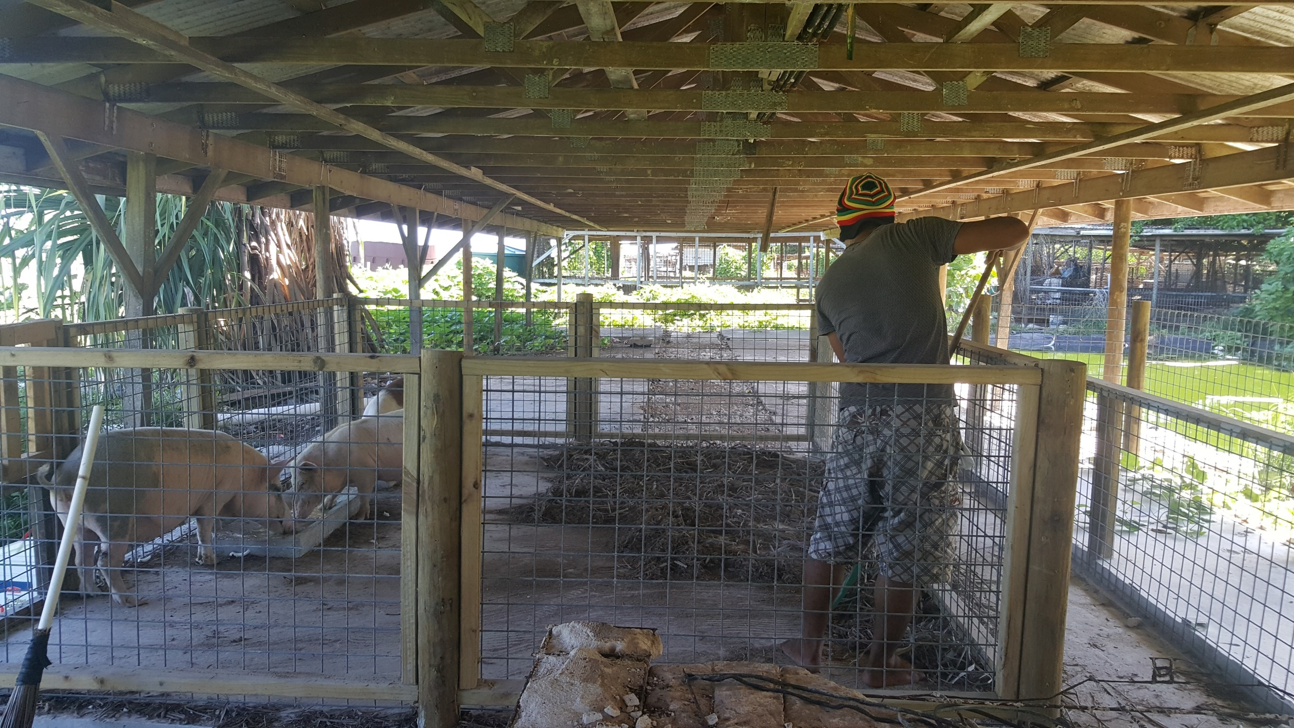
Progress of the Demonstration

Slide 12
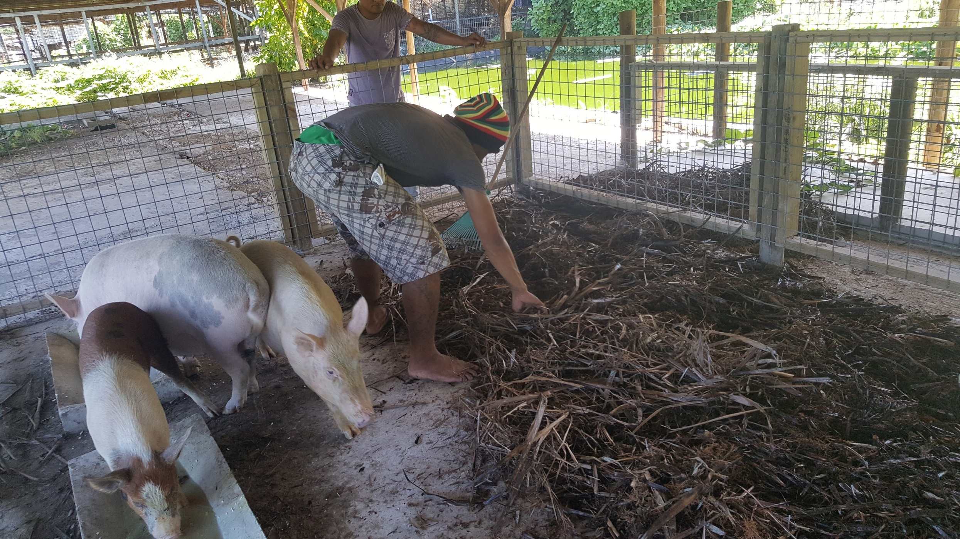
Progress of the Demonstration

Slide 13
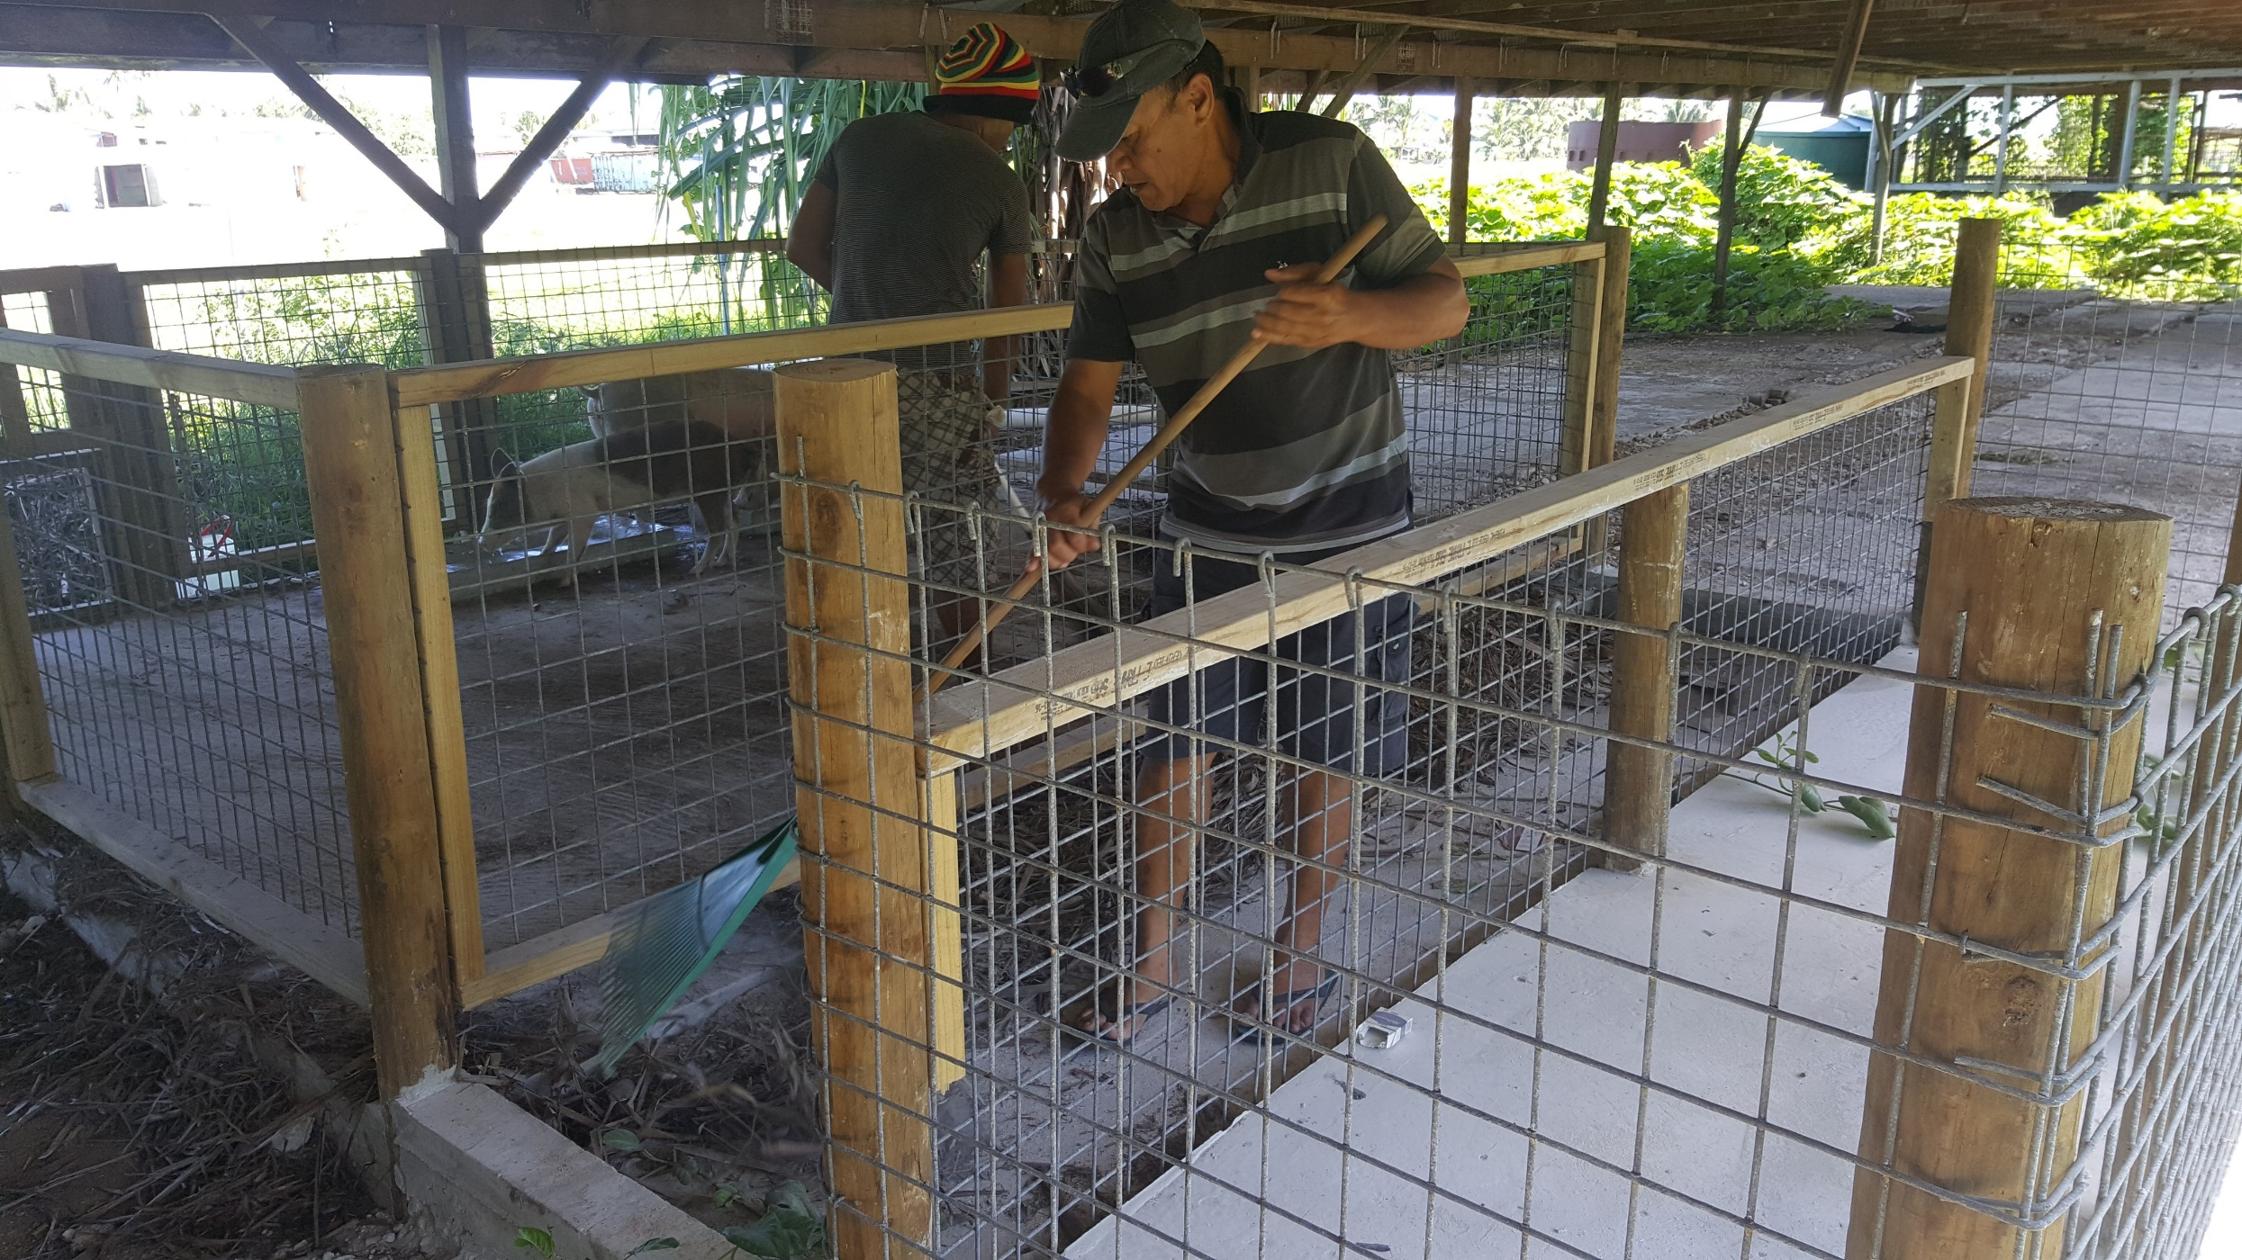
Progress of the Demonstration

Slide 14
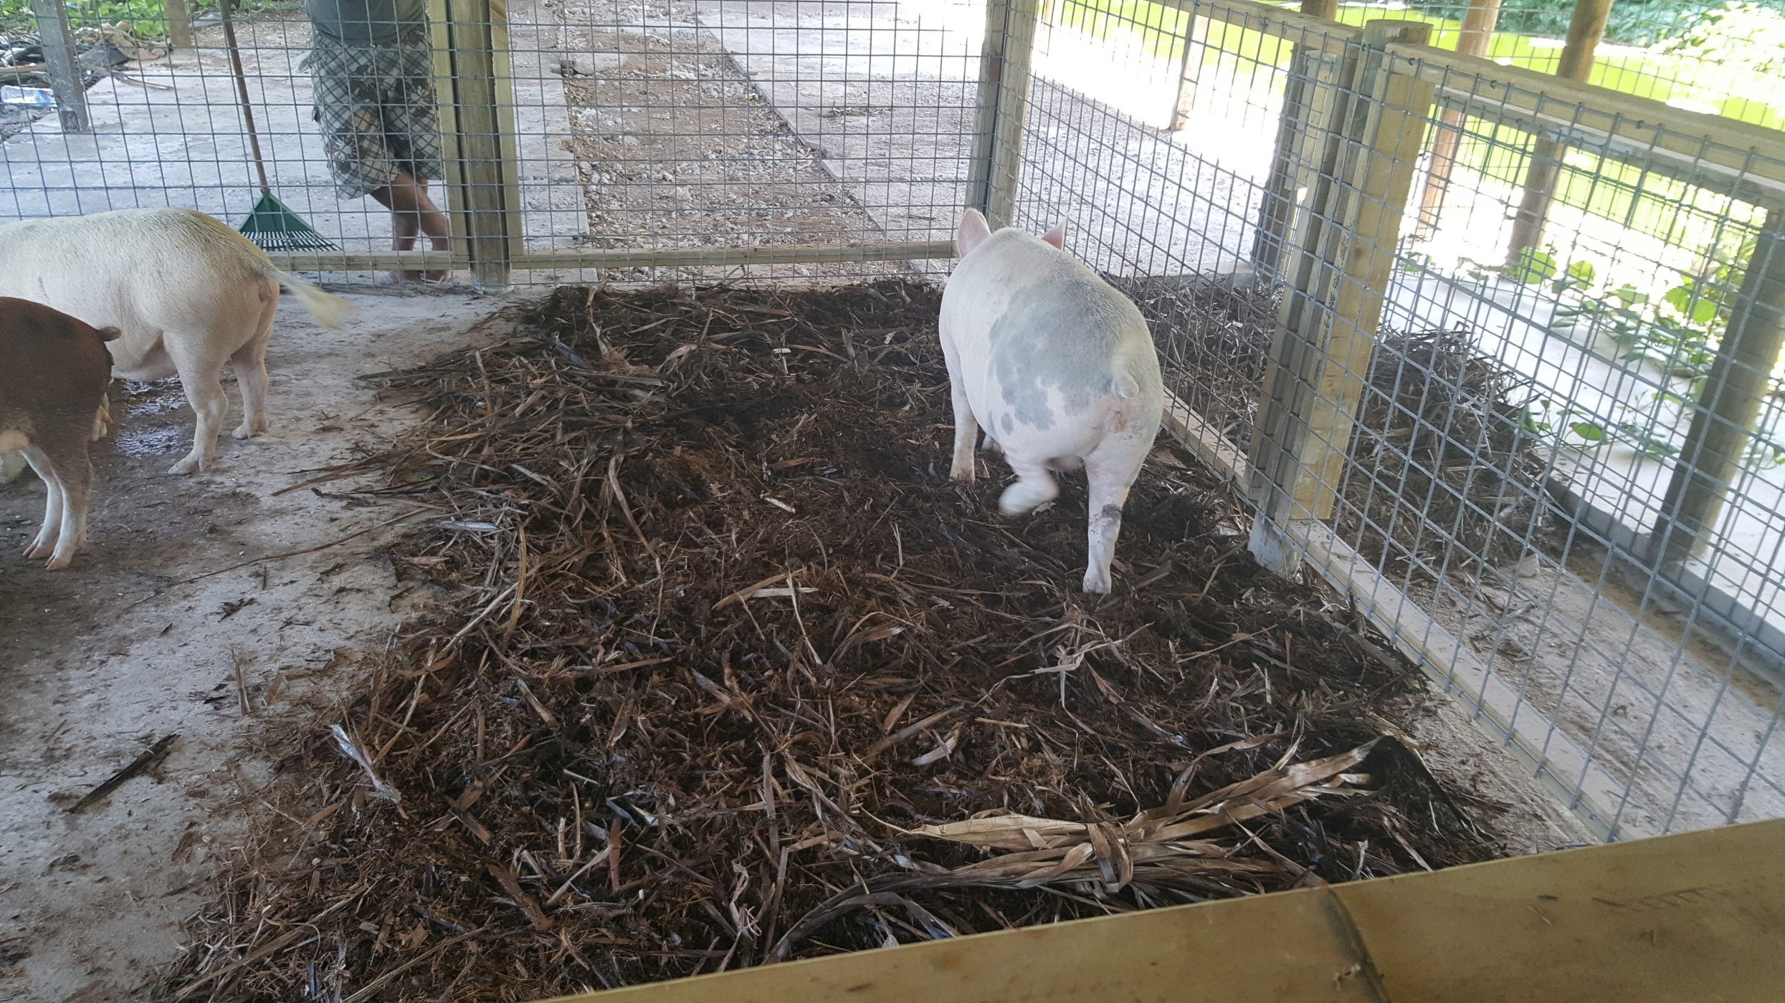
Progress of the Demonstration

Slide 15

Tuvalu IW R2R Project
THANK YOU FAKAFETAI LAHI

